Slide 1
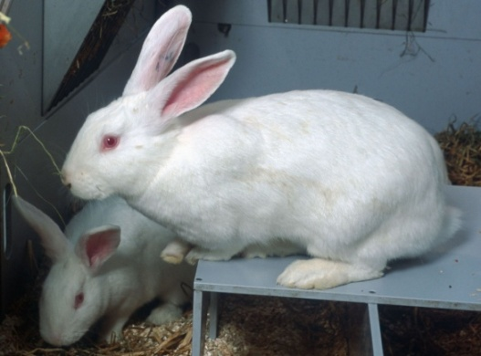
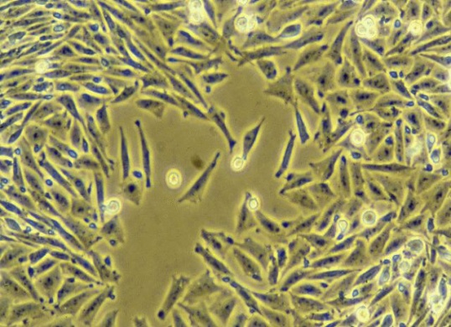
The ‘R’ of Replacement
Implementing alternatives to replace the use of animals in research and testing
Images: Novo Nordisk; RSPCA Photolibrary
Notes:
Slide 1. The ‘R’ of Replacement: The potential for implementing alternatives to the use of animals in research and testing
This set of slides was prepared by the Research Animals Department of the RSPCA, and is intended to provide a detailed overview, with up-to-date examples, of the principle of replacement of animals in scientific research. It is offered as a resource for teachers, lecturers or trainers, and as a source of information for lay members of animal ethics committees, and others with an interest in the subject.
The material contained in this resource can be used in its entirety as a presentation or can be adapted or expanded to meet the particular needs or learning outcomes of your target audience. Please contact the Research Animals Department if you would like to receive an editable version of this resource or any additional information: research.animals@rspca.org.uk

Slide 2
Presentation overview
Definitions and examples of ‘replacement’
Legal and ethical requirements
Scientific and practical advantages
Putting ‘replacement’ into practice
Concluding comments
Notes:
Slide 2. Presentation overview

Slide 3
Definitions and examples of Replacement
Notes:
Slide 3. Definitions and examples of Replacement

Slide 4
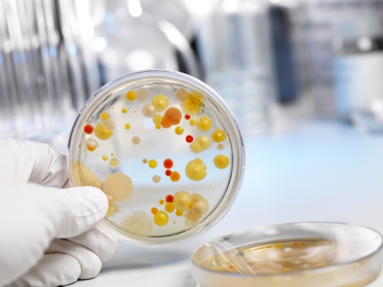
Replacement and the 3Rs
Definitions and examples
Reduction: reducing the number of animals
Refinement: reducing suffering and improving animal welfare in experiments and throughout the lifetime experience of the animal
Replacement: Replacing animals with methods that do not involve animal use
plus avoiding experiments using animals e.g. by a change in research strategy
iStockphoto.com/AndreasReh
Notes:
Slide 4: Definitions and examples – Replacement and the 3Rs
Replacement is one of the 3Rs of Replacement, Reduction and Refinement. These were first set out by William Russell and Rex Burch in 1959 as ‘The Principles of Humane Experimental Technique’¹. Since then, the 3Rs have become established as an internationally accepted approach to research involving animals, and have been written into legislation in many countries.
Strictly speaking, the term ‘replacement’ applies when an existing animal method is directly and fully replaced by a non-animal alternative. However, a wider interpretation encompasses the avoidance of animal use, for example when the value of a particular test or objective is called into question and the test is not done, or the experimental approach is changed, to avoid animal use. The development of a direct replacement test can take many years, so potential for ‘avoidance’ should always be explored.
¹Available at: http://altweb.jhsph.edu/pubs/books/humane_exp/het-toc

Slide 5
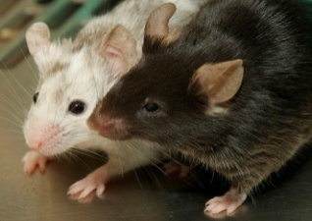
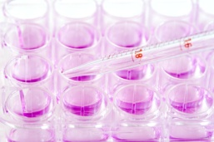
Is Replacement ‘all or nothing’?
Definitions and examples
NO!
Alternative methods may be used to replace animals in:
    a whole research programme
    a project within a programme
    an individual experiment
    one type of procedure
Alternatives can be used as part of a structured approach e.g. in vitro screening to select candidate drugs with the desired properties.
iStockphoto.com/Dra_schwarz
John Nicholson
Notes:
Slide 5: Definitions and examples - Is Replacement ‘all or nothing’?
It may be that animal experiments are considered unavoidable within an overall programme of research. However, it may be possible to replace animals in an individual project within the programme, in an individual experiment, or even in just one type of procedure. There are many different test systems or approaches which can be used in this way, so it is important never to dismiss the concept of replacement! It is important to think about the potential for alternatives in each part and at every stage of a research programme.
A good example of how alternative methods can be part of a research strategy is shown on the slide. Compounds to be assessed as potential medicines are first screened in computer models of molecular action, and in cell cultures in order to predict drug activity, metabolism, bioavailability or toxicity. This shows whether the compound is worth developing further, reducing the number that go forward into animal studies, and significantly reducing the number of animals used.

Slide 6
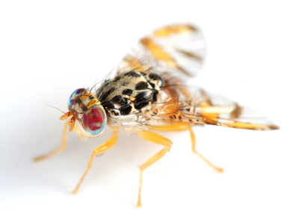
Alternative test systems (1)
Definitions and examples
  Invertebrates and micro-organisms
  Early developmental stage of vertebrates
  Animal cells, tissues, organs
  Human volunteers and donated
  human tissues.
iStockphoto.com/Arlinda71
Notes:
Slide 6a: Definitions and examples - Alternative test systems.
If full replacement of animals is not possible, then replacement of vertebrate species with invertebrates, or the use of vertebrates at early developmental stages (for example, early stage embryonated chicken eggs), or the use of tissues from dead animals (for example, animals killed for other projects, or abattoir material) are worthwhile partial solutions. This is often referred to as incomplete or relative replacement.
(Note that cephalopods – e.g. octopus, cuttlefish and squid - are now acknowledged as being capable of experiencing suffering and so are included under the new EU Directive for the protection of animals used for scientific purposes.)
There is more information on human volunteers and on invertebrates in slides 7 and 8.

Slide 7
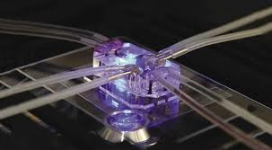

Alternative test systems (2)
Definitions and examples
  Human ‘organ on a chip’
  Computer models
Notes:
Slide 6b: Definitions and examples - Alternative test systems.
Probably the greatest recent impact on replacement has been the wider use of human tissues and cells in both basic research and toxicology. Human tissue “organ on a chip” technology is rapidly emerging as an exciting new replacement technology¹. In 2013 the UK National Centre for the Replacement, Refinement and Reduction of Animals in Research (NC3Rs) gave their annual 3Rs prize to a research group in the USA who have developed a human lung on a chip to investigate lung function and to test new therapeutics².
The use of computer-based methods is also increasing rapidly. For example, a research group in Manchester have recently produced a computational model of the part of a sheep heart responsible for pacemaker activity and is using it to model atrial fibrillation³.
¹ A Living system on a chip. Baker, M. Nature 471, 661-665 (2011)
² http://www.nc3rs.org.uk/news.asp?id=1898
³ A novel computational sheep atria model for the study of atrial fibrilation. Butters, T. D., Zhao, J., Smaill, B. & Zhang, H. Computing in Cardiology 39, 141-144 (2012)

Slide 8
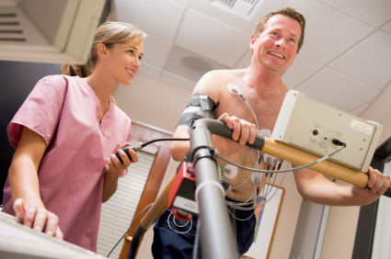
Example: use of human volunteers
Definitions and examples
  Humans are generally the best models of other humans. Many types of experiment can be done on human volunteers or human tissue as long as all the ethical considerations are addressed
  For example:
    Microdosing
    Non-invasive imaging
    Dietary studies
    Pain research
    Human cell or tissue culture
iStockphoto.com/CatherineYeulet
Notes:
Slide 7: Definitions and examples - Example: use of human volunteers
The majority of biomedical research is aimed at understanding human biology and disease, and trying to develop treatments for specific conditions. Also, most toxicological tests are intended to identify human health hazards. The possibility of obtaining the information required through ethical research on human subjects or human tissue should always be carefully considered before any animals are used. Potential methods include microdosing (the use of very low drug doses to study distribution and metabolism), imaging techniques (such as MRI and PET scanning), behavioural, physiological and dietary studies. Also, human cells and tissues obtained from normal volunteers or patients can replace the use of animal for their tissue for in vitro experiments. The results of experiments on humans or their tissues are likely to be much more relevant to human medicine and safety assessment than those obtained using other species. For example, the development of induced pluripotent stem cell technology, where donor cells e.g. blood or skin cells, can be ‘forced’ into reverting to a stem cell phenotype, has resulted a much greater range of human cells to be available for study.
Access to human volunteers or their tissues may prove challenging, but if the research would benefit scientifically, and would replace animal use, every effort should be made to establish collaborations with clinicians, to help identify suitable human subjects, conduct clinical investigations, or obtain tissue samples.

Slide 9
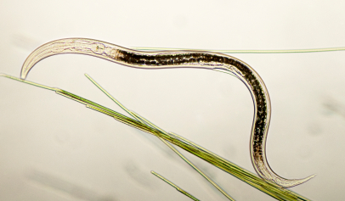
Example: use of invertebrates
Definitions and examples
To study basic biological functions or effects, a vertebrate model may not be necessary:
  For example:
  Drosophila (fruit fly), Dictyostelium (slime mold) and nematode worms are used in research on neurobiology - Alzheimer’s, epilepsy and neurodegeneration respectively
  Bacteria, yeast, and Drosophila are used to study genetics and the genetic toxicity of chemicals
iStockphoto.com/NancyNehring
Notes:
Slide 8: Definitions and examples - Example: use of invertebrates
It is often assumed that organisms closest to humans in evolutionary terms will provide the best ‘model’ for experiments on human biology and medicine i.e. a monkey is a better model for the human than is a rat, and a rat is better than a worm. However, this is not necessarily the case, and has been described as the ‘high fidelity fallacy’. In the case of very basic biological functions it is often unnecessary, at least in the first instance, to use a closely related species. For example, several invertebrate species are used in neurological research.
The fruit fly Drosophila has been used to study the development of Alzheimer’s disease, and other neurodegenerative conditions¹.
Drosophila larvae have been used to model aspects of pain sensation (nociception)².
The slime mould Dictyostelium has been used in research on epilepsy and bipolar disorder ³.
Caenorhabditis elegans, a nematode worm, has been used to study neurodegeneration⁴.
In toxicology, effects such as mutation can be detected using almost any organism, including bacteria and yeast. Bacterial tests for mutation are used to test almost all types of chemical for mutagenicity.
References:
¹Drosophila models of human neurodegenerative disease. Chan H.Y.E. & Bonini N.M. Cell Death & Differentiation 7, 1075-1080 (2000).
²Teaching report: the use of Drosophila melanogaster larval thermosensitive escape behaviour as a model system to demonstrate sensory functionosophila models of human neurodegenerative disease. Harrison, A. B., Oswald, M & Sweeney, S. T. Invertebrate Neuroscience 11, 109-112 (2010).
³Towards a molecular understanding of human diseases using Dictyostelium discoideum. Williams, R. S., K. Boeckeler, R. Graf, A. Muller-Taubenberger, Z. Li et al., Trends Mol. Med. 12, 415–424 (2006).
⁴C. elegans models of age-associated neurodegenerative diseases: lessons from transgenic worm models of Alzheimer's disease. Link C.D. Exp Gerontol. 41,1007-13. (2006).

Slide 10
Why replace animals?
Notes:
Slide 9. Section 2: Why replace animals?

Slide 11
Why replace animals?
Ethical and societal concerns
Legal requirements
Good science
Practical and economic gains
Notes:
Slide 10: Why replace animals? – Summary of reasons
There are four good reasons for replacing animals with humane alternatives:
ethical and societal concerns, legal requirements, good science, with associated practical and economic gains.
There is more information on each of these on the next few slides.

Slide 12
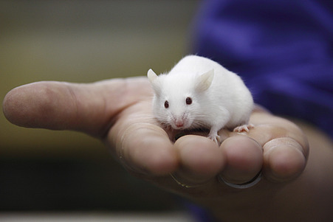
Ethical and societal concerns
Why replace animals?
Animals are sentient beings capable of experiencing pain and distress - recognised in the Treaty of Amsterdam (1997)
The use of animals in experiments is a major issue of concern for the public
Avoidance of unnecessary suffering is an important principle within the research community
Animal welfare is a powerful political factor in the EU
e.g. ban on testing cosmetics on animals;
establishment of the European Centre for
the Validation of Alternative Methods
RSPCA Photolibrary/AndrewForsyth
Notes:
Slide 11: Why replace animals? - Ethical and societal concerns
Animals are sentient beings capable of experiencing pain and distress - which has been written into the Treaty of Amsterdam (1997).
Their use in experiments is a long-standing concern within science and society, so there is an ethical imperative to explore alternatives to animal use. It is a major issue for much of the public who are concerned about animal welfare and the need to avoid causing unnecessary or unjustified suffering. Opinion polls in the UK indicate that while many people will support some research using animals, they require that the research be for serious medical conditions and causes no unnecessary animal suffering.
Public concern for lab animals has made it a powerful political factor which has resulted, for example, in a ban on the testing of cosmetics in the EU and the establishment of the European Centre for the Validation of Alternative Methods¹. A number of other Centres for Alternatives have also been established around the world.
The importance of public concern on the issue is also reflected in the Corporate and Social Responsibility policies of international companies that use animals. These increasingly include reference to their work to develop alternatives to animals in their company portfolios.
¹ http://ihcp.jrc.ec.europa.eu/our_labs/eurl-ecvam

Slide 13
Legal requirements
Why replace animals?
In many countries, the use of animals in science is controlled by law and implementation of all 3Rs is required
EU Directive 2010/63/EU specifically requires use of replacement methods wherever possible
The UK law (Animals Scientific Procedures Act 1986, amended 2013) makes 9 separate specific statements requiring the 3Rs to be implemented.
UK law requires scientists to:
  consider carefully if research objectives could be achieved without using animals in all or part of the project
  if alternatives cannot be used, explain why
Notes:
Slide 12: Why replace animals? - Legal requirements.
As a result of ethical and societal concerns, most countries with a well developed science base have regulations which require the 3Rs - including Replacement - to be implemented. European Directive 2010/63/EU¹ specifically mentions the need to use alternatives to living animals and to promote the development of alternative methods. This Directive was transposed into UK law in January 2013 and the amended legislation has 9 separate specific mentions of the 3Rs and requires scientists to demonstrate that they have searched for alternative methods and to provide evidence that no suitable alternative exists².
Even in the absence of legal requirements, there may be institutional or international guidelines which stipulate application of the 3Rs, e.g. the US Institute for Laboratory Animal Research (ILAR) Guide for the Care and Use of Laboratory Animals 2010³, the OIE’s Terrestrial Animal Health Code (2010)⁴, or the ICLAS guiding principles (2010)⁵.
In addition, international test regulations (for example the OECD guidelines for chemical testing and the European Pharmacopeia guidelines for testing vaccines) all state that the 3Rs - including Replacement - should be applied.
¹ http://eur-lex.europa.eu/LexUriServ/LexUriServ.do?uri=OJ:L:2010:276:0033:0079:EN:PDF
² http://www.homeoffice.gov.uk/publications/science-research-statistics/animals/transposition_of_eudirective/aspa_amendment_regulations?view=Binary
³ http://dels.nas.edu/Report/Guide-Care/12910
⁴ http://www.oie.int/eng/normes/mcode/en_sommaire.htm
⁵ http://iclas.org/wp-content/uploads/2012/10/CIOMS-ICLAS-Principles-Final.pdf

Slide 14
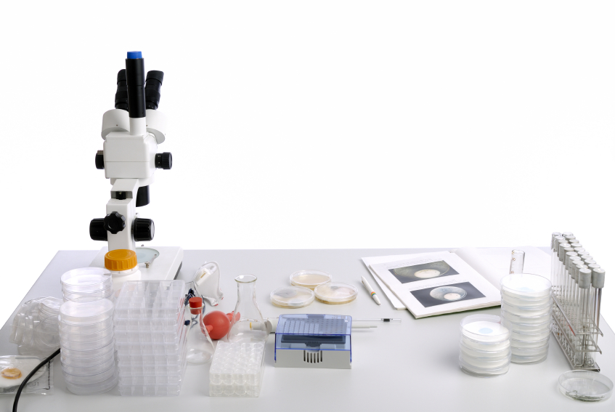
Scientific advantages
Why replace animals?
Studies at the molecular or cellular level may help scientific progress
Alternatives may be more valid than animal models
New technology can be exploited to improve research
Alternative methods may allow ethical studies in humans
iStockphoto.com/AndreasReh
Notes:
Slide 13: Why replace animals? - Scientific advantages
Researchers who are developing replacement methods often stress the scientific advantages of the techniques they are developing. In particular, they emphasise the value of obtaining information on molecular and cellular events before progressing to whole animal studies, and the greater validity of using human tissue or human volunteers rather than an animal model to study human health and safety.
The scientific arguments for replacement are strong and some examples of recent projects are given in the following slides.
The advantages of using alternative methods in various fields of research are discussed in:
A roadmap for the development of alternative (non-animal) methods for systemic toxicity testing. Basketter, D. A. et. al., Alternatives to animal experimentation : ALTEX 29, 3-91(2012)
Animal models of asthma: value, limitations and opportunities for alternative approaches. Holmes, A.M., Solari, R. & Holgate, S.T. Drug Discovery Today, Vol 16, 659-670 (2011).
Opportunities to Replace the Use of Animals in Sepsis Research. Langley, C. et al. Alternatives to laboratory Animals, Vol 33, 641–648 (2005).

Slide 15
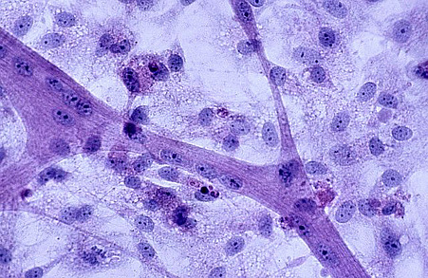
Why replace animals?
Studies at the molecular or cellular level may help scientific progress
Examples
  Use of a genetically altered (GA) human cell line, instead of GA mice, for research on Parkinson’s disease
  Development of in vitro multicellular models to study the role of microenvironment in breast cancer
  Both methods help in disease research and may also be useful for testing potential treatments
RSPCA Photolibrary/Barry Phillips
Notes:
Slide 14: Why replace animals? - Scientific advantages: Studies at the molecular or cellular level may help scientific progress
In vitro methods have obvious advantages for studying disease mechanisms or drug effects at the molecular or cellular level. Rather than replacing animal experiments, they are often just the obvious choice. In some cases, an in vitro model can be of value in testing potential treatments.
Two examples illustrate the value of in vitro methods in testing theories about disease development and testing potential treatments.
A genetically altered (GA) human cell line, has been developed for research on Parkinson’s disease. It was intended for use in for testing ideas about the nature of Parkinson’s disease, but the cells are now being investigated as a replacement for animal models for testing the efficacy of new drugs.
See: Rapid, complete and large-scale generation of post-mitotic neurones from the human LUHMES cell line. Scholz, D. et. al. Journal of Neurochemistry 119, 957-971 (2011)
In the second example, the combined culture of different cell types allows the study of cellular interactions in breast cancer progression, and may lead to the development of a more valid in vitro model for testing drug interventions.
See: Novel multicellular organotypic models of normal and malignant breast: tools for dissecting the role of the microenvironment in breast cancer progression. Holliday D. L., et. al. Breast Cancer Research 11, R3 (2009)

Slide 16
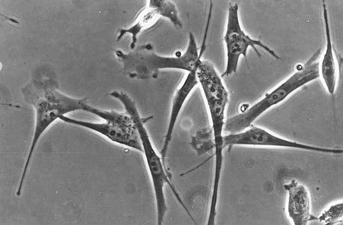
Why replace animals?
Alternative models may be more scientifically valid
Examples
Asthma: human cell models with important genetic aspects specific to human asthma
Intestinal disease: in vitro 3D models of human colonic epithelium and human oesophagus
Cystic fibrosis: human cell cultures
which develop the functions of normal
or CF airways, and model infections
observed in people with CF
RSPCA Photolibrary/Barry Phillips
Notes:
Slide 15: Why replace animals? - Scientific advantages: Alternative models may be more scientifically valid
Recognition of the limitations of existing animal models, and the need to find a model which better reflects what happens in humans, are powerful drivers for replacement. Often, the need to increase the validity of the model system leads to the use of human subjects, human tissue, or human cells rather than animals. Some examples include:
Animal models of asthma are poor for a number of reasons, and many alternative approaches are being explored to improve understanding and treatment of the condition e.g. tissue engineering, microfluidics, and computer modelling. For example: Developing a platform of in vitro models of asthmatic and healthy lung: An alternative to the use of animals in asthma research:
http://www.nc3rs.org.uk/researchportfolio/showcatportfolio.asp?id=206a
Animal models of intestinal disease can also be poorly predictive of human disease. Recent 3D tissue models of human colonic epithelium and been developed which will improve the mechanistic understanding of human intestinal function in health and disease. Dynamic and differential regulation of NKCC1 by calcium and cAMP in the native human colonic epithelium. Reynolds, A. et. al. Journal of Physiology. 582, 507-524
A novel 3D ex vivo model of native human Barrett’s oesophagus. Scobioala-Laker, N. et. al. Gastroenterology. 136, A-596-A597
Significant differences have been found between mouse models of cystic fibrosis and the condition in humans, particularly in terms of disease progression. Human cell cultures are grown under conditions which allow the cells to develop the features and functions of normal or cystic fibrosis airways so that the infections typically observed in people with cystic fibrosis can be modelled: http://eprints.aston.ac.uk/16494/

Slide 17
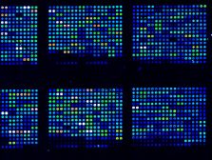
Why replace animals?
New technology can be exploited
Examples
Computer models of human organs, using data acquired with diffusion tensor imaging (DTI), can be used to conduct virtual experiments and to screen new drugs.
Dynamic tissue interactions can be modelled in vitro using microfluidics e.g. L’Oreal and Hurel have developed a microfluidics chip to study allergy and sensitisation.
‘Organ on a chip’ technology has been used to model human lung disease and test potential new drugs to treat pulmonary oedema.
iStockphoto.com/AndreNantel
Notes:
Slide 16: Why replace animals? - Scientific advantages: New technology can be exploited
The development of new technologies opens up opportunities for expanding or improving research in a variety of ways. In recent years, considerable advances have been made in molecular biology, medical imaging, information technology, microfluidics and robotics. The adoption and exploitation of these techniques has scientific or practical advantages for researchers, but can also reduce reliance on animal models.
Models of the heart, uterus and spinal cord are being developed for a wide range of applications such as screening new heart drugs, and studying spinal cord pathways. See for example: Diffusion tensor imaging in the construction of human virtual tissues: heart, gravid uterus and spinal cord:
http://www.drhadwentrust.org/past-research-projects/virtual-human-heart-uterus-and-spinal-cord
The ultimate application of computer technology in research would be the construction of computer models of the whole human body, which could be used to conduct virtual experiments.
A microfluidic chip has been developed (by Hurel Corp. and L'Oréal) that may replace skin allergy testing on animals. The chip comprises an artificial lymph node of cultured cells next to an artificial skin construct made from human cells. The two are connected with a microfluidic system. In an allergic reaction, dendritic cells migrate toward the artificial lymph node in response to a chemical gradient, where they stimulate the T-cells. http://www.hurelcorp.com/overview.php
Organ on a chip technology developed by scientists at the Wyss Institute for Biologically Inspired Engineering, part of Harvard University has been used to model the human lung. This technology has been utilised to study pulmonary oedema, a deadly condition in which the lungs fill with fluid and blood forms clots and to test potential new drugs. A Human Disease Model of Drug Toxicity–Induced Pulmonary Edema in a Lung-on-a-Chip Microdevice. Huh, D. et. al. Science Translational Medicine. 159, 147.

Slide 18
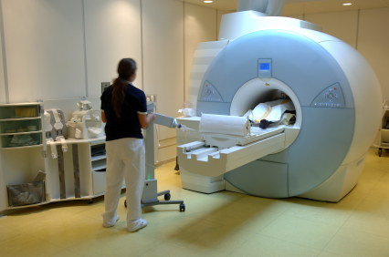
Why replace animals?
Alternative methods may allow ethical studies in humans
Examples
Dual-site Transcranial Magnetic Stimulation (TMS) can be used to study the interaction of areas of the human brain
MEG (magnetoencephalography) and MRS (magnetic resonance spectroscopy) can be used to study pain and pain relief drugs
Acceleration Mass Spectrometry (AMS)
allows pharmacokinetics of drugs
to be assessed using very low drug doses
iStockphoto.com/DrHeinzLonke
Notes:
Slide 17: Why replace animals - Scientific advantages: Alternative methods may allow ethical studies in humans
Methods which allow ethical studies in humans have considerable scientific advantages when the object of study is human biology and disease, but there are strict rules governing human studies. Ideally, the techniques are non-invasive or minimally invasive. Examples include:
The use of Transcranial Magnetic Stimulation (TMS) to study how the human brain works and help devise treatments for psychiatric conditions. For example: The orientation of attention in space, an interaction study using dual-site transcranial magnetic stimulation (TMS):
http://www.drhadwentrust.org/current-portfolio/advances-in-human-neuroscience
Two methods - MEG (magnetoencephalography) and MRS (magnetic resonance spectroscopy) - can be used to study pain and pain relief drugs in human volunteers. For example: Functional neuroimaging and the pharmacokinetics of pain :
http://www.drhadwentrust.org/current-portfolio/a-clearer-picture-of-pain-relief
Accelerator Mass Spectrometry (AMS) is a method of studying the pharmacokinetics of new drugs. It uses very low, safe drug doses and has great promise for reducing the failure of drugs at the ‘first-in-man’ stage, thus reducing wastage of animals in studies on drugs with inappropriate pharmacokinetic properties in humans. See: Microdosing and the 3Rs, by Malcolm Rowland: http://www.nc3rs.org.uk/news.asp?id=193

Slide 19
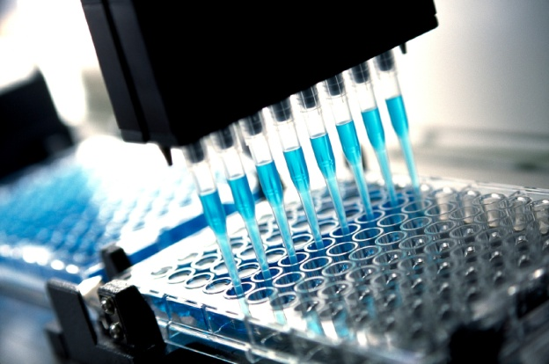
Practical advantages
Why replace animals?
Can be more efficient and cost effective
Can be a source of income (3Rs research funding; patent test methods)
Avoiding animal use reduces bureaucracy and is good for public relations
iStockphoto.com/DavidGray
Notes:
Slide 18: Why replace animals? - Practical advantages
Research using animals is very expensive and the use of alternative methods can bring substantial resource savings, due either to the speed with which results can be obtained, or the decreased cost of maintaining microorganisms or cell cultures compared with maintaining animals. A good example is the use of in vitro tests in high-throughput screening programmes for drug discovery in the pharmaceutical industry. The search for compounds with the ability to interact with a particular molecular target among millions of chemical structures would be practically impossible without this technology.
A number of organisations fund research that will lead to the replacement of animals, so this work can attract research funding.
There may also be commercial opportunities from the marketing of an alternative method if it can be patented-although there are ethical considerations regarding failure to freely share important replacement advances, especially if animal use continues due to financial constraints in academia or small biotechnology companies.
There is also PR value to institutions and industry of demonstrating a commitment to alternatives through structured well resourced research to replace animals.

Slide 20
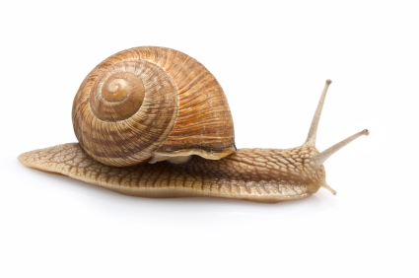
Practical advantages
Why replace animals?
Examples
Schistosomula grown in snails instead of rodents for screening of antischistosomal agents: allows cost effective screening of large sets of compounds
Wax moth caterpillars as a model for bacterial and fungal infections: easy to inject and maintain; inexpensive; suitable for high throughput drug screens and pathogenicity testing
Cell culture model of spinal cord injury for drug screening: could replace large numbers of animals and save time and cost
iStockphoto.com/WojtekKryczka
Notes:
Slide 19: Why replace animals? - Practical advantages : Examples
Three examples illustrate how replacement models are being developed that have clear practical advantages over the use of animals:
The methods currently used to test antischistosomal agents are based on the use of schistosomes obtained from infected mice or hamsters. Only small numbers of drugs can be tested at any one time. An in vitro method using schistosomes obtained from infected snails will shorten assay turnaround times, and allow large sets of compounds to be screened cost-effectively, without causing mice or hamsters to suffer.
(Development of an in-vitro assay for the screening of antischistosomal drugs: http://www.forschung3r.ch/en/projects/pr_110_08.html)
Wax moth caterpillars are an excellent model for studying bacterial and fungal infections. They are easy to inject and maintain, inexpensive, and little training is required to use them. The model is suitable for high throughput drug screens and pathogenicity testing.
(Pathogenicity of Aspergillus fumigatus mutants assessed in Galleria mellonella matches that in mice. Slater J.L., Gregson L., Denning D.W. & Warn P.A. Medical Mycology 49(Suppl. 1), S107–S113 (2011))
Rat models of spinal cord injury have a high animal welfare ‘cost’, as well as being technically demanding and time consuming. An in vitro cell culture model of spinal cord injury is being developed to replace rats for screening therapeutic agents.
(The development of an in vitro model of CNS injury to identify factors which promote repair:
http://www.nc3rs.org.uk/researchportfolio/showportfolio.asp?id=168)

Slide 21
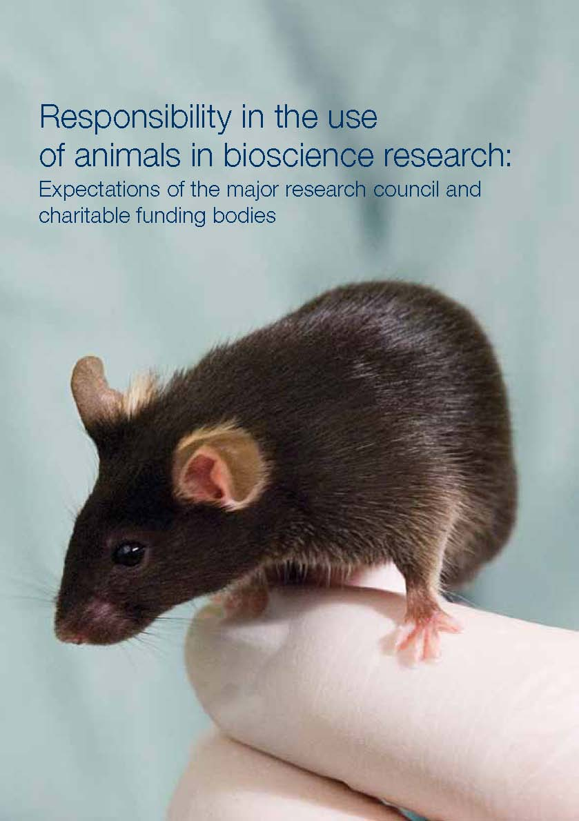
Policies of funders and journals
Why replace animals?
Most research funders (e.g. MRC, BBSRC, Wellcome Trust) now require the 3Rs to be applied
“… All experimental work should seek where possible to avoid the use of animals if the work has the potential to cause animals pain, suffering, distress or lasting harm….”
Some journals require authors to state: e.g. “all efforts were made to utilise alternatives” (Psychoneuroendocrinology)
Notes:
Slide 20: Why replace animals? - Policies of funders and journals
Most of the major research funding bodies in the UK now require that the research they fund “takes full account of the 3Rs”. Their expectations are set out in a booklet “Responsibility in the use of animals in bioscience research: Expectations of the major research council and charitable funding bodies”¹. They make a specific point about replacement - “All experimental work should seek where possible to avoid the use of animals if the work has the potential to cause animals pain, suffering, distress or lasting harm.”
The funders will also consider requests in grant proposals for resources for implementing the 3Rs.
Scientific journals can also play an important role in disseminating information and driving implementation of the 3Rs. For many years, there have been calls for scientific publishers to exert pressure on authors to implement the 3Rs and to provide space in publications for more detail of 3Rs methods². Only a limited number of journals have taken this up so far – an example, Psychoneuroendocrinology, is given on the slide. However, some recently published guidelines (the ARRIVE guidelines³) may leads to more progress in this area.
¹ http://www.mrc.ac.uk/Utilities/Documentrecord/index.htm?d=MRC001897
² Journal publication policies (RSPCA): www.rspca.org.uk/scientificjournals
³ http://www.nc3rs.org.uk/page.asp?id=1357

Slide 22
Putting replacement into practice
Notes:
Slide 21. Section 3: Putting replacement into practice

Slide 23
Finding alternatives with the internet
Putting replacement into practice
Subject specific literature:
e.g. Pubmed, Toxnet, Agricola
Guidance on how to search:
e.g. Altweb, CCAC, NC3Rs
Dedicated alternatives databases:
e.g. Go3R, AnimAlt-ZEBET, NORINA
Notes:
Slide 22: Putting replacement into practice - Finding alternatives with the internet
The internet is the first port of call for most people, and a rapid search for replacement information should include one or more of the broadly focused databases such as PUBMED/MEDLINE, TOXNET & AGRICOLA. A number of other websites give good guidance on how to search for alternatives in research, testing and education, and provide links to dedicated alternatives databases such as AnimAlt-Zebet (which is mainly toxicology) and NORINA.
Altweb: http://altweb.jhsph.edu/resources/searchalt/searchaltdata.html
NC3Rs: http://www.nc3rs.org.uk/landing.asp?id=38
AnimAlt-ZEBET: http://www.dimdi.de/static/en/db/dbinfo/zt00.htm
Go3R: http://www.gopubmed.org/web/go3r/WEB10O00f01000j100200010
CCAC: http://3rs.ccac.ca/en/searches-and-animal-index/guide/
NORINA: http://oslovet.veths.no/norina

Slide 24
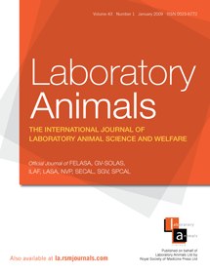
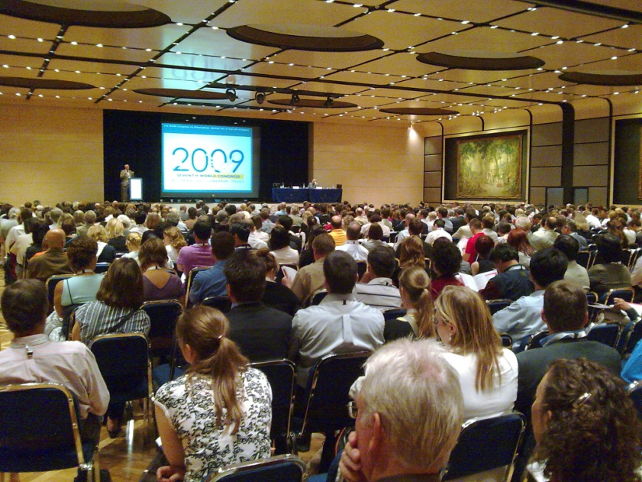
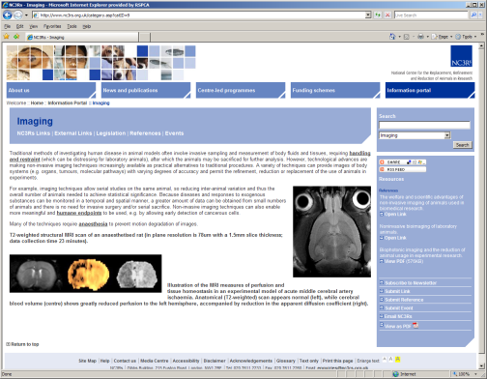
Putting replacement into practice
Other information sources
  Specialist journals
  Collaboration with specialist centres / departments
  Conferences
  Training courses
RSPCA Photolibrary/BarneyReed
Notes:
Slide 23: Putting replacement into practice - Other information sources
There is an ever increasing amount of information on existing and potential replacement methods available from a number of sources.
The literature on the specific area of research in question is an obvious place to start, but there are also more specialised alternatives and in vitro journals, such as Alternatives to Laboratory Animals (ATLA)¹.
Conferences, for example the triennial World Congress on Alternatives and Animal Use in the Life Sciences, are useful for networking on alternatives².
Working with other scientists who have experience with the use of alternative methods is a more direct way of learning about replacement methods, with the potential for collaboration, or transfer of the techniques between laboratories. All too often it seems that in vitro and in vivo scientists work separately rather than establishing the integrated approach that could advance science faster and save animals.
¹ATLA: www.frame.org.uk/page.php?pg_id=18
² 8th World Congress (Montreal 2011): www.wc8.ccac.ca; 7th World Congress (Rome 2009): www.aimgroup.eu/2009/wc7

Slide 25
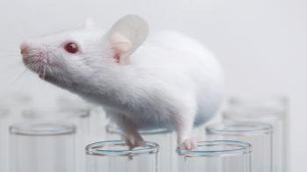
Putting replacement into practice
Possibilities for replacement should be considered at all stages of a project, for example when:
    designing the research programme - defining research objectives; choosing the test system
    carrying out interim/retrospective review
    thinking about the future
iStockphoto.com/Dra_schwarz
Notes:
Slide 24: Putting replacement in to practice – timing
The possibility of replacing animals needs to be a constant consideration throughout the design and conduct of a research programme. This should not only be considered at the start, but also whenever the progress of the programme is assessed (for example during interim or retrospective review of projects) and plans made for future projects.
Where replacement does not seem possible, it is important to try to identify the obstacles to replacement and explore how these could be overcome in the future - for example, by method development, training, or improved infrastructure.
Examples of some of the kinds of questions that it is useful to consider are shown on the next few slides. It is important to approach these with an open mind and look beyond what has ‘always been done before’.

Slide 26
Putting replacement into practice
Designing the research programme
- key questions
Is use of animals the best, or only, way to approach the research problem?
Can the project be broken down into modules or stages, some of which could use non-animal methods?
Can the project be structured to make better use of information from alternative test methods?
Notes:
Slide 26: Putting replacement into practice - Designing the research programme : Key questions (2)
The translation validity (the potential for data to be applicable to human studies) of animal models in the study of human biology and disease is highly variable. The potential value of alternative approaches should be carefully considered at the start of each project.
Careful definition of research objectives is essential to the good design of any experiment. Just because a particular question could be addressed using an animal model, it may not be the most appropriate approach to determining the best possible answer. A researcher may have spent many years perfecting their use of a particular animal model of disease, it may be tempting for them to try to apply their model to the widest possible range of experimental questions even when it is not the best approach to use.
Many research projects can benefit from the use of replacement methods as an adjunct or a precursor to animal experiments. Even where a sufficiently valid animal model exists, and alternative methods cannot fully replace it, there may be some research questions which can be addressed without animal use. It may be advantageous to find out more about molecular and cellular mechanisms, using in vitro methods, before considering an animal model. These techniques have the added advantage of rapidity, small scale, ease of manipulation and, where appropriate, the possibility of using human material. As researchers learn about disease mechanisms from animal models the role of in vitro assay systems may become more valuable. For example, if a specific inflammatory pathway is implicated in an animal model of autoimmune disease (and a similar pathway is implicated in human disease) a specific cell-based model may be the best assay system to test new therapeutics.

Slide 27
Innovative thinking…
Putting replacement into practice
Discussion point
What would we do if we could not use animals for all or part of the research programme?
Notes:
Slide 27: Putting replacement in to practice - Innovative thinking
Finally, a useful exercise for any research project or programme to stimulate ideas and innovative thinking is to run a workshop where participants have to try to come up with ways of addressing the research problem if animals could not be used at all for some reason.

Slide 28
Putting replacement into practice
Monitoring and reporting progress
Retrospective review
  Required by the Directive for some projects
  Member States must evaluate “any elements that may contribute to the further implementation of the requirement of replacement, reduction and refinement.”
  Good practice for all projects (see LASA guidelines)
Publish and disseminate information!
Notes:
Slide 28: Putting replacement into practice – Monitoring and reporting progress
It is good practice for decisions made at the initial project design stage to be reviewed regularly - both during and at the conclusion of the project.
In the revised EU Directive, a retrospective assessment is required for some projects - those involving primates and those with severe procedures. This must include an assessment of ‘any elements’ that may contribute to the further implementation of the 3Rs.
The UK Laboratory Animal Science Association (LASA)¹ and others recommend that there is value in all projects should undergoing retrospective review. The original questions about the value and appropriateness of the chosen approaches can be revisited to see if there are any lessons to be learned that would influence the design, conduct or management of future studies. Any recent developments in alternative methods or technology that could be incorporated to future work can also be considered at this stage and the need for disseminating any information can be discussed.
Above all, if replacement - either complete or incomplete - has been achieved it is important to let others working in the field know, either through in-house communications, external meetings or publications in the scientific literature!
¹http://www.lasa.co.uk/PDF/Guidance%20notes%20RR%20(2004).pdf
See also:
http://www.rspca.org.uk/sciencegroup/researchanimals/ethicalreview/retrospectivereview

Slide 29
Putting replacement into practice
Thinking about the future
Identifying obstacles to replacement
          Scientific
            Lack of existing validated methods
            Difficulty of modelling complexity/in vivo interactions
          Legal
            Regulatory requirements
            Tradition
            Practical
              Lack of facilities, equipment or expertise for required techniques
Notes:
Slide 29: Putting replacement into practice - Thinking about the future - Identifying obstacles to replacement
Where a replacement technique or approach is not available, it is important to try to identify the obstacles which limit the use of alternatives in order to make progress in replacing animals¹.
The most common obstacles to the direct replacement of animals are scientific i.e. the difficulty of modelling a complex interactive biological system - significant amounts of research may be required to identify, develop and validate alternative methods.
In the case of regulatory studies (safety and efficacy testing) the potential for replacement is also limited by legislative requirements which are difficult to change.
The difficulty of breaking away from a traditional approach within a research area where animals have always been the default option is another problem, but an innovative and flexible approach can challenge such limitations.
Practical considerations such as the availability of equipment, access to facilities, lack of expertise, or funds are another factor. For example, replacement techniques may require a significant change in technology, with implications for specialised facilities, training, and equipment.
The latter constraints should be easier to overcome, but ways of addressing all of them need to be explored, rather than dismissing the problems as unsolvable.
¹ The ethics of research involving animals. The Nuffield Council on Bioethics. Section 11.19 (2005)

Slide 30

Putting replacement into practice
Thinking about the future
    Making the case for support for replacement
    Overcoming obstacles to replacement may require financial support for the necessary research, infrastructure, equipment or training. This could be sought from:
  Research funders or host organisations
  Charities supporting alternatives research
  Individual government or EU funds
  Industry, e.g. cosmetics/pharmaceutical companies
Notes:
Slide 30: Putting replacement into practice - Thinking about the future - Making the case for support for replacement
When a good case can be made that an alternative method would have significant scientific or practical advantages, it may be possible to obtain funding to support the development or introduction of a new method. The organisation supporting the research may provide additional funds, especially if they want to demonstrate support for the development of alternatives.
Some charities (such as the Dr Hadwen Trust) are specifically set up to support work on alternatives. The EU has a number of calls for research proposals in the area of replacement in its Framework Research Programmes. In the UK, the NC3Rs which is funded by the government through the major funding bodies, the Wellcome Trust and industry, also supports research aimed at replacing animal use.
A number of industry sectors are interested in the development of alternative methods so support or collaborations might be available from cosmetics, chemicals or pharmaceutical companies or through their trade associations.
Useful web addresses:
European Commission Framework Research Programmes: http://cordis.europa.eu/fp7
European Partnership for Alternative Approaches to Animal Testing: http://ec.europa.eu/enterprise/epaa/index_en.htm
NC3Rs: www.nc3rs.org.uk
Dr Hadwen Trust: www.drhadwentrust.org
Johns Hopkins Centre for Alternatives to Animal Testing (CAAT): http://caat.jhsph.edu/

Slide 31
Summary points
There are many good reasons (ethical, legal, scientific) to replace animals in research.
Many replacement methods exist, and some new technologies have great replacement potential.
Replacement is not all-or-nothing, but can be applied to parts or stages of a project.
Overcoming obstacles to replacement may be a challenge, but can be met with:
  innovative thinking
  willingness to challenge the status quo
  careful design of research
  knowledge of developments in methodology
  dedicated resources
  better collaboration and dissemination of 3Rs information
Notes:
Slide 31. Summary points.

Slide 32
This resource was created by the
Research Animals Department of the RSPCA
For more resources see our website: www.rspca.org.uk/researchanimals
2014
All internet hyperlinks were checked and correct on 7/11/2013
Notes:
Slide 31.
Further information:
www.rspca.org.uk/researchanimals

