Slide 1
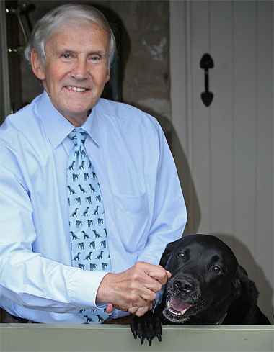
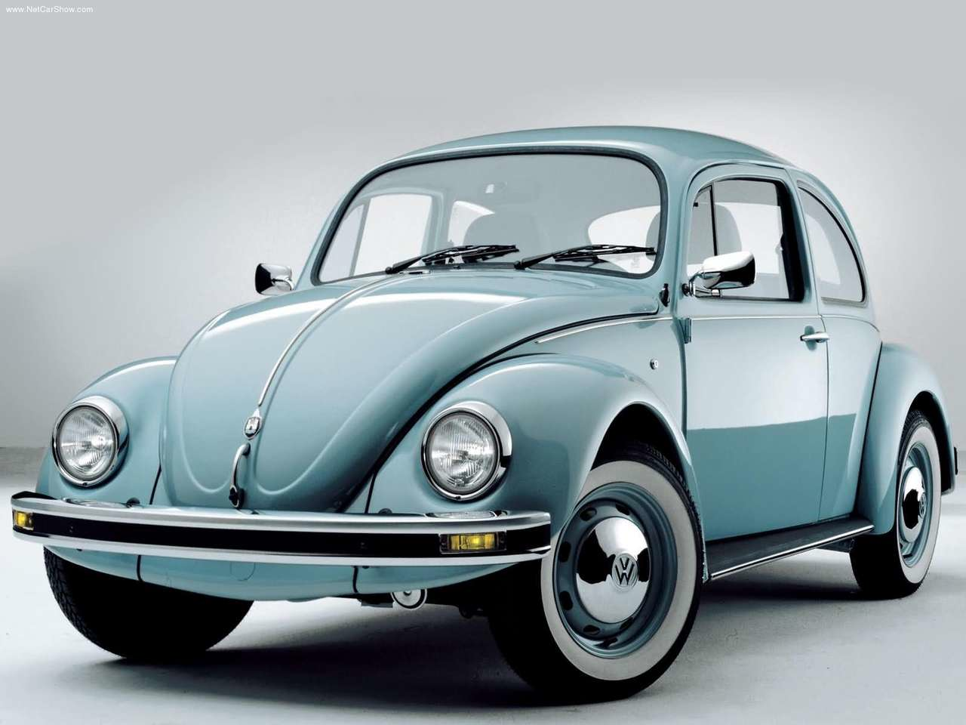
Commemoration of the work of Professor Bob Michell
Measurement of Glomerular filtration rate
Professor Michael Peters
• Professor of Applied Physiology
Brighton and Sussex Medical School
• Nuclear Medicine Physician
Royal Sussex County Hospital, Brighton
• Friend and Colleague of Bob
Merlin

Slide 2
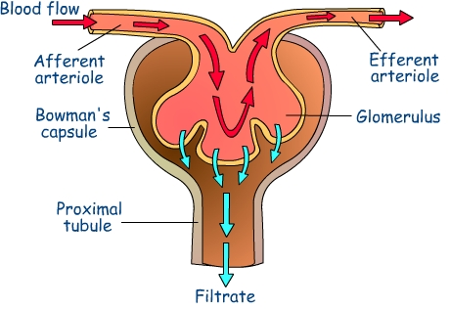
GLOMERULAR FILTRATION
On average, there are ~1 million nephrons per kidney

Slide 3
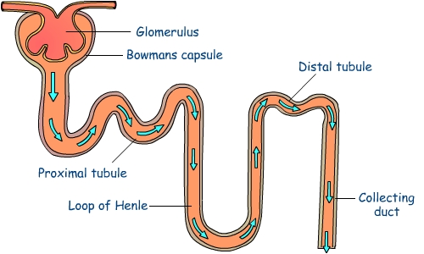
Water transport through the nephron
Renal plasma flow
500 ml/min
495-499 ml/min
GFR: 100 ml/min
(filtration
fraction 20%)
Urine flow rate: 1-5 ml/min
(water reabsorption: 95-99%)

Slide 4
CLINICAL INDICATIONS FOR MEASURING GFR IN HUMAN MEDICINE
Nephro-urological disease
Chemotherapy dose regimes in patients with cancer
Work-up for live kidney donation
Monitoring patients on nephrotoxic drugs; e.g cyclosporine.

Slide 5
CLEARANCE (Z) IS THE IMAGINARY BLOOD FLOW THAT IS COMPLETELY CLEARED OF SUBSTANCE
So has units of ml/min
Z_{U}
Z₁
F₁
Z₂
F₂
Z₃
F₃

Slide 6
Inulin (~5 kDa) the ideal filtration marker
Not protein-bound in plasma
Freely filtered at glomerulus
No tubular secretion
No tubular reabsorption
No extra-renal uptake

Slide 7
MEASURING URINARY INULIN CLEARANCE AT STEADY STATE BY CONTINUOUS I.V. INULIN INFUSION
Conc_{urine} (U) x urine flow rate (V)
= Conc_{plasma} (P) x GFR
GFR = UV/P

Slide 8
FILTRATION MARKERS USED CLINICALLY
⁵¹Cr-EDTA (~300 Da)
^{99m}Tc-DTPA (~500 Da)
¹²⁵I-iothalamate (~900 Da)
X-ray contrast agents e.g. iohexol (~800 Da)
Distribution “space” of filtration markers is extracellular fluid volume (ECFV)

Slide 9
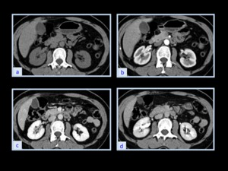
Depiction of GFR with radiological contrast agent

Slide 10
MEASUREMENT of GFR from BOLUS INJECTION and PLASMA CLEARANCE: multisample technique
y(t) = Ae^{-α1t} + Be^{-α2t}
area = A/α₁ + B/α₂
Plasma clearance =
injected activity
area under curve
α₁
α₂
ml/min = MBq
(MBq/ml) x min

Slide 11
SCALING GFR for WHOLE BODY SIZE
Weight
Surface area
Lean body mass
ECFV
Body water
Surface area = πr².4
Volume πr³.4/3
= 3/r
Notes:
Regression of ECFV against BSA has negative intercept

Slide 12
PLASMA CLEARANCE
Start sampling from 2 h (slope-intercept method)
area under clearance curve is under-estimated if first exponential is ignored
Brochner-Mortensen corrected for “lost” area using a polynomial equation

Slide 13
PLASMA CLEARANCE MEASURED from TERMINAL RATE CONSTANT (α₂):
Slope-only technique
α₂ ≈ GFR
ECFV
ECFV = GFR
corrected α₂
α₂
ECFV of “standard man” = 13 litres/1.73 m²

Slide 14
ERRORS in MEASURING GFR from SINGLE BOLUS PLASMA CLEARANCE
PRE-INJECTION
  errors in administered activity
INJECTION
  tissued injection
POST-INJECTION
  errors in sample timing
  errors in sample pipetting
QC :
• correlation coefficient of least squares fit to sample points should be >0.99
• difference between GFR/1.73m² BSA and GFR/13L ECFV should be <15%

Slide 15
PLASMA CLEARANCE single sample
Drawbacks:
• optimal sample time depends on function
• no QC

Slide 16
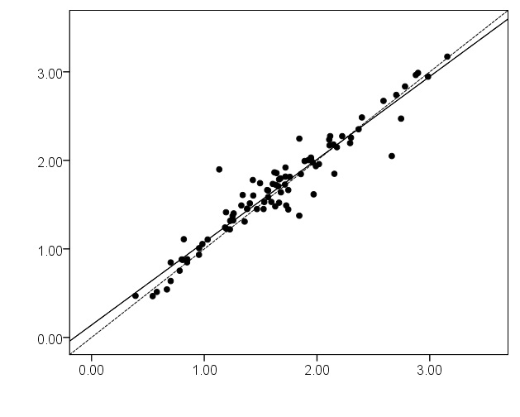
MEASUREMENT of GFR in CATS with IOHEXOL single sample versus 3-sample slope-intercept
Single sample
(ml/min/kg)
N C Finch et al
J Vet Intern Med
2013;27:782-90
Slope-intercept (ml/min/kg)

Slide 17
INTER-CENTRE COMPARISON of PRECISION of GFR MEASUREMENT from SLOPE-INTERCEPT METHOD in 15 centres on 1,878 healthy prospective kidney donors
RATIONALE:
• GFR shows biological variation (>10%)
-diet
-exercise
-age
• ECFV shows less biological variation (~5%)
Coefficient of variation of ECFV is therefore a marker of departmental technical expertise
Peters et al, Eur J Nucl Med Mol Imaging 2012

Slide 18
PARTICIPATING CENTRES
Royal Sussex County Hospital, Brighton
Addenbrooke’s Hospital, Cambridge
Royal Liverpool University Hospital
St Bartholomew’s Hospital, London
King’s College Hospital, London
St George’s Hospital, London
Derriford Hospital, Plymouth
Kent and Canterbury Hospital
St Mary’s Hospital, London
Royal Free Hospital, London
Manchester Royal Infirmary
University Hospital, Coventry
St James’s University Hospital, Leeds
Charing Cross Hospital, London
Glasgow Royal Infirmary

Slide 19
WIDE VARIATION IN CV OF ECFV BETWEEN CENTRES

Slide 20
VERY CLOSE WITHIN-DEPARTMENT GFR CORRRELATION BETWEEN MEN AND WOMEN

Slide 21
WHY IS WITHIN DEPARTMENTAL GFR/ECFV SO CLOSELY ASSOCIATED BETWEEN MEN AND WOMEN?
Non-random error? Age bias? Regional variation?

Slide 22
GFR DECLINES WITH AGE FROM 40 y - FASTER IN WOMEN THAN MEN
0.051 ml/min/l/y; r = 0.37
0.079 ml/min/l/y; r = 0.49
Age (y)
Age (y)
Peters et al, NDT 2012

Slide 23
NO AGE-RELATED DECLINE in ECFV
ECFV = GFR/corrected α₂

Slide 24
OBESITY IMPAIRS GFR IN WOMEN BUT NOT MEN (mean ± SD)
men
women

Slide 25
Renal reserve and its reduction in remaining kidney after kidney donation
Rook et al ter Wee et al
(2006) (1990)
______________________________________________
Pre-donation (% increase in GFR)
- dopamine infusion 13.4 13.8
- amino acid infusion 17.9 11.2
- both infusions 27.7 20.0
--------------------------------------------------------------------------
Post donation (% increase in GFR)
baseline (% of pre-donation) 65% 65%
-dopamine infusion 5.3
- amino acid infusion 9.6
- both infusions 12.6
_____________________________________________

Slide 26
RENAL RESERVE IN DONATED KIDNEY IS SIMILAR TO RETAINED KIDNEY
(ter Wee et al JASN 1994)
baseline GFR (ml/min/1.73 m²) 78 70
stimulation (% increase in GFR)
- dopamine infusion 7.7 6.4
- amino acid infusion 11.1 11.3
- both infusions 18.3 16.6

Slide 27
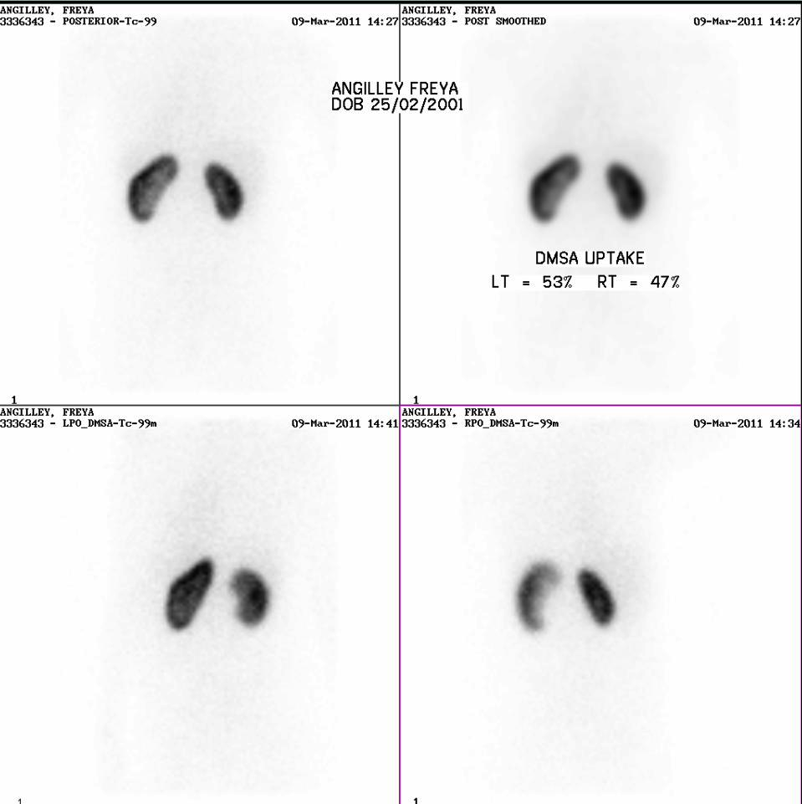
INDIVIDUAL KIDNEY GFR establish differential function
INDIVIDUAL KIDNEY GFR
Measure differential function and apply to total GFR

Slide 28
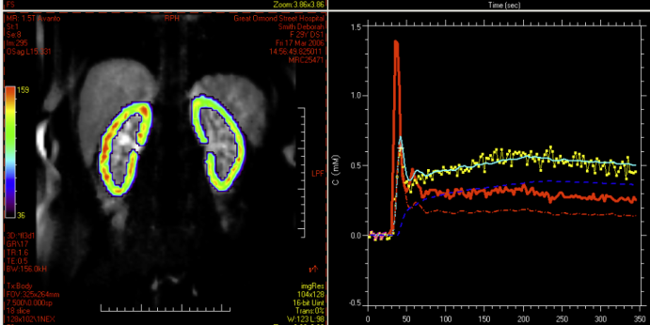
Regional GFR imaged with Gd-DTPA and dynamic MRI
Kindly supplied by Professor Isky Gordon, Institute of Child Health, UCL

Slide 29
4 THINGS THAT EXCITED BOB
Salt. Michell AR. Salt, hypertension and renal disease; comparative medicine, models and real diseases. Postgrad Med J 1994;70;686-94.
“Effective blood volume”. Michell AR. Effective blood volume: an effective concept or a modern myth. Perspect Biol Med 1996 Summer;39(4):471-90.
Neglect of renal impairment in the elderly as a cause of drug overdose.
eGFR.

Slide 30
SERUM CREATININE AS A MEASURE OF GFR
4v MDRD equation
eGFR = 186 x (creatinine/88.4)^{-1.154} x age^{-0.203} x 0.742 (if female) x 1.21 (if black)
Levey AS, et al. A More Accurate Method To Estimate Glomerular Filtration Rate from Serum Creatinine: A New Prediction Equation. Ann Int Med 1999; 130: 461-470.

Slide 31
eGFR versus Cr-51-EDTA
6-sample
3-sample
corrected α₂

Slide 32
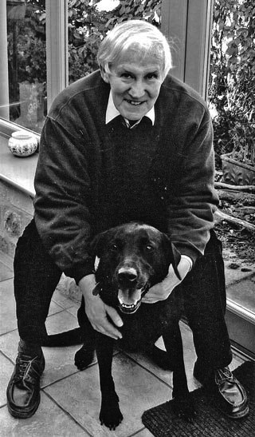
Thank you!

