Slide 1
Hypertension in the cat – an overview of RVC research
Jonathan Elliott
Royal Veterinary College
London

Slide 2
Landmarks for feline hypertension research at the RVC
1992 first BSAVA Clinical Studies Trust Fund grant awarded (Penney Barber appointed - PhD)
1993 Measurement of ionised calcium using electrode methods – is low ionised calcium related to feline hypertension?
1994 funding from Waltham Centre for Pet Nutrition (small contract for diet pilot study)
1998 Harriet Syme appointed to PhD scholarship – to follow the observation that low potassium was linked to hypertension
2005 Rosanne Jepson appointed to PhD to study early stage CKD and role of hypertension

Slide 3
Landmarks for feline hypertension research at the RVC
2008 – Natalie Finch appointed – made the observation linking urinary cadmium excretion and hypertension
2008 – Shubhro Chakrabarti examined the association between clinical factors and renal pathology in cats
2011 – Rosanne Jepson re-joins the group following her residency training and started working on genetic factors in feline hypertension (ongoing)
2012 – Esther Bijsmans appointed and studies blood pressure changes with time (longitudinal studies) and markers of hypertension and response to treatment
2014 – Henk Van Den Broek appointed and identified a relationship between increased FGF-23 and hypertension
2015 – Amlodipine licensed for use in the cat

Slide 4
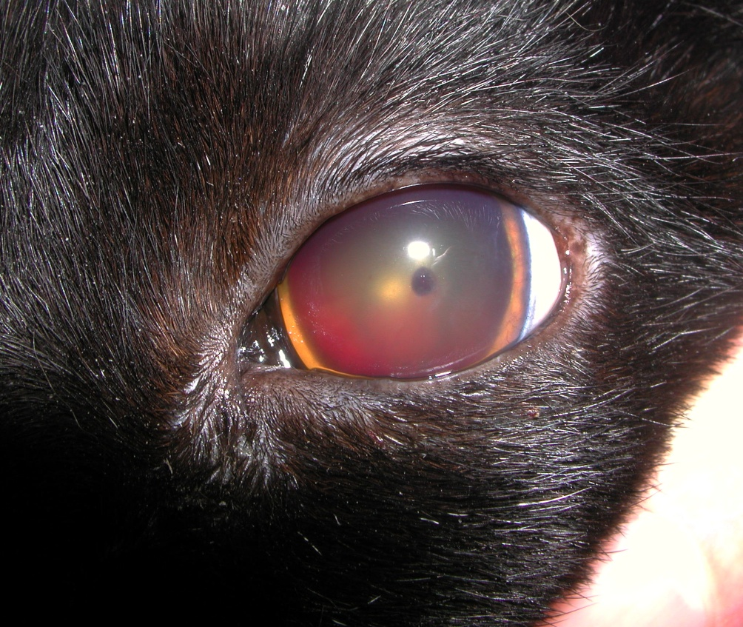
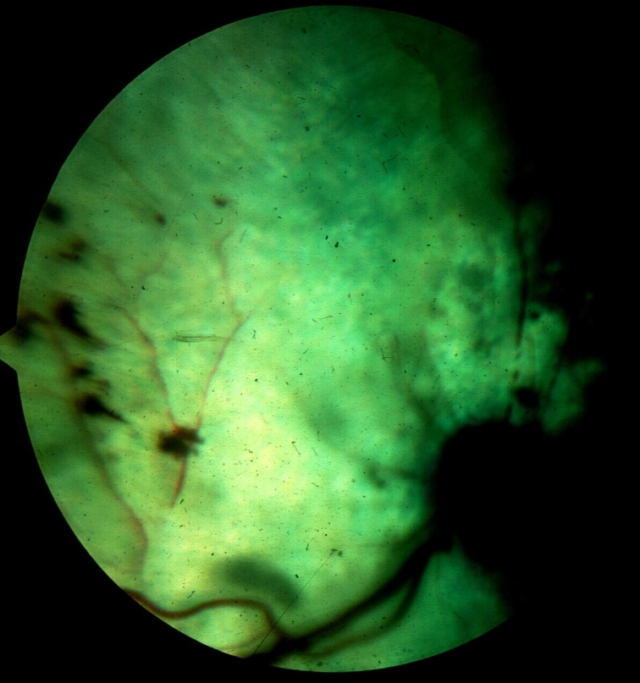
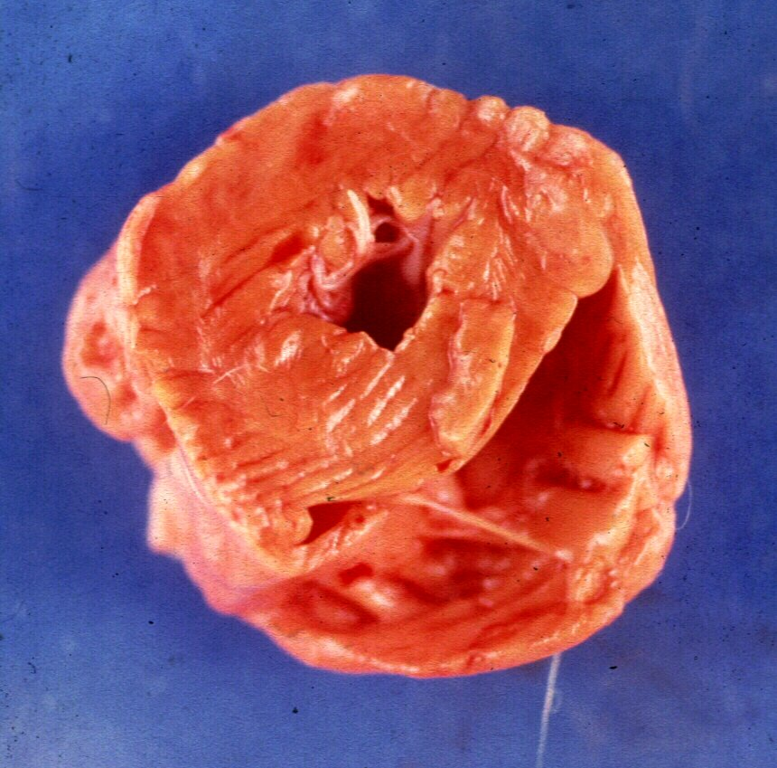
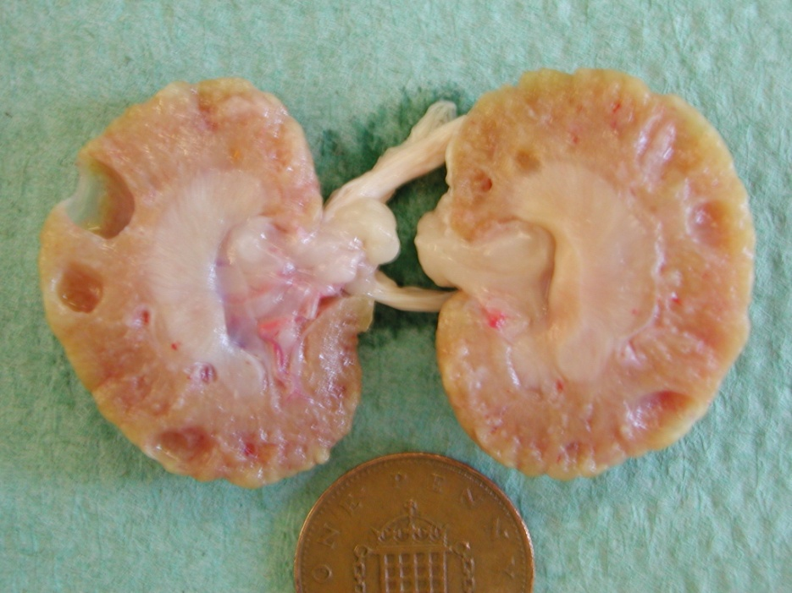

Slide 5
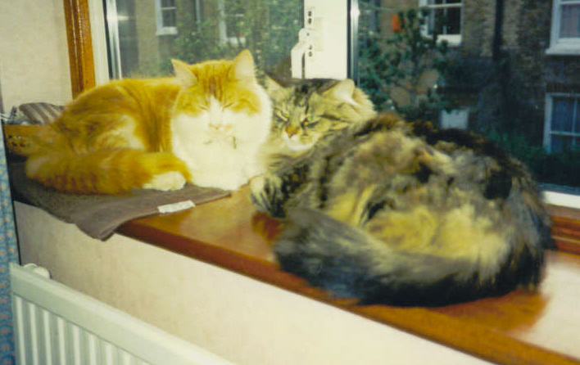
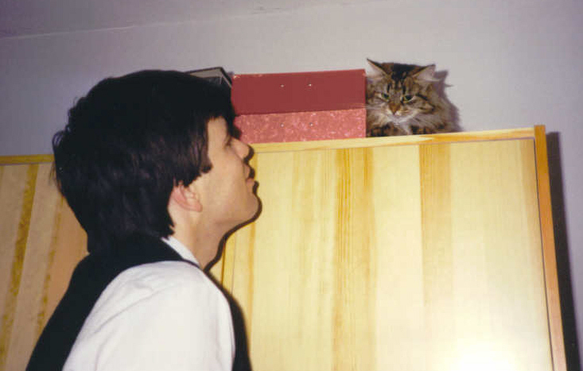
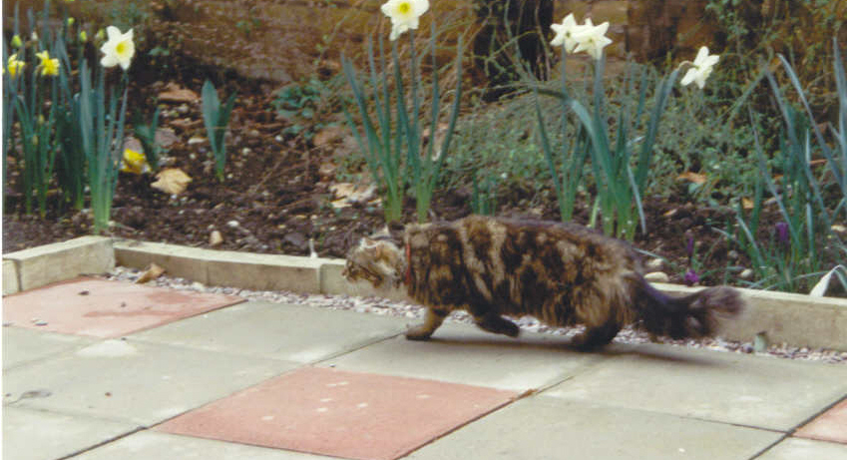


Slide 6
What are the risk factors for hypertension in the cat?
Most reports of hypertension suggest it occurs most frequently in association with underlying disease
    Chronic kidney disease
    Hyperthyroidism
    Hyperaldosteronism (Conn’s Syndrome)
    Secondary to use of erythrocyte stimulating agents
    Idiopathic hypertension – unknown aetiology (represents 1 in 6 (c18%) of hypertensive cats we see)
    blood pressure increases with age in cats as it does in people (their food contains too much sodium too!)

Slide 7
Blood pressure of healthy cats
Age (yrs) | Number | SBP | DBP | MAP
<1 | 17 | 123.7 ± 11.1 | 61.6 ± 11.6 | 82.0 ± 12.7
1-3 | 13 | 122.6 ± 11.1 | 62.6 ± 7.4 | 83.4 ± 8.5
3-5 | 13 | 127.0 ± 16.3 | 65.3 ± 16.1 | 86.7 ± 18.0
5-7 | 11 | 129.3 ± 17.1 | 70.4 ± 15.4 | 90.6 ± 17.1
7-11 | 12 | 127.4 ± 14.5 | 67.6 ± 17.5 | 88.1 ± 17.2
11-14 | 16 | 158.2 ± 33.6 | 96.7 ± 28.8 | 120.6 ± 32.2
14-16 | 16 | 162.0 ± 22.1 | 91.9 ± 22.6 | 117.4 ± 24.8
>16 | 6 | 179.0 ± 25.5 | 117.5 ± 26.5 | 139.7 ± 27.6
Cats aged 11 years or above had significantly higher pressure and a higher SD than those <11 yrs
Only 60 of the 104 cats enrolled had their renal function assessed
Most of these cats were from a colony kept for nutrition studies
Prevalence of hypertension not defined
Bodey & Sansom (1998) JSAP 39: 567-573

Slide 8
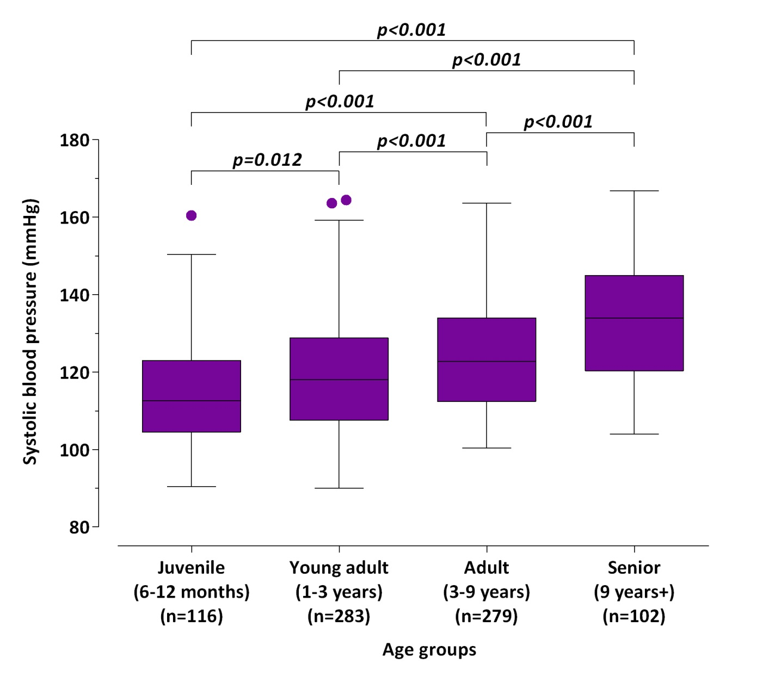
Systolic blood pressure in healthy cats
780 cats sampled at a re-homing centre
All healthy on PE but no blood screening undertaken
Other factors found to influence BP
  Body condition score
  Sex
  Demeanour of cat
Payne et al., J Vet Intern Med. 2017 Jan;31(1):15-21.

Slide 9
Prevalence of hypertension in healthy cats
Jepson et al., 2009 JVIM 23:806–813
118 cats were screened – all assumed healthy by their owners
15 cats had SBP >170 mmHg (persistently (6) or associated with ocular lesions (9))
Median SBP was 139.8 [125.5, 163.3] mmHg
SBP in those cats that became azotaemic (n=29) within 12 months was 149.2 [133.6, 174.2] vs. 136.0 [124.0, 150.6] mmHg in those that were non-azotaemic (n=66) at 12 mth (P=0.053)

Slide 10
Does SBP increase with age in the cat?
133 normotensive healthy cats were recruited
124 of these cats remained normotensive for their follow-up period [666 (495, 1065) days]; systolic BP increased at a rate of 0.4 ± 0.1 mmHg/100 days
9 cats became hypertensive after a follow-up period of 939 (685, 1217) days
SBP at recruitment was significantly higher in the cats that became hypertensive:
    131.6 (115.0, 143.7) vs. 145.6 (139.5, 154) mmHg
This study shows BP increases with age and a pre-hypertensive phase probably could be defined in cats (>140 mmHg)

Slide 11
Conclusions to studies in healthy cats
There are relatively few studies determining the prevalence of hypertension in cats
This varies with age – most studies have involved relatively small populations of younger cats
Once a cat is 10 years old, regularly checking its blood pressure would be the best way of identifying hypertension at an early stage
c13% of cats ≥10 years old will be hypertensive
[Prevalence from Jepson et al., 12.7 (6.7-18.7)%]
Identification and treatment at an early stage could avoid target organ damage (brain, eye, heart, kidney)

Slide 12
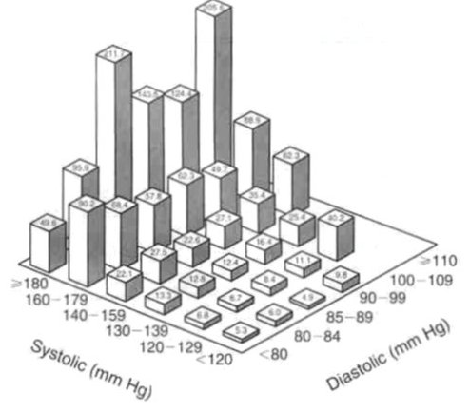
Is systemic hypertension a factor in progression of CKD?
Evidence from human medicine seems clear-cut
Elevations of BP
are a strong
independent risk
factor for ESRD
Category ESRD RR BP
Incid
(10⁵ yr)
Optimal 5.3 1.0 120/80
Normal 6.6 1.2 129/84
High normal 11.1 1.9 139/90
Stage 1 21.0 3.1 159/100
Stage 2 43.6 6.0 179/110
Stage 3 96.1 11.2 209/120
Stage 4 187.1 22.1 210/120
Klag et al., 1996
NEJM, 334, 13-18
Notes:
Scan in Figure 1 from Klag et al., 1996 (NEJM, 334, 13-18).

Slide 13
Epidemiological study – feline CKD
Enrolled 103 consecutive cases of CKD diagnosed at first opinion clinics in central London
Excluded cases with:
  Acute kidney injury
  Any drug treatment that would lower BP
Cats with concomitant suspected or confirmed hyperthyroidism were included
Multivariable logistic regression was used to examine potential risk factors

Slide 14
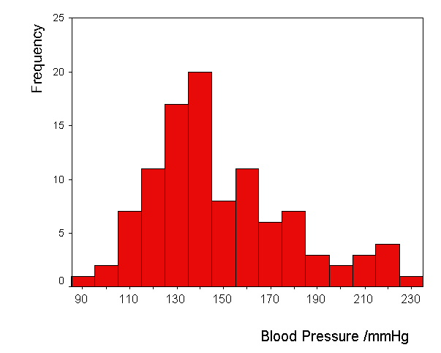
Distribution of systolic blood pressure measurements in 103
cats with chronic renal failure
Syme et al., (2002) JAVMA, 220, 1799-803

Slide 15
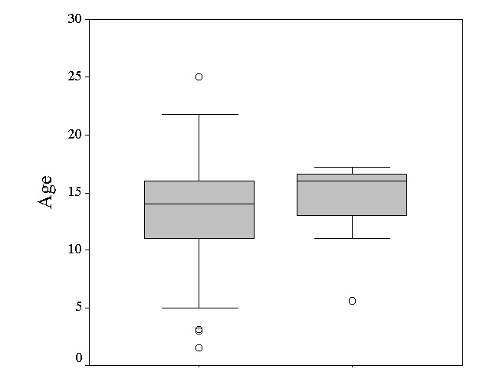
Age as a risk factor for hypertension in renal disease
Syme et al., (2002)
JAVMA, 220, 1799-803
Normotensive Hypertensive

Slide 16
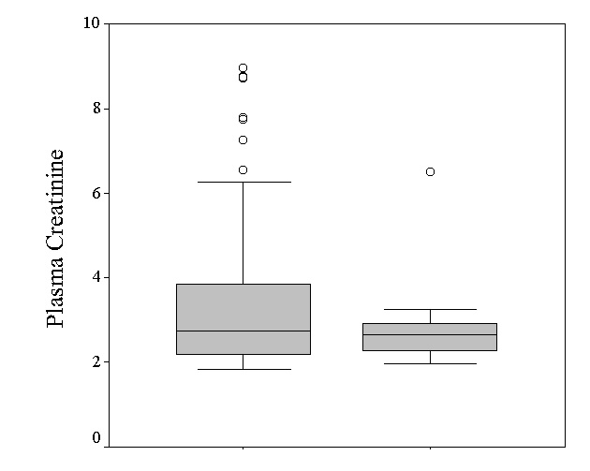
Plasma creatinine concentration as a risk factor
Syme et al., (2002)
JAVMA, 220, 1799-803
Normotensive Hypertensive

Slide 17
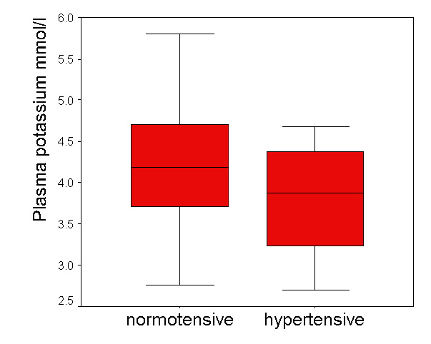
Plasma potassium concentration as a risk factor
* P=0.02, logistic regression
OR 0.39
*
Syme et al., (2002) JAVMA, 220, 1799-803

Slide 18
Blood pressure and mortality
SABP per se does not appear to be an independent factor influencing the survival of cats with CKD
However, hypertension is significantly related to mild proteinuria in cats
Proteinuria is a significant predictor of survival in the cat

Slide 19
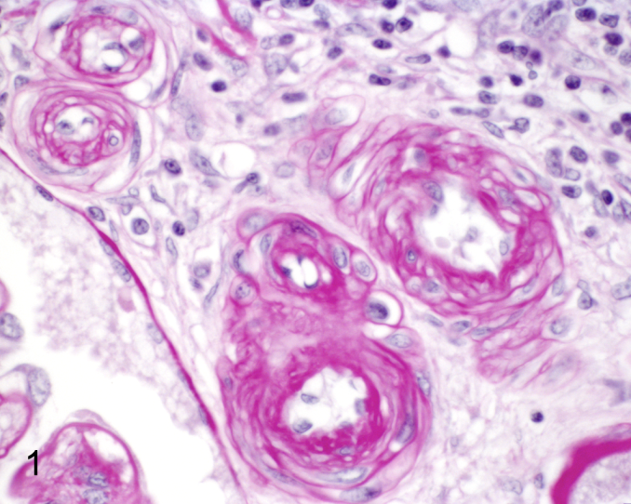
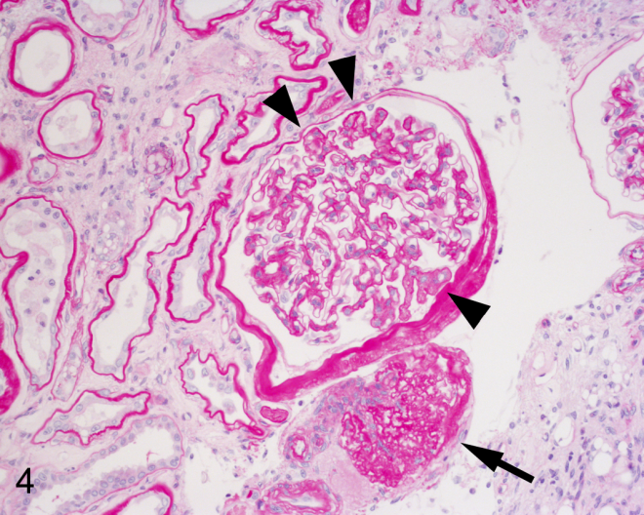
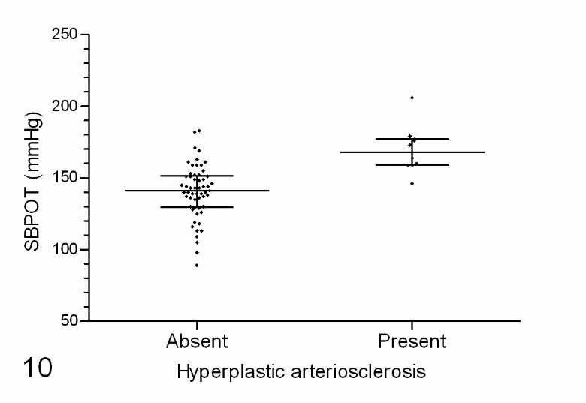
Histopathology study
Chakrabarti S et al., Vet Pathol, 2013 Jan;50(1):147-55
higher time-averaged systolic blood pressure was associated with glomerulosclerosis and hyperplastic arteriolosclerosis

Slide 20
Urinary albumin excretion in 136 cats with renal dysfunction and/
or hypertension
5
13
22
14
21
28
32
Syme et al., 2003 JVIM, 17, 405

Slide 21
<0.2 (49)
0.2-0.4 (30)
>0.4 (29)
Survival in days
Jepson et al (2007) JVIM 21(3):402-9

Slide 22
Does Blood pressure increase over-time in CKD cats?
265 cats dx with CKD (Aug 2000-2012) and seen for >3 months (longitudinal follow-up)
105 (39 [33-45] %) were dx with concomitant hypertension (or hypertension dx within 3 mths)
Higher prevalence than previous study
Of the remaining 160 cats
    133 remained normotensive (follow-up 316 [225-512] days); SBP 133.2 [121.2,144.6] mmHg; rate of change of SBP 0.5 ± 0.1 mmHg/100 days
    27 (17%) became hypertensive (median follow-up 379 [281-771] days); SBP 147.2 [140.4 , 156.1] mmHg; rate of change of SBP 1.1 ± 0.3 mmHg/100 days; 13 of these cats had retinal lesions at dx of hypertension
Bijsmans et al., (2015) JVIM 29:855–861

Slide 23
Development of hypertension over time
Cox’s proportional hazards ratio:
0.2 (0.08 – 0.36) – P<0.001)
Bijsmans et al., (2015) JVIM 29:855–861

Slide 24
Conclusions
Cats with CKD are at a 2 to 3 fold higher risk of being hypertensive vs. healthy cats of similar age
Normotensive CKD feline patients are 5 times more likely to develop a blood pressure where treatment is needed to prevent target organ damage than are healthy cats
A pre-hypertensive stage could be proposed for cats with CKD (140-150 mmHg)
Does starting antihypertensive interventions at an early stage prevent severe hypertension developing?
What would this do to progression of CKD?

Slide 25
Classification of feline hypertension
Systolic blood pressure (mm Hg) | Diastolic blood pressure (mm Hg) | Risk of future target organ damage | BP substage
 |  |  | Original | New
<150 | <95 | Minimal | AP0 | Normotensive
150 - 159 | 95 - 99 | Mild | AP1 | Borderline hypertensive
160 - 179 | 100 - 119 | Moderate | AP2 | Hypertensive
>180 | >120 | Severe | AP3 | Severely hypertensive
International Renal Interest Society 2015
(based on ACVIM Consensus statement 2007)
Professor Harriet Syme and Dr Rosanne Jepson are part of the ACVIM consensus group working on a new Hypertension consensus statement

Slide 26
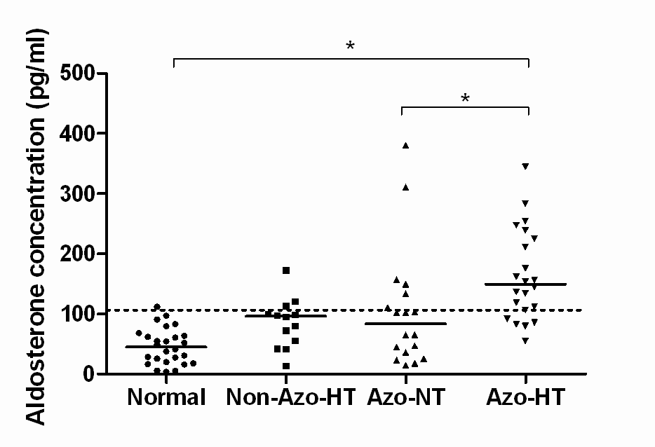
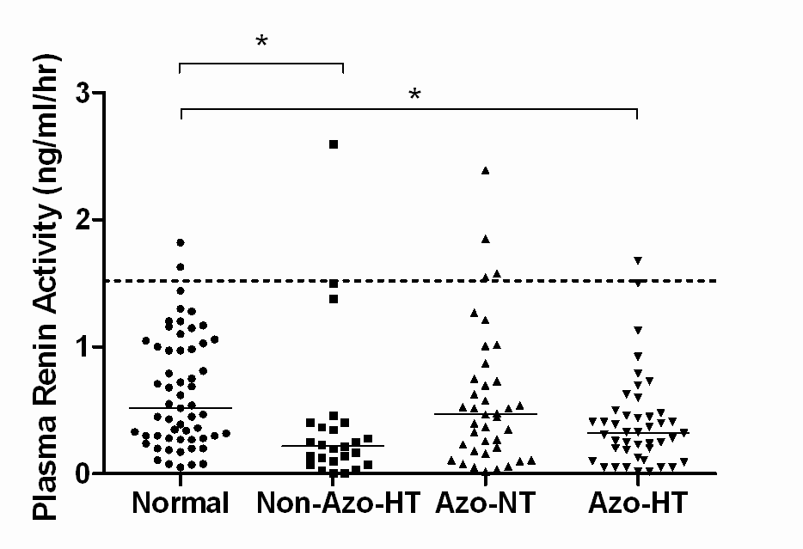
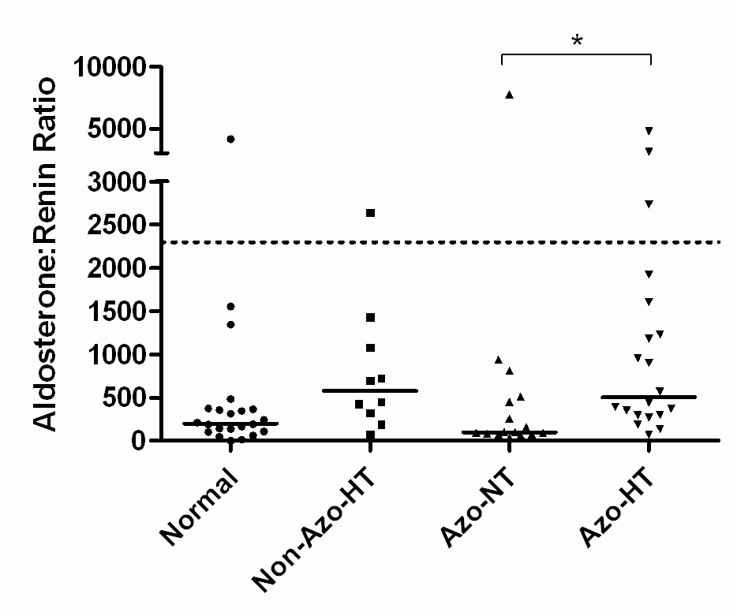
Evaluation of RAAS in hypertensive cats
Jepson et al., (2014)
J Vet Intern Med;28(1):144-53

Slide 27
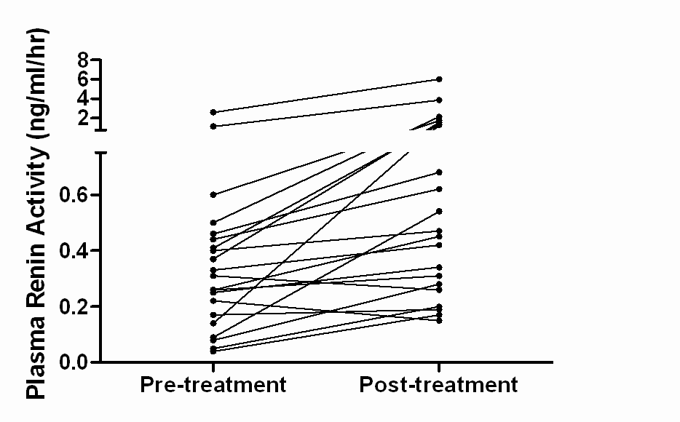
Effect of amlodipine treatment on RAAS
Plasma aldosterone concentration did not change
pre 122.8 pg/ml [92.3, 162.4], post 108.4 pg/ml [57.1, 176.5]
Plasma renin activity significantly increased
pre 0.32 ng/ml/hr [0.15, 0.46], post 0.54 ng/ml/hr[0.28, 1.51]
Jepson et al., 2014 J Vet Intern Med.;28(1):144-53
Rosanne is working with colleagues at QMUL to work out the genomic
factors underpinning feline hypertension that underpin the phenotypes we see

Slide 28
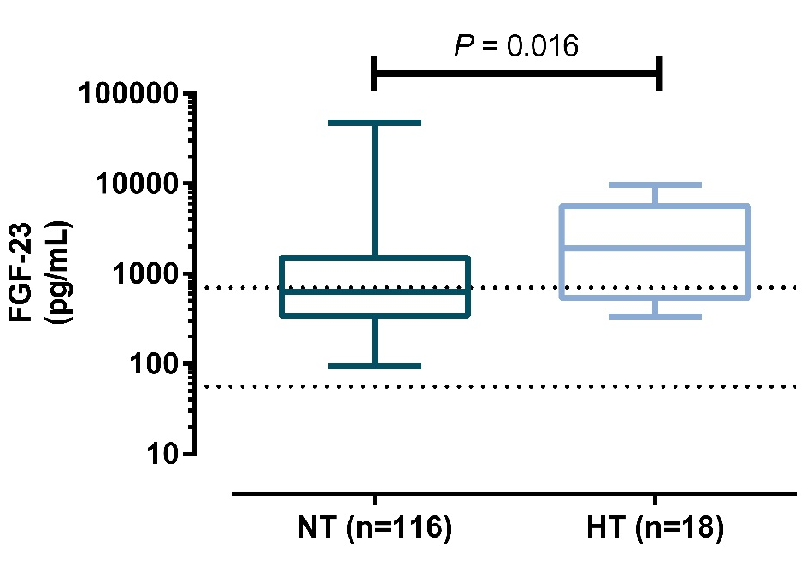
Is FGF-23 higher in hypertensive cats?
FGF-23
  NT: 633 [344, 1507] pg/mL
  HT: 1650 [501, 4946] pg/mL
  P=0.016
Creatinine (P=0.925) and phosphate (P=0.608) not different
Chloride
  NT: 118 [116, 120] mmol/L
  HT: 116 [114, 118] mmol/L
  P=0.011
FGF-23 also related to development of hypertension over time in cats followed longitudinally
Data presented at ECVIM 2016; Van den Broek et al.
Notes:
This graph shows the FGF-23 concentration on a logarithmic scale in the NT and HT group. The plasma FGF-23 concentration was significantly higher in cats with systemic hypertension at diagnosis of azotaemic CKD. The majority of cats with hypertension have FGF-23 concentration above the reference interval of 700pg/mL depicted by the dotted line.
Of note, plasma creatinine and phosphate concentrations, two important predictors of FGF-23, did not differ between the groups.
The only other biochemical variable that differed between groups was plasma chloride concentration, which was lower in hypertensive cats.

Slide 29
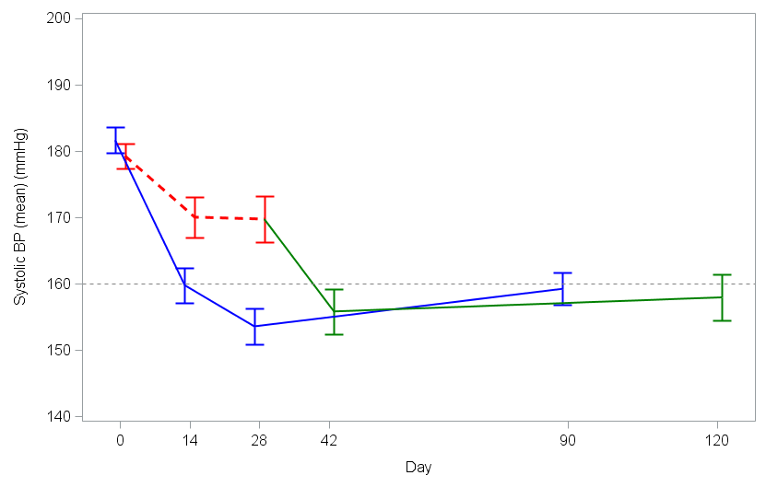

Treatment of hypertension – what factors influence response to treatment?
Huhtinen M, et al., (2015) J Vet Intern Med: 29(3):786-93.
Dose escalation from day 14:
amlodipine 54%
placebo 80%
Moderate risk of TOD
Note! Placebo group switched to amlodipine on day 28
Notes:
Draw the line in SAS

Slide 30
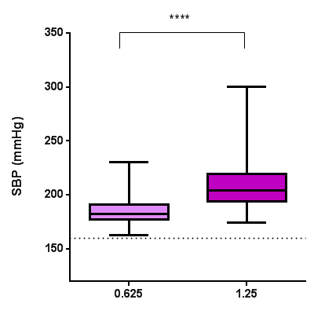
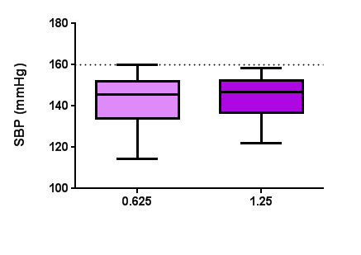
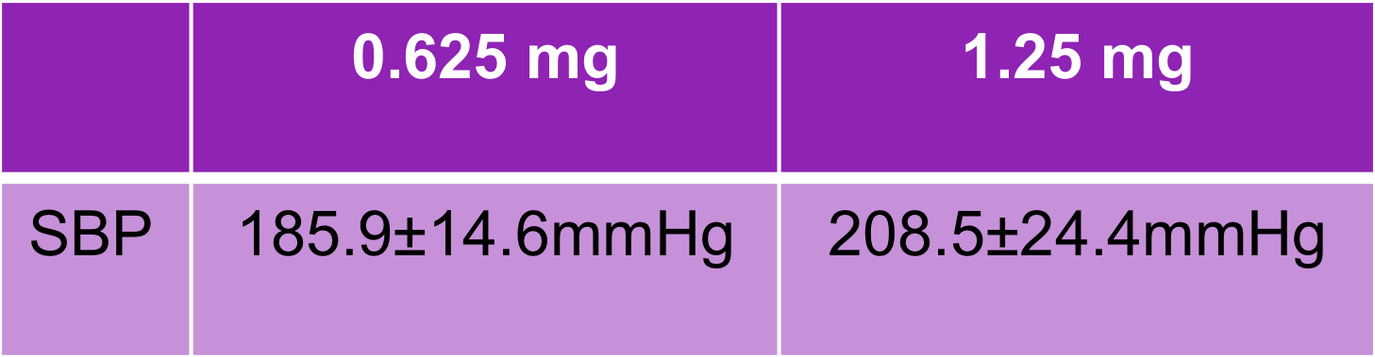
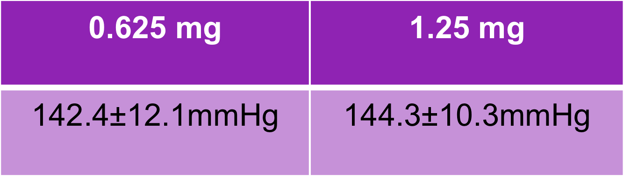
What factors determine the dose of amlodipine required to control hypertension
P<0.001
Hypertensive visit Controlled visit
Bijsmans ES, et al., (2016) J Vet Intern Med: 30(5):1630-1636
Notes:
Linear mixed effects model split into two slides. Hypertensive visit significantly higher SBP in 1.25mg group.

Slide 31
Results – Dose and Concentration
Dose
  0.625mg: 0.17±0.04mg/kg
  1.25mg: 0.33±0.09mg/kg
    P<0.001
Plasma amlodipine concentration
  0.625mg: 33.3 [25.5, 54.9] ng/mL
  1.25mg: 70.5 [48.9, 98.7] ng/mL
    P<0.001
    In a multivariate analysis both dose and amlodipine concentration predicted ΔSBP
Bijsmans ES, et al., (2016) J Vet Intern Med: 30(5):1630-1636
Notes:
Plasma amlodipine concentration was twice as high in cats on 1.25mg compared to those receiving 0.625 mg,as was the dose in mg/kg that the cats were receiving. Dose in mg/kg, plasma amlodipine concentration, and potassium were associated with the absolute change in SBP in the univariable analysis (P<0.1). The plasma amlodipine concentration and the dose in mg/kg remained positively and significantly associated with decrease in SBP in the multivariable model (P<0.05).

Slide 32
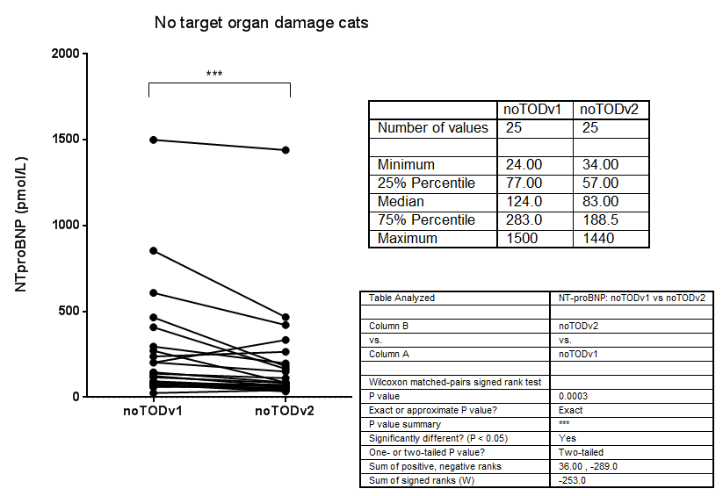
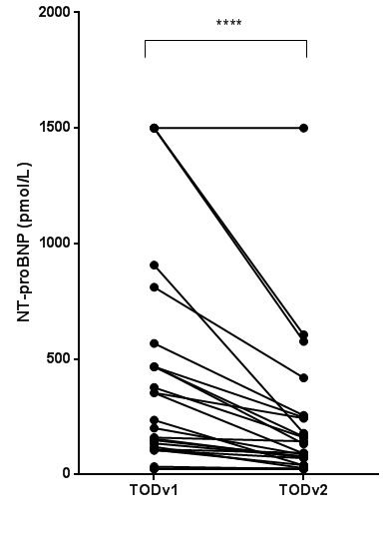
NT-proBNP – change with treatment
61.5% decrease (P<0.01)
33.1% decrease (P<0.01)
Bijsmans et al., J Vet Intern Med. 2017 May;31(3):650-660.
Notes:
NT-proBNP concentration decreased by 61.5% (P<0.01) with antihypertensive treatment (to 113.5[71.6,246.3]pmol/L) in cats with TOD, and by 33.1% (to 83.0[77.0,188.5] pmol/L) in cats with noTOD. SBP was not significantly different between groups at time of diagnosis of hypertension (182.8[168.2,204.6] vs. 180[175.8,187.2]mmHg, P=0.747).

Slide 33
Closing remarks
ARM inspired me to ask questions of clinical relevance from the cases of CKD / hypertension we saw
We are able to recruit many qualified veterinarians who are curious to find the answers and who generate their own questions
They read the rodent and human medical literature and figure out what is different about the cat
New technologies will help in the future – but attracting the right people to ask the questions will always be the key to success
Bob Michell was a leader of those people

Slide 34
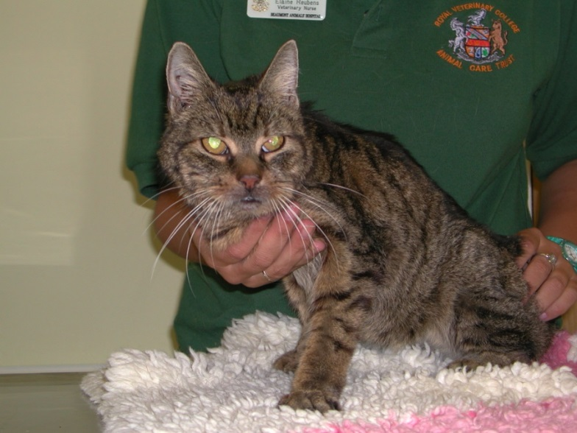

Acknowledgements
Evetts-Luff Animal Welfare Trust
Cats, clients and staff at the Beaumont Sainsbury Animals’ Hospital, Camden and PDSA Bow
RVC Feline Research Group
Professor H Syme, Dr R Jepson
Current and past PhD students and veterinary nurses (Hannah, Elaine, Kim, Robyn & Nicola)

