Slide 1

Hypertension in dogs
Angela Bodey
BSc BVSc PhD MRCVS

Slide 2
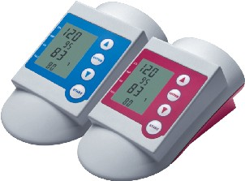
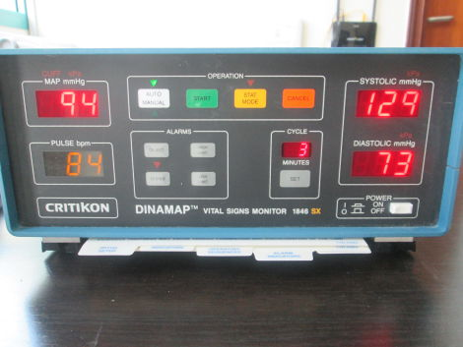
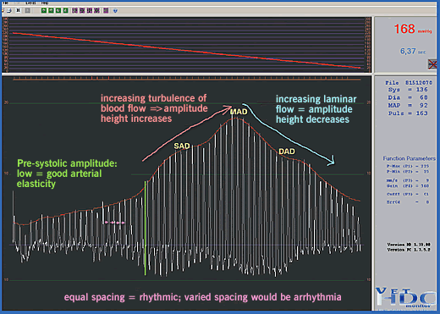
Measurement of blood pressure in dogs
Intra-arterial means
  Arterial puncture
  Radiotelemetric implants
Compressive cuff
  Doppler
  Oscillometry
  High definition oscillometry
Notes:
Limitations
validation
standard protocol for achieving readings
experienced personnel

Slide 3
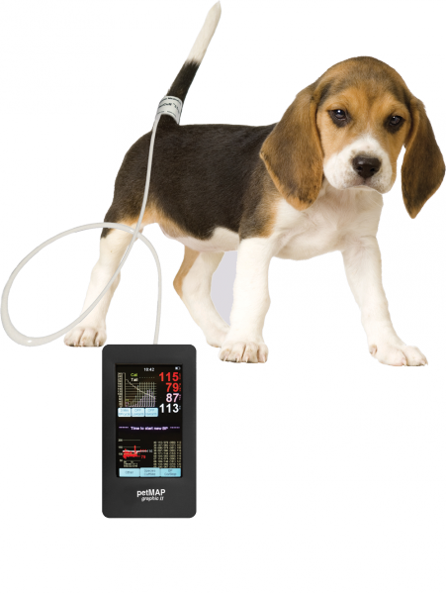
Measurement of blood pressure in dogs
Cuff site
Cuff size
Measurement protocol
Recording
Rejection of readings
Precision versus accuracy
Notes:
Cuff width at least 40% or arm circumference

Slide 4

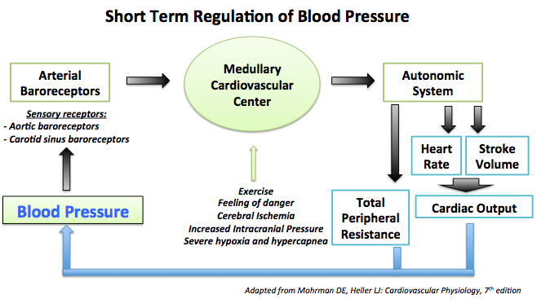
Blood pressure varies
Moment by moment
Notes:
Real issues with msts in the context of anxiety

Slide 5
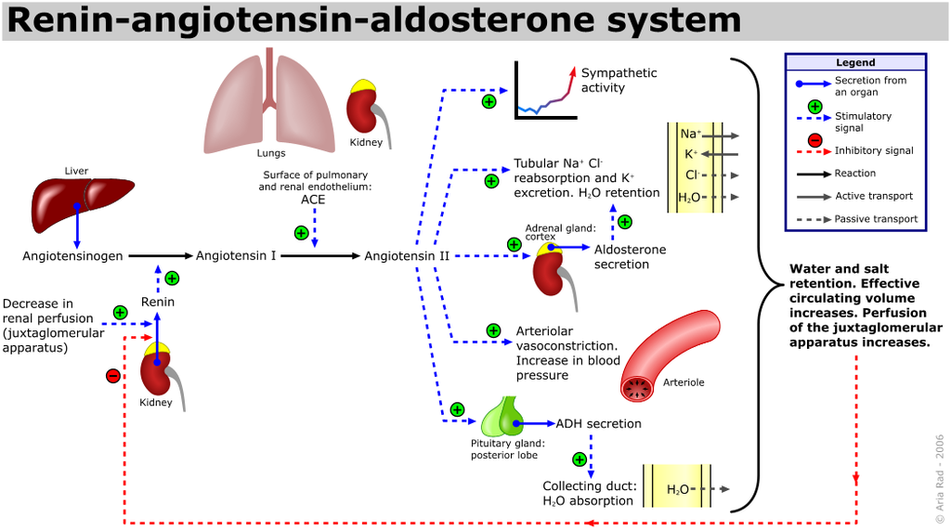
Blood pressure varies
Over longer periods

Slide 6
Blood pressure and age in dogs
Notes:
NB BPs log normally distributed for all msts, with right skew
Epidemiological study 1903 dogs, of which 1782 normal and therefore contribute to data above

Slide 7
Heart rate and age in dogs

Slide 8
Blood pressure and breed in dogs

Slide 9
Blood pressure and breed in dogs
Notes:
NB order by level of systolic pressure as per previous slide
NB diastolic pressure tracks

Slide 10
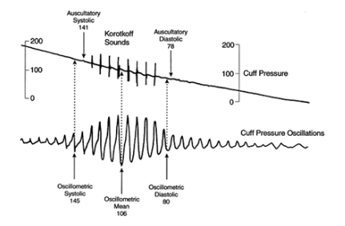
Blood pressure and breed in dogs
Notes:
MAP high to low in order of systolic pressure
Bigger differences here as affected by HR
True/direct MAP calculated as (CO.SVR) + CVP, estimated as DP + 1/3 pulse pressure and dependent upon heart rate
At higher HR MAP close to arithmetic mean of systolic and diastolic pressure due to the change in shape of the arterial pressure pulse
MAP equivalent to the perfusion pressure seen by the organs
Oscillometric MAP measured from the cuff pressure graph, not calculated

Slide 11
Heart rate and breed in dogs
Notes:
No consistent with the idea of small breeds having higher HR
Sight hounds lower HR but higher MAP dt high systolic and diastolic pressure

Slide 12
Blood pressure by breed and exercise level (1-4)
Notes:
Exercise levels are 1-little, 2-moderate, 3-plentiful, 4-strenuous, working left to right for each of the two breeds shown
Blood pressure isn’t much different within breed for all exercise levels, it is just higher for Deerhounds than for Labradors.
Labradors=lowest BPs-couch potatoes or endurance athletes
Deerhounds=highest BPs-sprint athletes

Slide 13
Heart rate by breed and exercise level
Level 1
Level 2
Level 3
Level 4
Notes:
Heart rate gets less for the dogs that exercise more, particularly the Deerhounds, and is lower for Deerhounds than for Labradors for all but those receiving the least exercise
These are measurements taken at rest

Slide 14
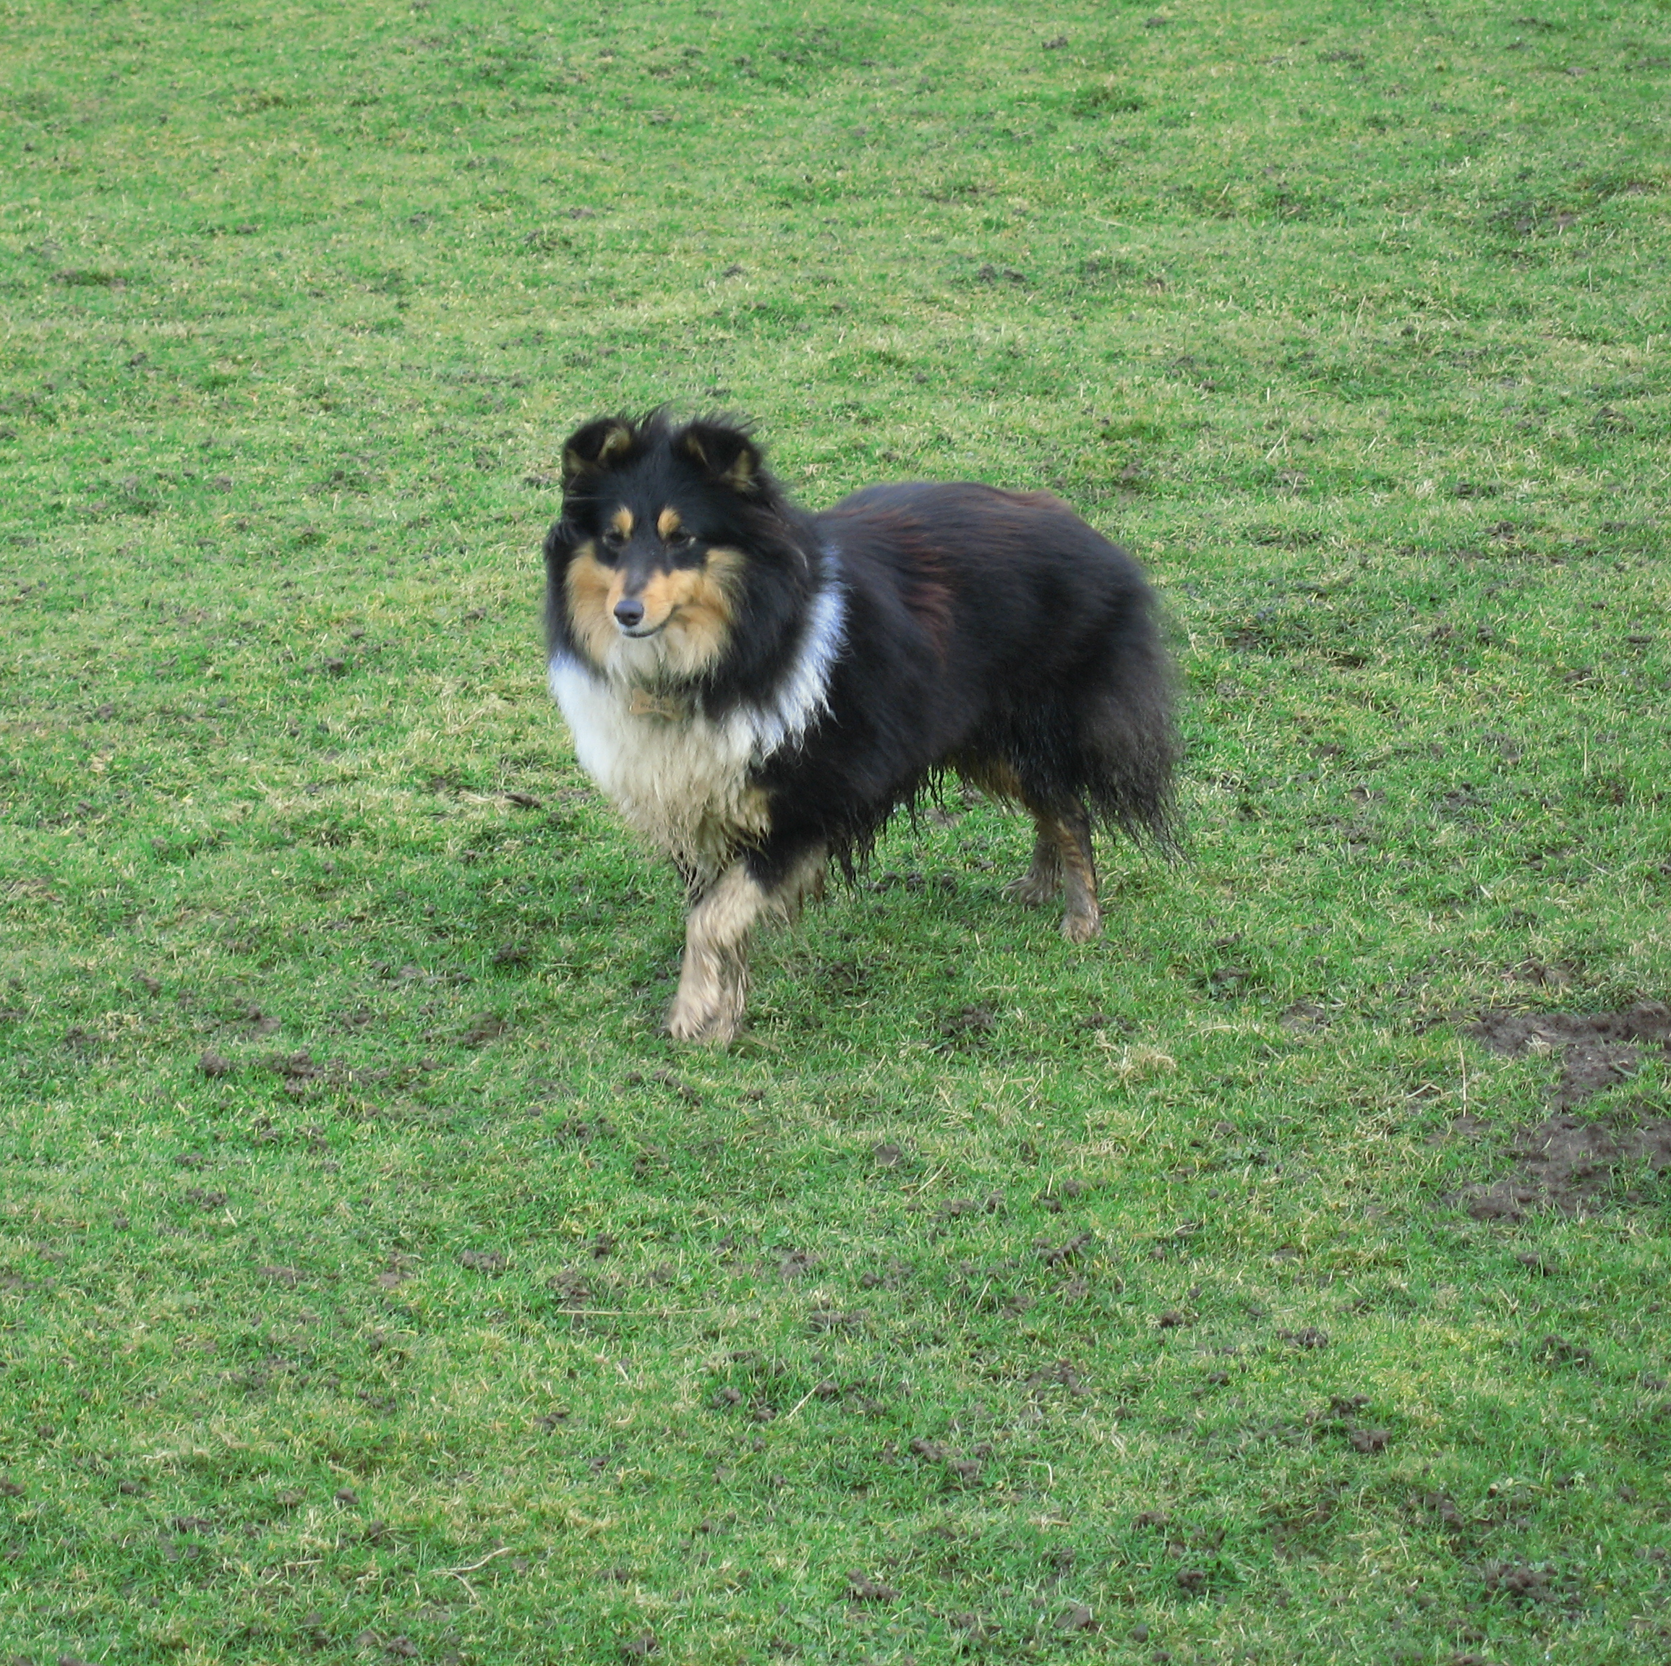
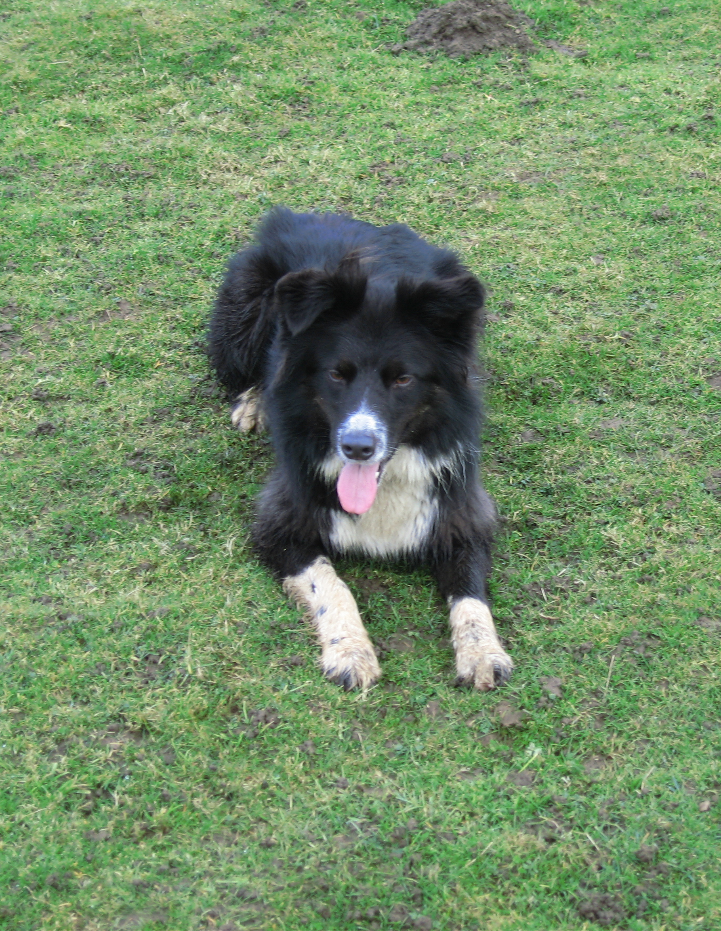
Others factors affecting blood pressure in dogs
Sex
  Male>neutered>female
Temperament
Nervous/excitable>calm
Condition score
Overweight>underweight/ideal
Notes:
Males higher than both male and female neutered, and females lower than all others by 6 mmHg for systolic/diastolic and MAP
Nervous/excitable higher than calm by about 7-8mmHg for systolic, diastolic and MAP
Overweight greater than underweight/ideal by about 4mmHg for systolic, diastolic and MAP

Slide 15
White coat hypertension
Results from the measurement process
Fight and flight response
But not predictable, even when behavioural evidence is there
Sympathetic versus parasympathetic nervous system effects
Notes:
Some dogs will pant and seem very anxious in the consulting room, and yet their heart rate is not as high as the behavioural signs would suggest it might be.
There could also be a mismatch with blood pressure, depending upon effects of heart rate on blood pressure, and to what extent vasoconstriction plays a role

Slide 16
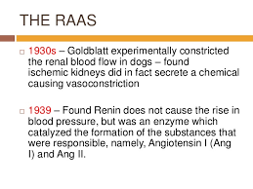
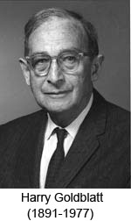
Models of canine hypertension
Goldblatt dogs
Notes:
Richard Bright, Guy’s Hospital, 1800s linked renal dz and hypertensive end organ damage (in this case “heavy hearts”) as he observed that patients with abnormal kidneys often had heavy hearts. He suggested that a blood chemical of renal origin might be the cause of the enlarged hearts, and that the heart enlargement reflected elevated cardiac workload due to increased peripheral resistance. He never measured blood pressure-he was working 50 years before the existence of hypertension was recognised.
Prior to Goldblatt’s model, other experimental work had tested the hypothesis that hypertension had a renal basis-implementing varying degrees of renal ablation, renal vein constriction or ligation of the renal artery, renal vein and ureter. These measures sometimes resulted in fleeting elevations of blood pressure.
Goldblatt’s models involved experimentally compromising renal arterial flow by clamping the main renal artery, to varying degrees. The idea came from the observation of pathologists that hypertensive patients had intrarenal sclerosis of arteries and arterioles at PME. Goldblatt’s hypothesis was that if impaired renal blood flow was the fundamental cause of hypertension, then this could be mimicked by constricting the main renal artery.
Silver clips, made for the purpose and set for varying degrees of constriction, were applied to the renal artery of dogs. Goldblatt observed that mild constriction of the main renal artery was sufficient to induce a rise in blood pressure within 24-72 hours. The same effect on blood pressure was not seen with application of clips to splenic or femoral arteries.
Once hypertension was established, removal of the clip resulted in a return to normal blood pressure, suggesting the ischaemic kidney maintained the elevated pressure. If the clipped kidney was removed, then pressure returned to normal. If the second renal artery was then clipped, blood pressure rose again.
In Goldblatt’s early experiments, hypertension lasted 4-6 weeks then blood pressure normalised, even with the clips still in place. The return to normal blood pressure was associated with development of renal arterial collateral circulation, especially through the renal capsule. Subsequent experiments involved wrapping the decapsulated kidney in a membrane to prevent revascularisation, and in such models, when the renal artery was constricted, hypertension occurred and persisted.
Experiments of Goldblatt and colleagues buoyed up the idea that the kidney produced a chemical substance which elevated blood pressure. This led to the purification and characterisation of renin, identification of the JG apparatus of the kidney and biochemical characterisation of renin’s target effects of the angiotensin system, BP and aldosterone secretion in the adrenal cortex.
Goldblatt dogs- end organ damage
?renal
ocular-range of features of hypertensive retinopathy
LVH

Slide 17


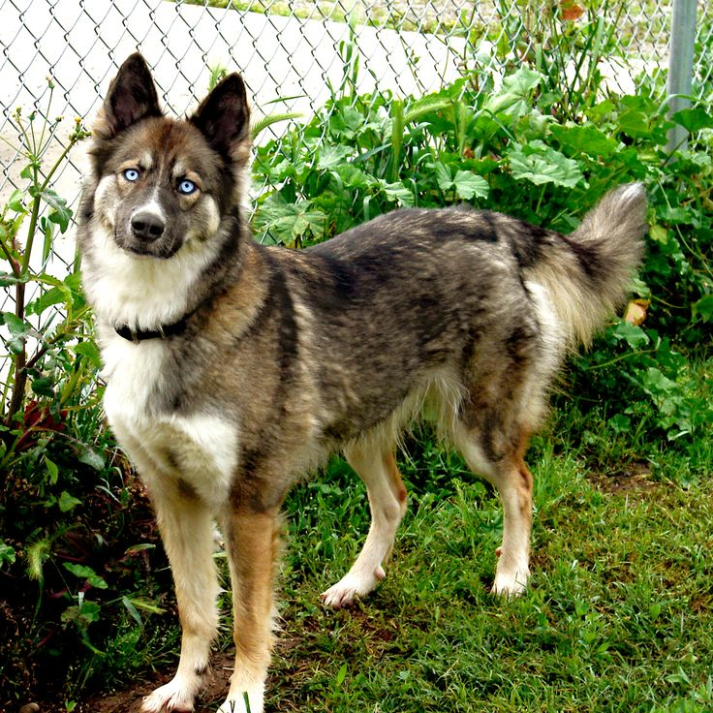
Models of canine hypertension
Penn Hypertensive Dogs (PHD)
5 year old GSD Labrador cross dog
Siberian Husky bitch
ARM
Notes:
First dog-bleeding in the eyes, retinal detachment, BP 275/160, but no evidence of other dz (Penn), apparently sodium sensitive blood pressure
Long term observation in this dog were fragmentation of the aortic internal elastic lamina, hypertrophy and hyperplasia of the intramural coronary arteries, subendothelial and fibromuscular proliferation and fragmentation of the renal arterial internal elastic lamina, moderate glomerular tuft atrophy, absence of atherosclerosis.
First bitch-similar conditions (Michigan)
These two mated and seven puppies produced. Husky type. Some had hypertension, some borderline hypertension and some normtension (cut off 160/90 mmHg). Further inbreeding between pups and parents led to genesis of the Penn Hypertensive Dog, a dog model of spontaneous hypertension.
Dogs have normal plasma biochemistry, hormone and renal function, some are salt sensitive.
No correlation between blood pressure and renin, angiotensin or catecholamine levels.
Direct BP msts-trained to accept, considered hypertensive of BP > 160mmHg systolic and 110mmHg MAP
Clinical signs not seen until dog is five years old or older-then see retinal changes
Longitudinal studies suggest that the canine vasculature is resistant to the effects of hypertension and hypertension does not appear to cause changes in left ventricular structure and function.
High pressure dogs have more labile pressure in this group.

Slide 18
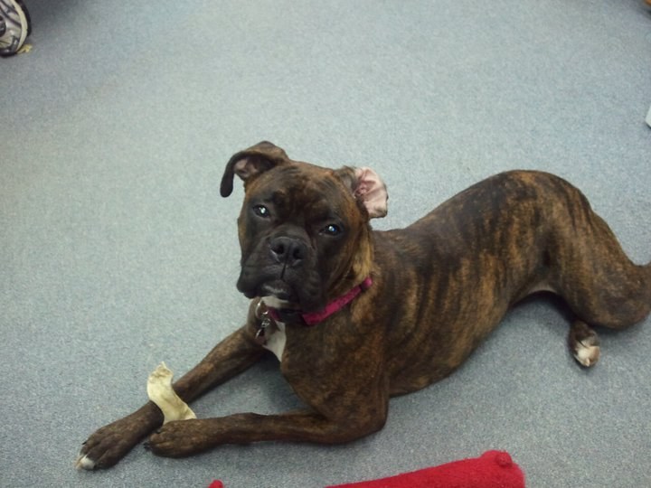
Secondary hypertension in dogs
Chronic kidney disease
Acute kidney disease
Epidemiological study
BP CKD > normal by 10/8 (10) mmHg
Notes:
Epidemiological study
Normals average BP 131/74 (97) HR 110 1267 animals average 4.4 yrs old
CKD average BP 141/83 (107) HR 123 63 animals average 7.2 yrs old
Dotty Sargeant-congenital nephropathy and hypertension

Slide 19
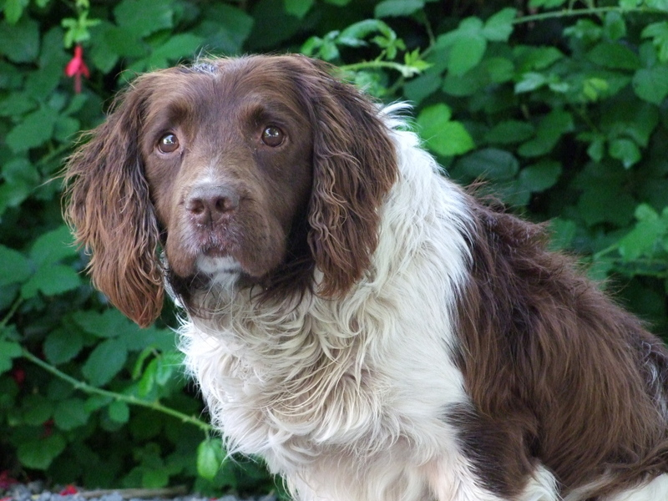
Secondary hypertension in dogs
Hyperadrenocorticism
    Native
    Iatrogenic
Notes:
Older springer bitch presented for primary vaccination course, seemed well and no consistent history of hyperadrenocorticism

Slide 20
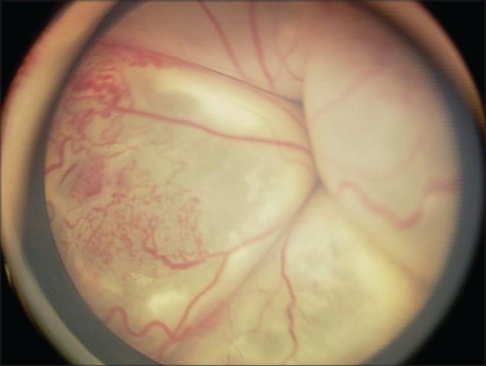
Secondary hypertension in dogs
Epidemiological study
BP hyperadrenocorticism > normal by
25/18 (20) mmHg
Notes:
Presented next week acutely blind-I had not looked at the ocular fundi the week before, there were no consistent signs, but on presentation this time she was polydipsic, polyphagic and had bilateral total bullous retinal detachment, bloods were consistent with hyperadrenocorticism ? Hypertension
Epidemiological study
Normals average BP 131/74 (97) HR 110 1267 animals average 4.4 yrs old
Hyperadrenocorticism average BP 156/92 (117) HR 127 21 animals average age 9.7 yrs old

Slide 21
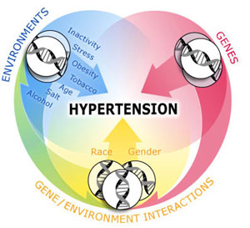
Secondary hypertension in dogs
Diabetes mellitus 12/8 (9)
Obesity
Hyperaldosteronism
Phaeochromocytoma
Hypothyroidism 12/12 (12)
Notes:
Epidemiological study
Normals average BP 131/74 (97) HR 110 1267 animals average 4.4 yrs old
CKD average BP 141/83 (107) HR 123 63 animals average 7.2 yrs old
DM average BP 143/82 (106) HR120 31 animals average 10.3 yrs old
Hypothyroid average BP 143/86 (109) HR 114 27 animals average 9.3 yrs old
Hyperadrenocorticism average BP 156/92 (117) HR 127 21 animals average age 9.7 yrs old

Slide 22

Idiopathic hypertension in dogs
Systolic hypertension
Diastolic hypertension
Notes:
NB issues around measurement, especially indirectly, may give misleading results on this
Doppler does not measure systolic pressure well
Systolic pressure is very labile dt effects of sympathetic nervous system

Slide 23
Target organ damage
Kidney
Ocular lesions
Hypertensive encephalopathy
Cardiac changes
Epistaxis
Notes:
Kidney-reduced renal function, proteinuria, microalbuminuria in people
Proteinuria directly related extent of increase in BP and rate of decrease of GFR in exptal study in dogs
Rx antihypertensives in animals leads to reduction in proteinuria
Ocular lesions-exudative retinal detachment, retinal haemorrhage, multifocal retinal oedema, retinal vessel tortuosity, retinal perivascular oedema, papilloedema, vitreal haemorrhage, hyphaema, secondary glaucoma, retinal degeneration.
Lesions greater at higher BP but NB individual susceptibility
Hypertensive encephalopathy-white matter oedema and vascular lesions>lethargy, seizures (Whippets??), acute onset of altered mentation, altered behaviour, disorientation, balance disturbances (vestibular syndrome), focal neurological deficit (stroke)
Cardiac changes-murmur, gallop, LVH

Slide 24
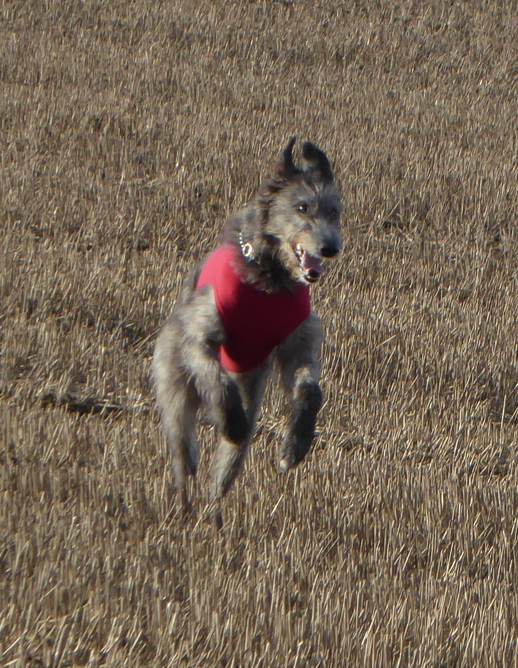
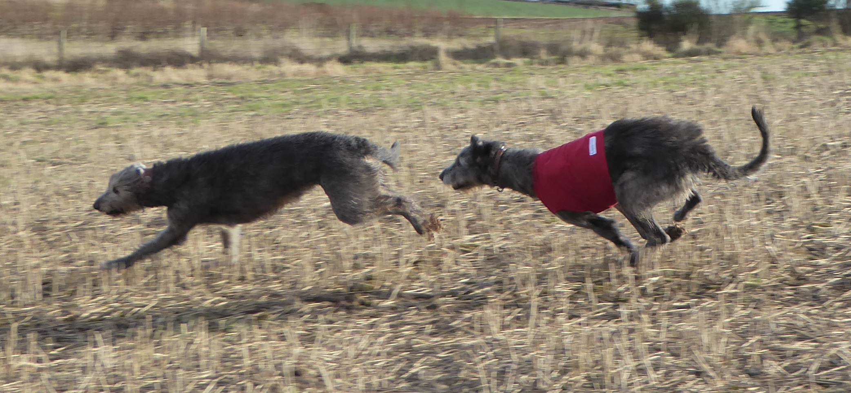
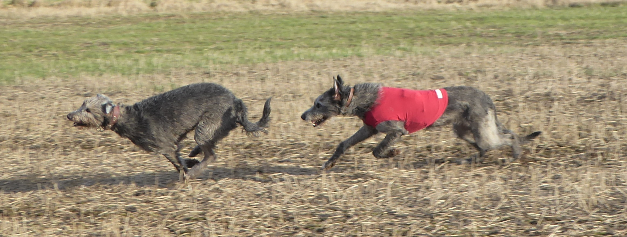
Sighthounds
Canine athletes
Does higher diastolic pressure allow adequate coronary perfusion despite higher left ventricular muscle mass?
Are there other cardiovascular benefits?
Higher angiotensinogen in Deerhounds whose parents had higher pressures

Slide 25
Conclusions
Blood pressure measurement in dogs requires repeatable technique, carried out with understanding of the measurements’ precision and accuracy
Population data show that there are age and breed differences in blood pressure
Secondary hypertension occurs in dogs suffering from those conditions it is associated with in other species
Dogs are resistant to the development of idiopathic hypertension, and when it does arise, they are resistant to its effects

Slide 26





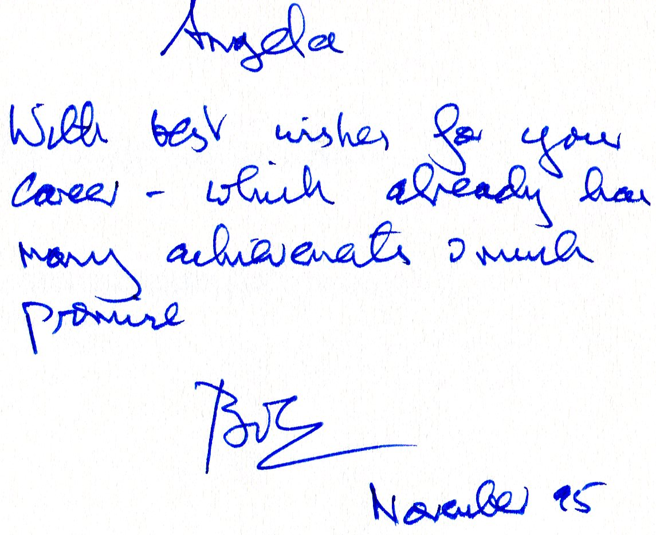
Thank you for you attention

