Slide 1
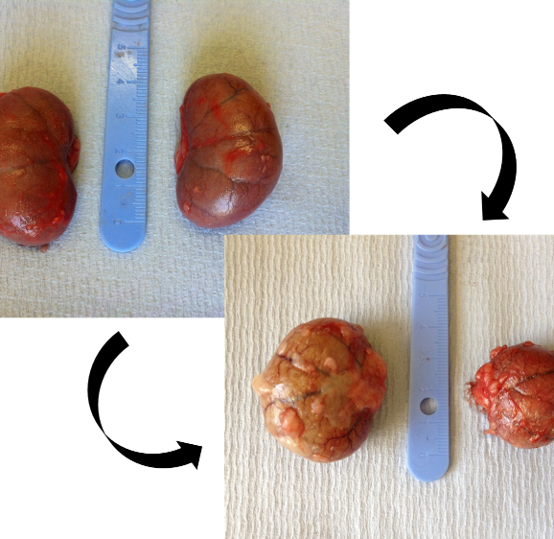
Feline kidney disease – early diagnosis
Bob Michell Symposium 2017
Harriet Syme
BSc BVetMed PhD FHEA MRCVS DipACVIM DipECVIM-ca
Notes:
Feline kidney disease – research at the RVC to achieve early diagnosis
30 minutes

Slide 2



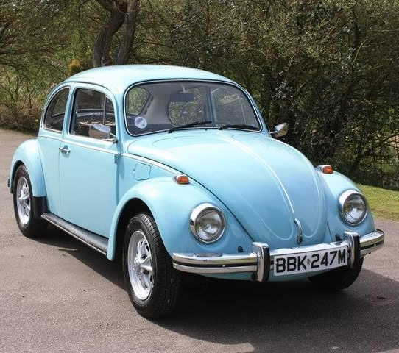
“Bob”
Physiology lecturer
Tutor

Slide 3
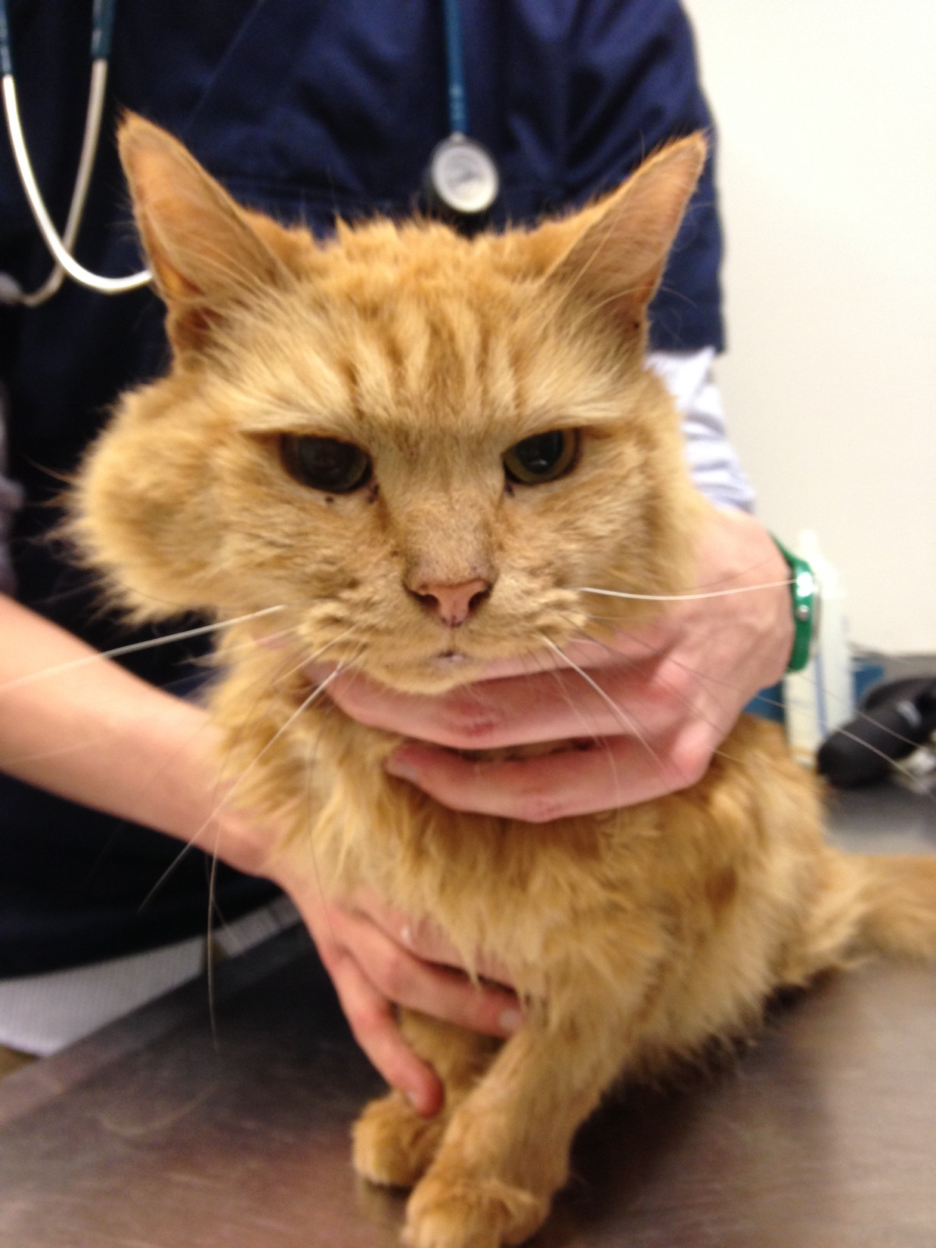
Feline Kidney Disease
8 million cats in the UK (18% households)
  2017 PFMA data
Renal disease most common cause of death in cats >5 y
  O’Neill (2015) JFMS 17:125-33
Prevalence estimates:
  3.6% all cats
  O’Neill (2014) Vet J 202: 286-91
  28% of cats >12 y
  Bartlett (2010) Prev Vet Med 94: 264-71
Notes:
Lawler – suggested CKD was a mortality antagonist - survival-driven adaptive process of progressive nephronloss resulting in decreased energy expenditure
Vetcompass data from participating primary care practices
Fibrosis is a normal sequel of injury, but in CKD the normal wound healing response fails to terminate
The expansion of the extra-cellular matrix (ECM) gradually destroys normal tissue structure
Histopath: Severe cortical interstitial fibrosis and inflammation. Periodic acid-Schiff
and hematoxylin.
118,016 cats attending 90 practices in England, 4009 cats with confirmed deaths were randomly selected for detailed study

Slide 4
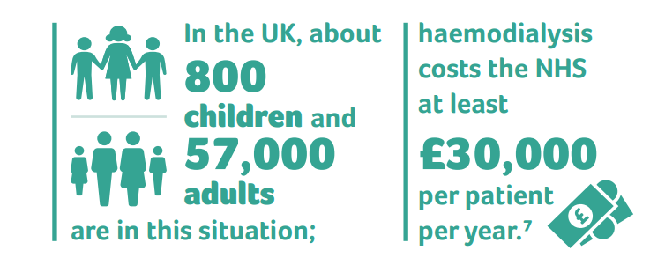
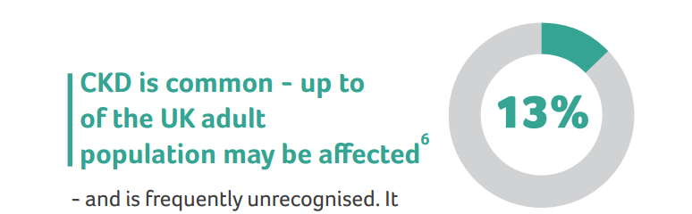
Comparative Medicine
⁶ https://catalogue.ic.nhs.uk/publications/public-health/surveys/
heal-surv-heal-life-eng-2009/heal-surv-heal-life-eng-2009-rep-v2.pdf
⁷ https://www.england.nhs.uk/wp-content/uploads/2014/04/
a07-renal-transpl-ad-0414.pdf
Notes:
Taken from UK renal research strategy
Chronic kidney disease (CKD) is the term conventionally applied to abnormalities of kidney structure or function that are present for more than three months and have implications for health.
frequently unrecognised.
It commonly co-exists with diabetes and cardiovascular disease.
A small but important minority of people with CKD will progress to 'end stage kidney disease', where regular dialysis treatment or kidney transplantation are needed to sustain life.

Slide 5
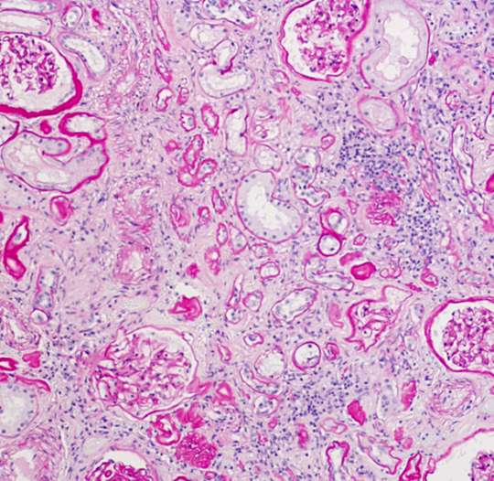
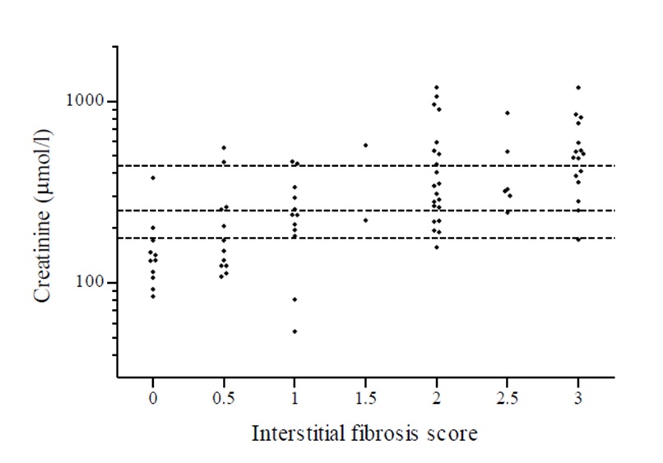
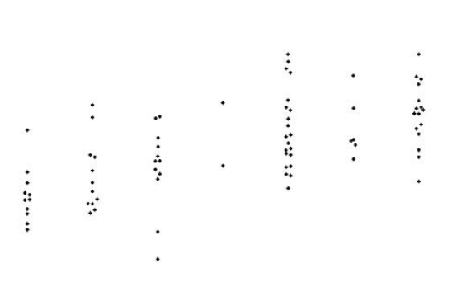
Need for ‘Early’ Diagnosis
Identifiable underlying cause in only 18% of the azotaemic cats
    Chakrabarti (2013) Vet Path 50: 147-55
Notes:
Previous studies have suggested 1/3 to ½ of catswith ckd have underlying identifiable cause
Only 1 cat with primary glomerular disease
Lesions are predominantly tubule-interstitial
80 cats, 20 non-azo and 60 with variable severity of azotaemia

Slide 6
Approaches to Early Diagnosis
Better estimates of GFR
Alternative biomarkers of injury/dysfunction
Hypothesis-free search for biomarkers (-omics)
Identify underlying aetiological factors
Pathophysiology of declining renal function

Slide 7
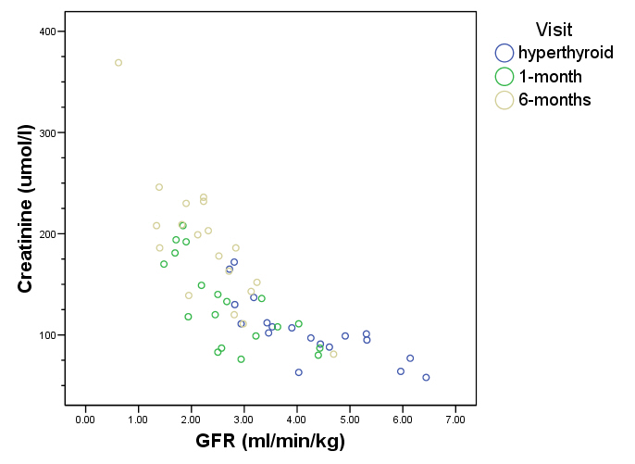
GFR
1/[creatinine]
GFR
Notes:
¾-7/8 nephrectomy creatinine increases to 1.5-2.0x baseline, sometimes out of RR

Slide 8

Limitations of Traditional Estimates
Poor sensitivity of creatinine
  ¾ to ⅞ ^{ths} nephrectomy
    1.5 – 2.0 x baseline
  11/12 ^{ths} nephrectomy
    3.5 mg/dl [310 µmol/l]
Will other estimates perform better?
Mathur (2004) AJVR 65: 1006-13
 | Control (n=7) | Remnant (n=7) | Change | P
GFR | 3.55 ± 0.35 | 1.51 ± 0.25 | -57% | <0.05
Creat (mg/dl) | 1.40 ± 0.04 | 2.35 ± 0.14 | +68% | <0.05
[µmol/l] | [124 ± 4] | [201 ± 12]
Notes:
May remain within reference range (following ¾ to 7/8ths nephrectomy)

Slide 9
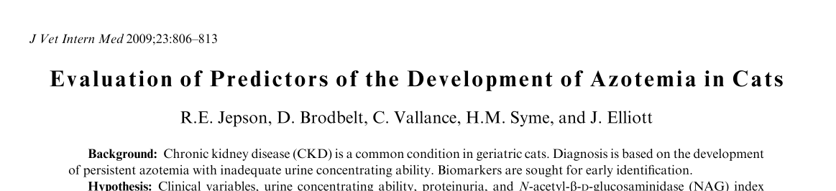
Prospective longitudinal cohort study
Non-azotaemic, healthy cats, >9 years
Followed every 6 months until death, azotaemia or study end point
Multivariable logistic regression to predict development of azotaemia within one year

Slide 10
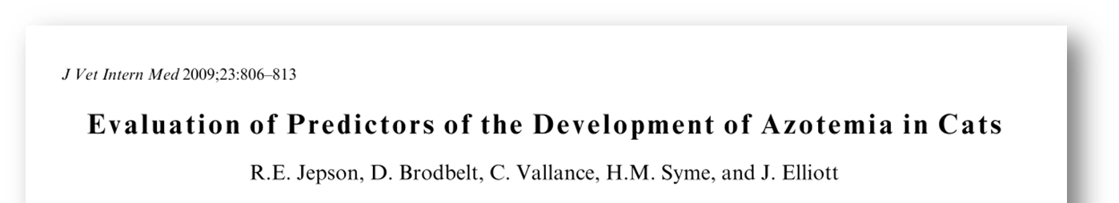
118 cats recruited
    9.3% died or euthanized
    9.3% lost to follow up
    30% developed azotaemia by 12 months
Parameter | Non-azotaemic | Azotaemic | Sig (p)
Urea (mmol/l) | 10.2 [9.1, 11.6] | 12.2 [10.7, 15.7] | <0.001
Creatinine (µmol/l) | 134 [115, 151] | 153 [139, 167] | 0.001
UA/C | 10.7 [6.6, 29.5] | 34.1 [15.1, 72.0] | 0.002
UP/C | 0.14 [0.11, 0.20] | 0.19 [0.14, 0.39] | 0.004
Age (years) | 12.6 [11.0, 14.0] | 14.6 [12.2, 15.1] | 0.023
USG | 1.050 [1.032, 1.060] | 1.042 [1.023, 1.051] | 0.043
NAG index | 0.85 [0.35, 1.35] | 1.40 [0.74, 2.39] | 0.05
Notes:
29 azo, 66 non-azo cats
Also evaluated other parameters such as SBP and PO4, K which were not different between groups
predominately found within the lysosomes of the proximal tubular cells and plays an integral role in the tubular processing of protein. NAG previously has been evaluated in small groups of healthy cats and in those with various types of urinary tract disease.18,19 It also has been evaluated as a biomarker for the development ofazotemia in hyperthyroid cats treated with methimazole
(N-acetyl-b-D-glucosaminidase [NAG])
In total we recruited 118 initially healthy non-azotemic geriatric cats and followed them longitudinally to the 12 month time point.
Of these approximately 10% died or were euthanised for reasons unrelated to renal disease, a further 10 % were lost to follow up and 30% developed azotemia by 12 months.
The table on this slide highlights those variables in the univariate analysis that reached statistical significance nd were predictive at recruitment of the future development of azotemia at 12 months.

Slide 11
Parameter | Non-azotaemic | Azotaemic | Sig (p)
Urea (mmol/l) | 10.2 [9.1, 11.6] | 12.2 [10.7, 15.7]
Creatinine (µmol/l) | 134 [115, 151] | 153 [139, 167] | 0.004
UA/C | 10.7 [6.6, 29.5] | 34.1 [15.1, 72.0]
UP/C | 0.14 [0.11, 0.20] | 0.19 [0.14, 0.39] | 0.004
Age (years) | 12.6 [11.0, 14.0] | 14.6 [12.2, 15.1]
USG | 1.050 [1.032, 1.060] | 1.042 [1.023, 1.051]
NAG index | 0.85 [0.35, 1.35] | 1.40 [0.74, 2.39]

Slide 12
Tubular Markers
Enzymes
N-acetyl-b-D-glucosaminidase (NAG)
γ-glutamyl-transferase (GGT)
Cauxin
Low Molecular weight proteins
Retinol binding protein
Beta-2-microglobulin
Markers of AKI
Neutrophil gelatinase-associated lipocalin (N-Gal)
Kidney injury model-1 (KIM-1)
Notes:
Cauxin, this is a 70KDa carboxylesterase enzyme which colocalises with megalin and cubulin in PTC and is secreted into the urine. It is feline specific and involved in the production of the pheromone Felinine and hence is found in particularly high concentrations in entire male cats.

Slide 13
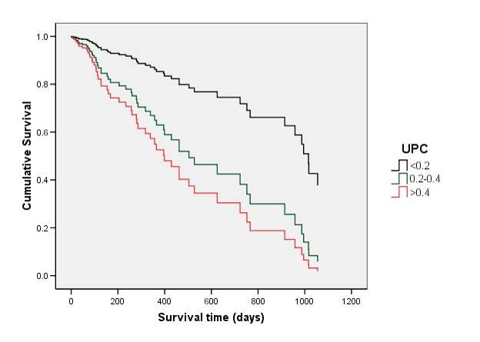
UPC Survival

Slide 14
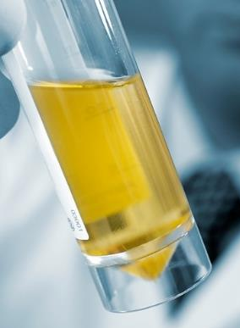
Proteomics
Study of protein expression within a tissue or body fluid
Urinary proteome is a global assessment of pattern of peptides and proteins
May reflect health, disease and change in function
Easily obtainable substrate
    ‘fluid biopsy’ of the kidney
Notes:
And with this in mind we ventured into the world of proteomics…..
Proteomics is the study of protein expression within either a tissue or a body fluid. As such the urinary proteome is a global assessment of the pattern of peptides and proteins occurring within urine. Such a protein pattern could reflect the health or change in function of the kidney. Urine is an easily obtainable substrate which as been suggested to represent a fluid biopsy of the kidney. Comparison of the urinary proteome may therefore allow differentiation between health and disease.

Slide 15
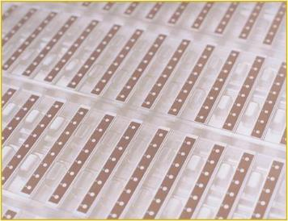
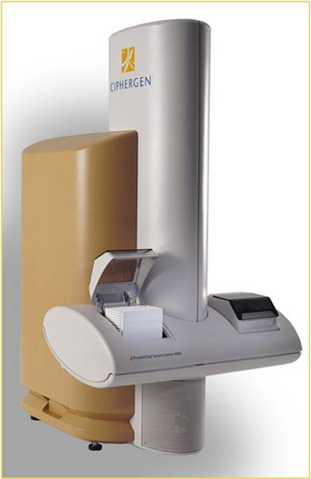

SELDI-TOF-MS
Surface Enhanced Laser Desorption Ionization Time-of-Flight Mass Spectrometry
High throughput
Highly sensitive
Advantageous for assessment of clinical samples
Utilises protein chip arrays coupled to a time-of-flight mass spectrometer
Notes:
Many techniques have been utilised to assess the urinary proteome in humans but the technique that we evaluated is referred to as surface enhanced laser desorption ionisation mass spectrometry or SELDI for short.
This is a high throughput and highly sensitive technique for isolation of proteins or peptides within biological substrates.
It has the major advantage that it allows assessment of large numbers of samples simultaneously and is therefore useful for clinical based research.
It utilises protein chip arrays as in the photograph coupled to a time of flight mass spectrometer.

Slide 16
SELDI-TOF-MS
Intensity
Mass to charge ratio (m/z)
Notes:
After processing samples with SELDI – the output data is a series of spectra
On this slide there are example spectra – with intensity on the y axis and mass to charge ratio on the x axis. Each row represents a single urine sample from a single cat and you can see that each sample contains a complex pattern of peaks that represent a peptide pattern.

Slide 17
Urinary proteomics
Intensity
Non-azotaemic Cat 1
Non-azotaemic Cat 2
Non-azotaemic Cat 3
Azotaemic Cat 1
Azotaemic Cat 2
Azotaemic Cat 3
Mass to charge ratio (m/z)
Notes:
We evaluated urine samples from non-azotemic cats at entry to the prospective study that had been monitored for 12 months so that we knew whether they had developed azotemia within a 12 month period.
So this pilot study suggests that there are peptides and proteins that can be delineated in feline urine that predict the future development of azotemia and suggest that SELDI-TOF-MS may be a useful biomarker discovery tool for veterinary medicine. However, there are a number of limitations with this technique and ultimately it may be that the pattern of peptides is more informative than individual peptides of protein.
On this slide the top three spectra represent urine samples taken from entry to the prospective study. These cats were followed longitudinally and were still non-azotemic at 12 months.
Conversely the three bottom spectra represent urine samples that were taken at entry to the prospective study but these cats were documented to be azotemic a year later.
WE can clearly see that there are some peptides present in those cats that went on to be azotemic a year later that were no present in those cats that were non-azotemic.
These peptides with molecular weight around 10,000 da represent potential biomarkers for the development of azotemia.

Slide 18
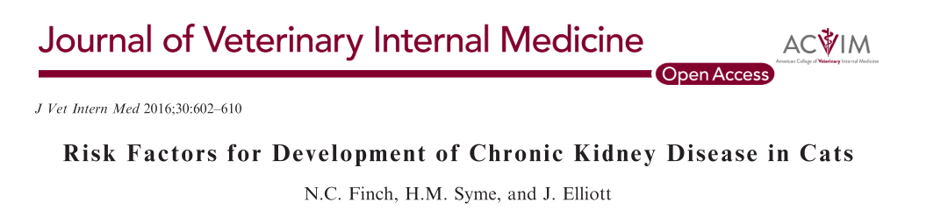
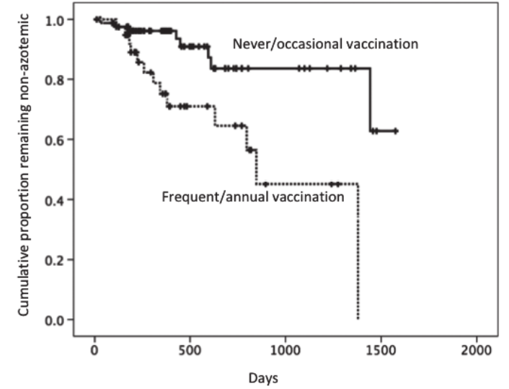

Slide 19
Approaches to Early Diagnosis
Better estimates of GFR
Alternative biomarkers of injury/dysfunction
Hypothesis-free search for biomarkers (-omics)
Identify underlying aetiological factors
Pathophysiology of declining renal function

Slide 20
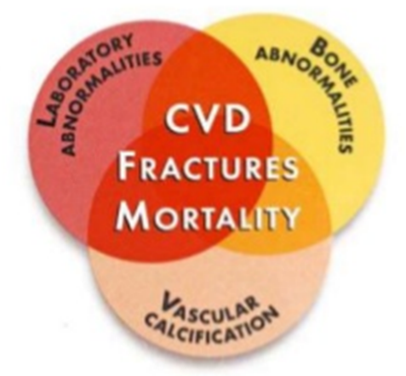
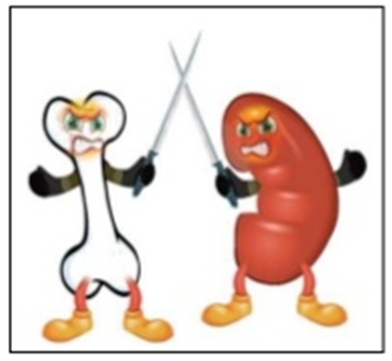
CKD – Mineral Bone Disorder
Term introduced by the KDIGO foundation (human medicine):
A systemic disorder of mineral and bone metabolism manifested by either one or a combination of the following:
Abnormalities of calcium, phosphorus, PTH or vitamin D metabolism
Abnormalities in bone turnover, mineralization, volume, linear growth, or strength
Vascular or other soft tissue calcification
Notes:
In humans with CKD, especially those receiving dialysis there is an increased rate of fractures and bone pain is a significant component of their CKD-related morbidity.
“Kidney Disease: Improving Global Outcomes” (KDIGO) foundation introduced the term “chronic kidney disease - mineral and bone disorders” (CKD-MBD), in the attempt to bring together alterations in mineral metabolism markers, renal osteodystrophy (ROD) and vascular or other soft tissue calcifications (VC).

Slide 21
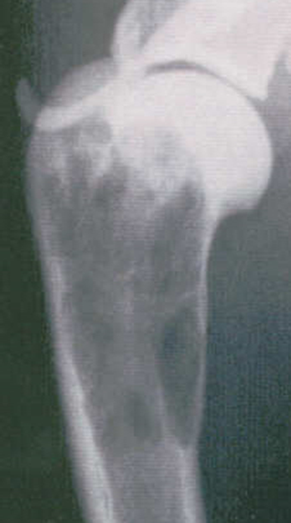
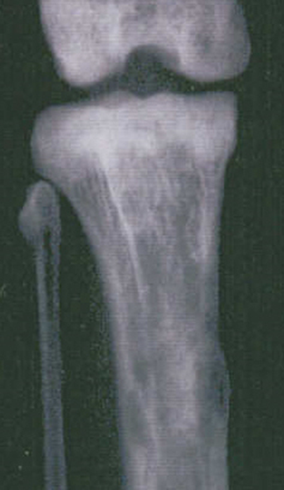
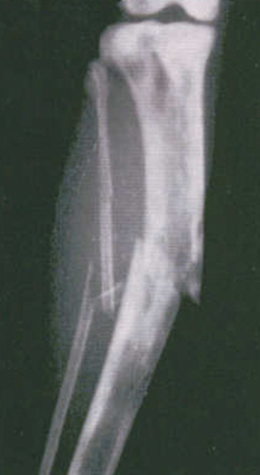
Not in our patients?
Or infrequently appreciated clinically
Images: Penney Barber

Slide 22
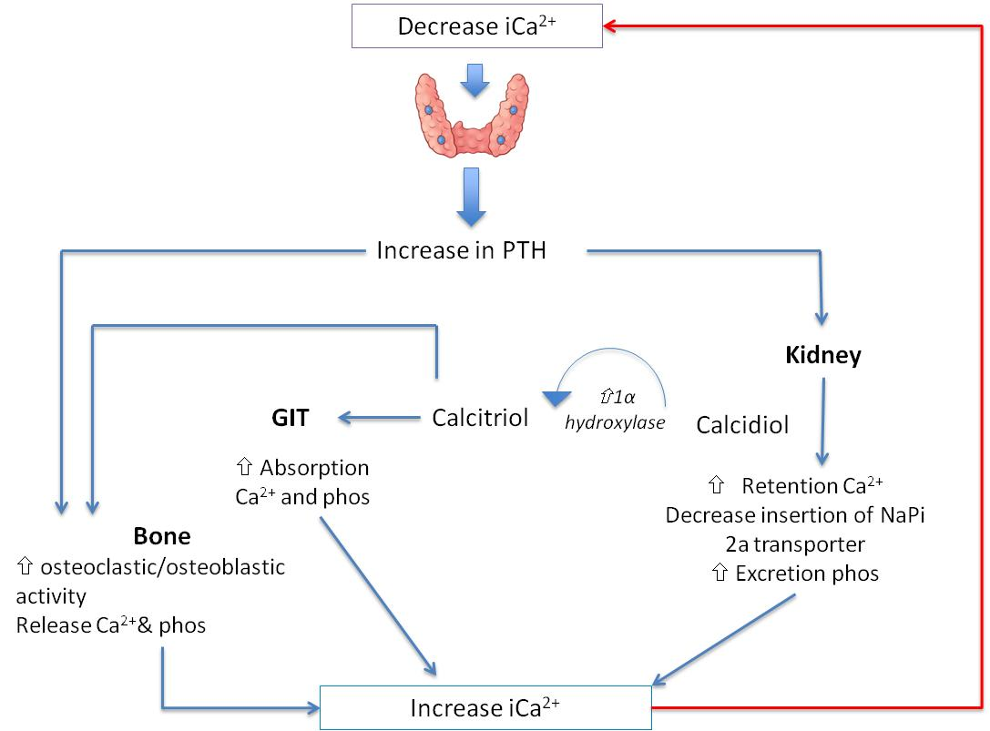
Notes:
So just as a refresher on calcium and phosphorus regulation – we know that any decrease in free or ionised calcium is sensed by the parathyroid gland – in response to the reduction in calcium the parathyroid gland produces Parathyroid hormone. PTH has a number of important actions.
It acts on bone to increase osteoclastic and osteoblastic activity resulting in the release of calcium and also phosphorus.
It also acts on the kidney and here it has a couple of roles. It increases the conversion of calcidiol (inactive vitamin D) via 1 alpha hydroxylase to active calcitriol. Calcitriol has the knock on effect within the GITract of increaseing the absoprion of both calcium andphosphorus. Cacitriol also acts synergistically at bone to increase ostoclastic and osteoblastic activity.
PTH in the kidney also increases retention of calcium preventing calcium wastage in the urine and at the same time decreases the insertion of the sodium phosphate transporter – increasing excretion of phosphorus.
All of these mechanisms are focussed on increasing free calcium which completes this negative feedback loop – normalising body calcium.

Slide 23
FGF-23
251 amino acid polypeptide hormone (glycosylated)
  low molecular weight (32 kDa), freely filtered at the glomerulus
Secreted by osteocytes and osteoblasts
Stimulus for secretion – thought to be through a mechanism that senses phosphate but not characterised. Proposed could be:
  Intestinal phosphate absorption
  Filtered load of phosphate per nephron
  Emerging paradigm – needs to be a permissive threshold of ionised calcium
  Vitamin D responsive element on FGF-23 gene – so calcitriol influences FGF-23 secretion

Slide 24
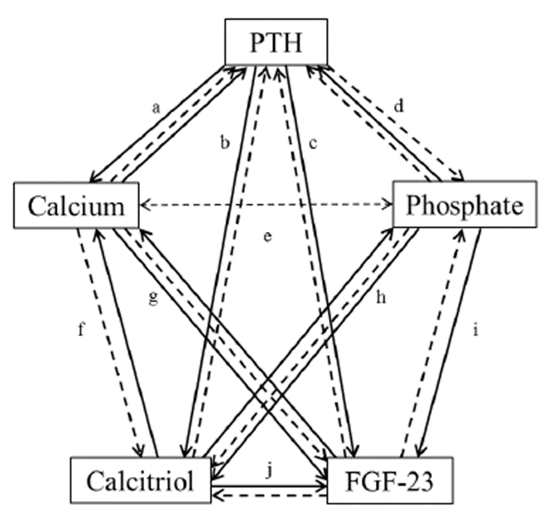
Horribly Complicated!

Slide 25
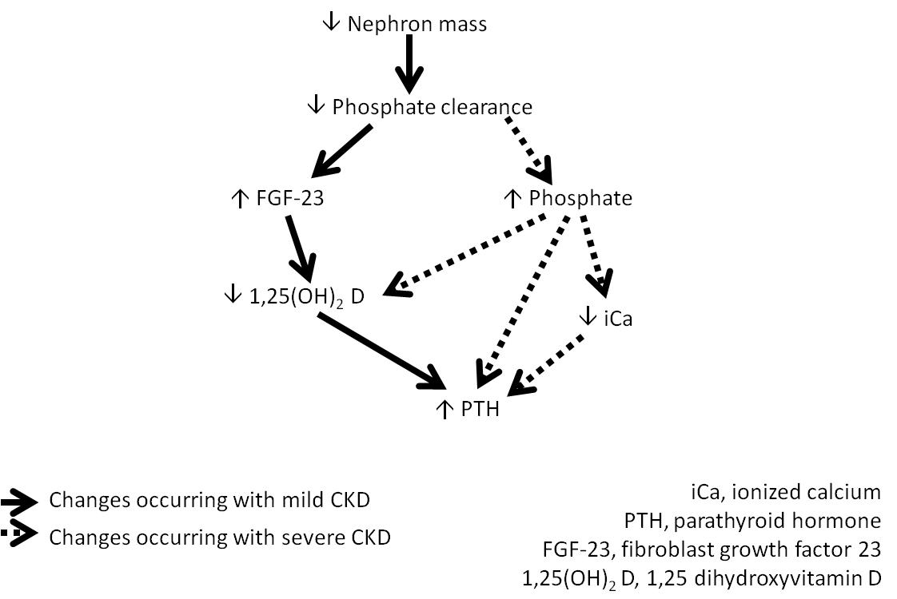
CKD - MBD
↑ Phosphate Clearance
Notes:
PTH, FGF-23 and Vitamin D
The excessive secretion of PTH in patients with CKD is referred to as secondary hyperparathyroidism. Traditionally this has been a focus for monitoring and treatment of patients with CKD since it is correlated with patient morbidity and mortality in humans, and it is presumed in animals. Diets with decreased phosphate content have been shown to decrease severity of hyperparathyroidism and improve survival. However, in human medicine attention has widened in the last decade to encompass changes in the concentrations of other hormones as well as PTH. The preferred term is now CKD – mineral and bone disorder (MBD); this is defined as a systemic disorder of mineral and bone metabolism manifested by either one or a combination of the following:
Abnormalities of calcium, phosphorus, PTH or vitamin D metabolism
Abnormalities in bone turnover, mineralization, volume, linear growth, or strength
Vascular or other soft tissue calcification
The relative importance of the various humoral factors that are responsible for CKD – MBD varies according to the stage of the disease. In the earliest stages of CKD, even when the patient is non-azotaemic, FGF-23 secretion by osteoblasts and osteocytes is increased in response to decreased renal clearance of phosphate. FGF-23 reversibly inhibits the activity of the enzyme 1α-hydroxylase so reducing the formation of active 1,25-dihydroxyvitamin D (1,25 (OH)₂D, also known as calcitriol). The reduction in 1,25(OH)₂D, in turn, increases secretion of PTH. The actions of both FGF-23 and PTH are to increase phosphate excretion by the kidney by decreasing the number/activity of luminal sodium/phosphate co-transporters in the proximal tubule. PTH also acts to increase mobilisation of calcium and phosphate from bone. In early CKD the actions of FGF-23 and PTH are sufficient to normalise plasma phosphate concentration. As disease progresses, however, reabsorbtion of phosphate by the nephron is at a minimum and further increases in PTH and FGF-23 concentrations cannot decrease this any further. Phosphate excretion becomes entirely dependent on GFR, as this falls further hyperphosphataemia results. In advanced CKD 1α-hydroxylase activity is irreversibly reduced due to the paucity of nephrons, and hyperphosphataemia and ionized hypocalcaemia also directly stimulate the secretion of PTH (Figure 11.5).
Although changes in PTH, 1,25 (OH)₂D and FGF-23 have all been associated with a worse prognosis in human patients with CKD, their inter-related regulatory mechanisms make the contribution of individual factors difficult to dissect. It is also unclear whether interventions to normalise their concentrations will improve patient outcomes. It is not, therefore, routinely recommended that the concentrations of these hormones be measured when managing canine and feline patients with CKD although they are an area of active clinical research and so this situation may change in the future.

Slide 26
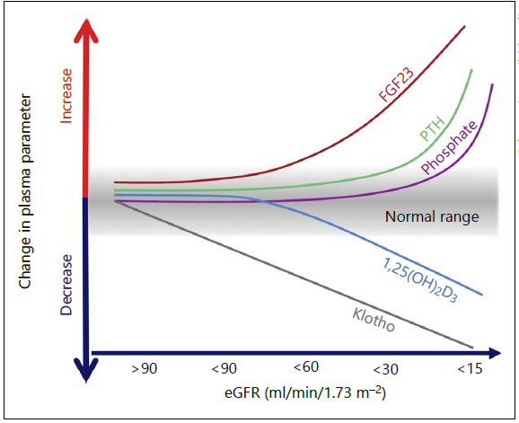
Human CKD
Nitta (2014) Nephron Clinical Practice
Notes:
co-receptor of FGF1R
expressed primarily in the kidney and parathyroid glands
phenotype of klotho deficient mice very similar to that of FGF-23

Slide 27
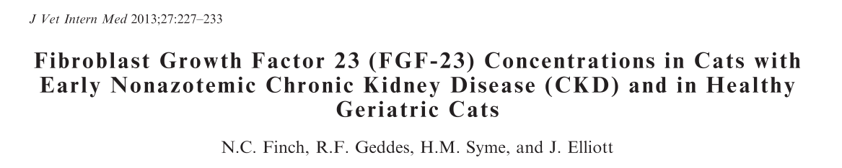
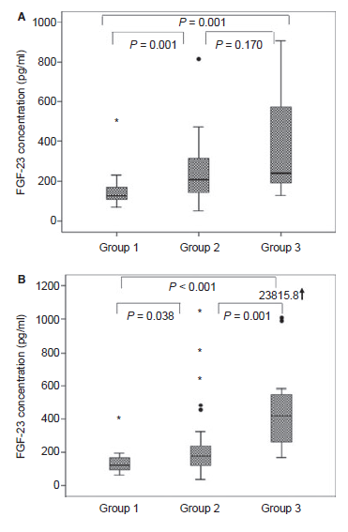
62 non-azotaemic cats
Classified by creatinine (µmol/l) after 12-months
  < 140 (n=15)
  140-177 (n=33)
  > 177 (n=14)
Notes:
Also differences between groups at 12 months
In this study PTH was not different between the groups – although it had been in a larger study with a different assay
Moderate positive correlation with PTH and inverse correlation with GFR

Slide 28

‘Catch 22’
If CKD could be detected in its early stages treatment might be more effective
Until effective treatments are identified for management of pre-azotaemic CKD, extensive testing is hard to justify

Slide 29
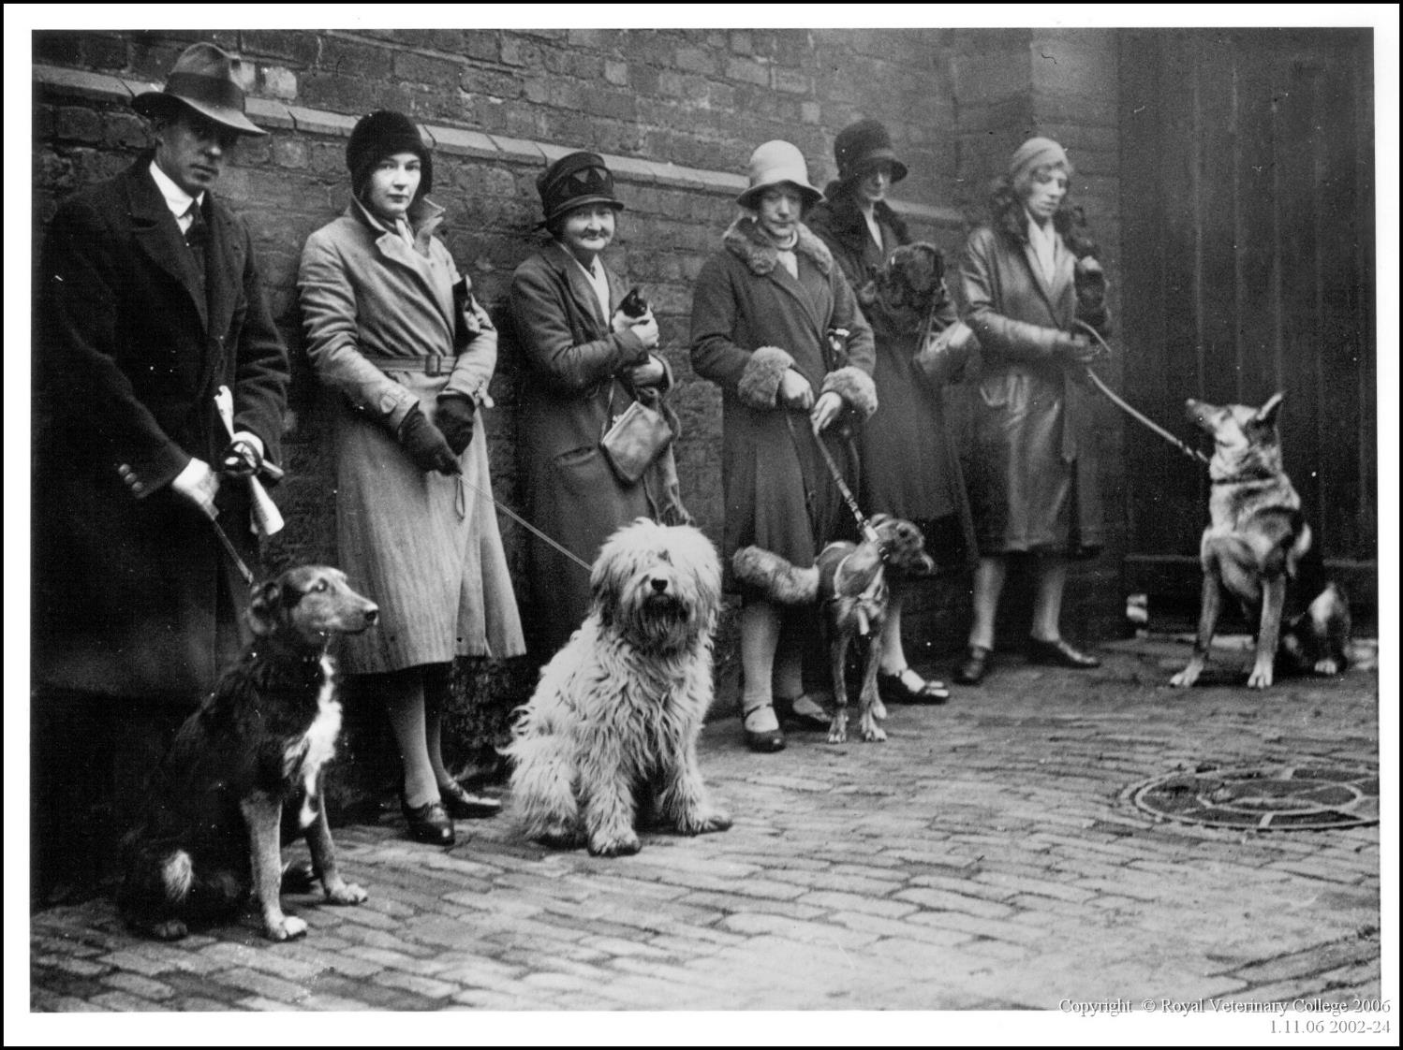
Any
Questions?

Slide 30
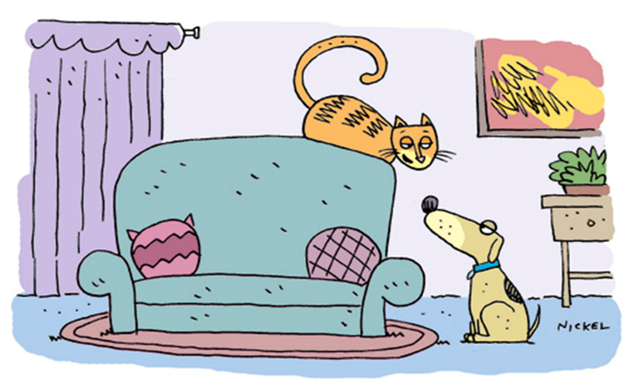

Questions?

Slide 31
FGF-23 and prediction of survival (all cause mortality) and progression
Geddes et al., JVIM 2015; 29:1494–1501
Notes:
Abstract had 91 cats – now 94.
Multivariate analysis showed
FGF-23 to be an independent predictor of mortality in CKD cats (independent of age, UPC, creatinine)
FGF-23 measured at diagnosis, proved to be a significant (P=0.017; OR 3.89 [1.27-11.9] risk factor for progression (whereas plasma phosphate and PTH were not)
FGF23 not the villain though – seems to act to ameliorate damage. If neutralising Ab to FGF23 given to rats this decreases PTH but vascular calcification increases and mortality rapid

Slide 32
FGF-23 in non-azotaemic cats
62 non-azotaemic cats
Finch et al JVIM (2013);27:227–233
Notes:
Explain the groups and what A and B are – same as last slide
FGF-23 significantly increased in group 3 when compared to group 1 at baseline, and significantly higher than groups 1 and 2 at 12months.

Slide 33
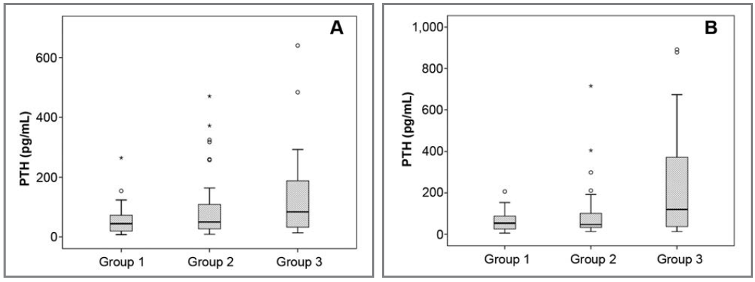
PTH in non-azotaemic cats
*
*
*
High PTH: 0% 7.7% 19.4%
High P: 0% 0% 0%
High PTH: 0% 5.8% 35.5%
High P: 2.9% 0% 16.1%
118 non-azotaemic cats
Finch et al JAVMA (2012);241:1326–1355
Notes:
Explain the groups and what A and B are
PTH significantly increased in group 3 when compared to group 1 at baseline, and significantly higher than groups 1 and 2 at 12months.
Discuss greater percentage of cats with increased PTH than P in all groups.

Slide 34
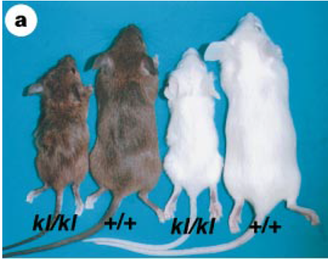
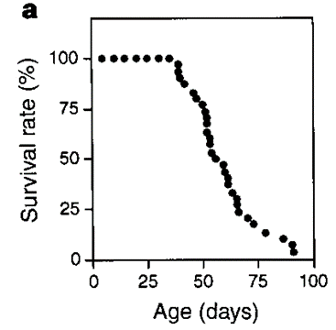

α-Klotho Kuro-o (1997) Nature 390: 45 - 51
co-receptor of FGF1R
expressed primarily in the kidney and parathyroid glands
phenotype of klotho deficient mice very similar to that of FGF-23
Notes:
A lot that is yet to be understood – such as why it is predominantly expressed in the distal tubule when the main physiological action of FGF23 is in the prox tubule
Also unclear what the physiological role of soluble vs membrane bound klotho is

Slide 35
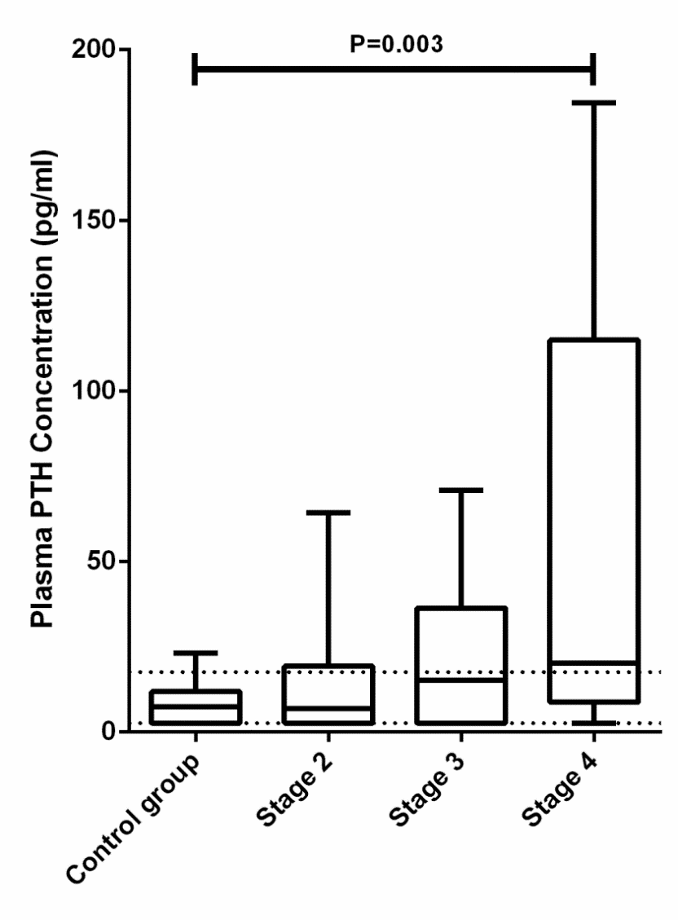
Updated – now including FGF-23
Note the logarithmic scale for FGF-23. PTH increase is more variable and tends to increase later than FGF-23
Geddes et al., (2013)
J Vet Intern Med; 27(2):234-41.
Notes:
Figure 1: Box-and-whisker plot illustrating the median and range of FGF-23 concentrations for each group of cats.
Say this clearly shows that FGF-23 increases as renal function declines.
One thing that is notable is that FGF-23 concentrations in the cats are really high (10x that of humans) – an adaption to a high meat diet or emblematic of the problem?

Slide 36
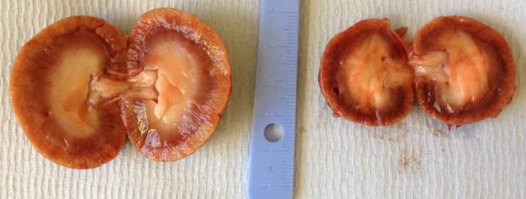
Feline CKD
Prevalence increases with advancing age, affecting
  28% of cats >12 years¹
  31% of cats >15 years old²
Cause often unknown
Survival time without intervention: 233 days³
Bartlett et al., 2010
Lulich et al., 1992
3.Elliott et al., 2000
Notes:
Cause: congenital (PKD, renal amyloidosis) vs. acquired (renal lymphoma, NSAIDs, lily poisoning. urolithiasis? FELV/FIV?)
Progressive: reduction in functional nephron numbers → glomerular hyperfiltration and hypertension → continued deterioration of renal function

Slide 37
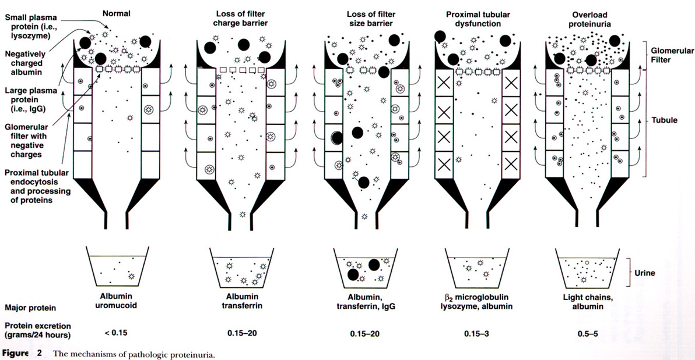
Markers of tubulointerstitial injury
Change in function of tubular cells
Indicate cellular damage
  Proteinuria
    Urine protein to creatinine ratio
    Albuminuria
  Low molecular weight proteins
    Retinol binding protein
    Urine Cystatin C
  Urinary enzymes
    NAG, GGT
    Cauxin
  Renal tubular markers
    Urine NGAL
    Kidney injury molecule 1
Notes:
Markers of tubulointerstitial injury can perhaps best be divided into those that tell us about change in function of the tubular cells such as overall magnitude of proteinuria which we most often measure as urine protein to creatinine ratio although in research urine albumin to creatinine ratios have also been evaluted.
Then we have low molecular weight proteins – such protein should be freely filtered at the glomerulus and then completely reabsorbed by the proximal tubular cells. An ability to detect LMW proteins in the urine therefore indicates alteration in tubular absorptive mechanisms and the key examples that we will look at here are RBP and urine cystatin C
Or alternatively markers that indicate cellular damage – and so for eample here we have urinary enzymes which are often located on the brush border of tubules such as NAG GGT and cauxin or urine NGAL.
Serum based & freely filtered
Imply impaired tubular absorption
Expressed as ratio to urine creatinine
Early tubulointerstitial disease
Retinol binding protein
β₂-microglobulin
α₁-microglobulin

Slide 38
Proteomics:
Proof of concept:
  Peptides/proteins identified that differentiated cats at risk of developing azotemia
  SELDI-TOF-MS may be a useful biomarker discovery tool
Limitations to the technique
Patterns of peptides may prove most informative
Notes:
So this pilot study suggests that there are peptides and proteins that can be delineated in feline urine that predict the future development of azotemia and suggest that SELDI-TOF-MS may be a useful biomarker discovery tool for veterinary medicine. However, there are a number of limitations with this technique and ultimately it may be that the pattern of peptides is more informative than individual peptides of protein.

Slide 39
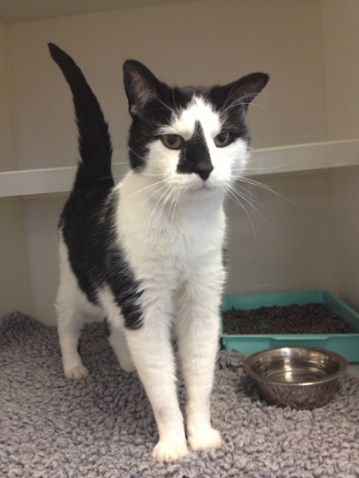
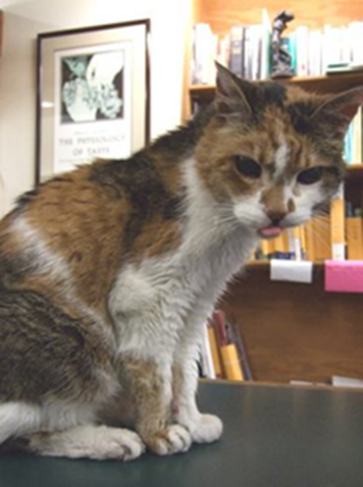
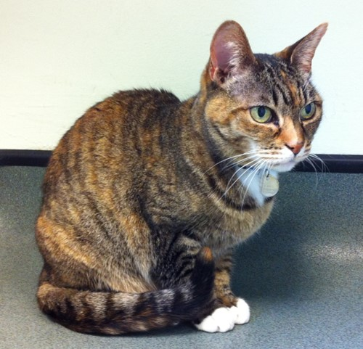
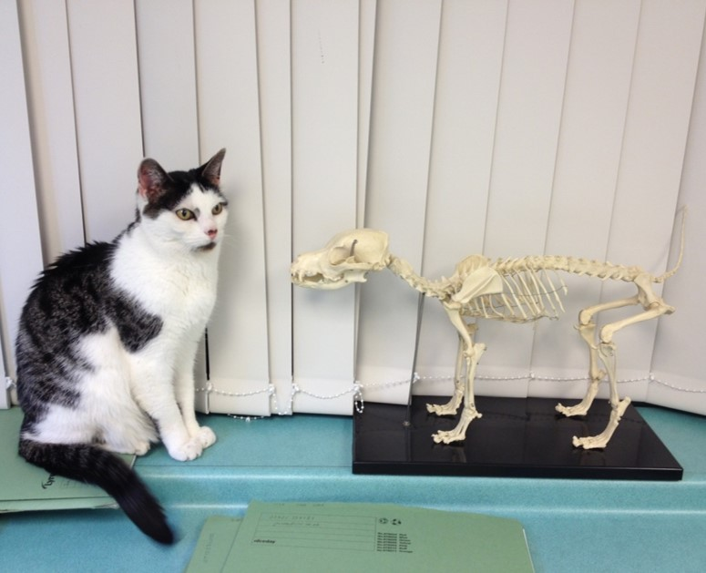

Slide 40
Feline Chronic Kidney Disease:
Pressure, Proteinuria & Proteomics
Rosanne E. Jepson
Notes:
Thank you for the very kind introduction. It is an honour to have been awarded the IRIS prize and to have been invited here today to share with you some of the key findings from the research that I have performed over the past few years.

Slide 41
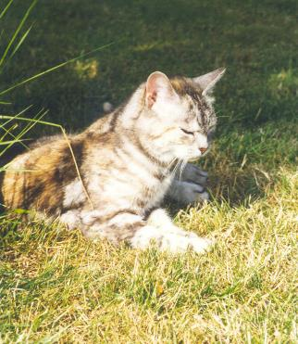
Introduction: Chronic kidney disease
Importance of the kidney
Feline kidney disease
  30% cats >15 years
Significant cause of morbidity and mortality
Lulich et al (1992) Comp Contin Educ Small Anim Prac 14; 127-152
Elliott et al (2000) JSAP 41; 235-242
Notes:
The kidney is a vital organ for excretion of waste and which day in day out provides the homeostatic mechanisms necessary for water and electrolyte balance, maintenance of blood pressure and synthesis of hormones such as erythropoeitin and active vitamin D.
Although there is relatively little data available regarding the prevalence of chronic kidney disease in the feline populpation studies suggest that a large proportion of elderly cats will be affected.
And kidney disease impacts greatly on morbidity and quality of life of geriatric cats and is a leading cause of mortality amongst elderly cats. For example the study by elliott and colleagues suggested that of those cats diagnosed with CKD nearly 60% will ultimately die or be euthanised from issues related to their kidney disease.

Slide 42
Introduction: Renal disease progression
Loss of nephrons
Haemodynamic adaptive processes within kidney
Renal function
Azotemic
Threshold for
progression
Hypertrophy, glomerular hypertension and hyperfiltration
Maintenance of SNGFR
Time
Notes:
In the 1980’s Brenner introduced the theory that after damage or loss of nephrons caused by an initial renal insult, haemoadaptive processes take place within the kidney resulting in hypertrophy, glomerular hypertension and hyperfiltration. These changes during the early stages help to maintain SNGFR. However, this adaptive process is ultimately detrimental to the kidney and can lead to loss of further nephrons.
As shown on the graph on the right hand side, although initially beneficial in trying to maintain renal function, ultimately a threshold is reached after which decline in renal function is a self fullfilling prophecy and progression is inevitable.

Slide 43
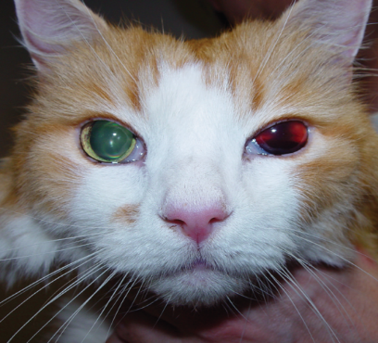
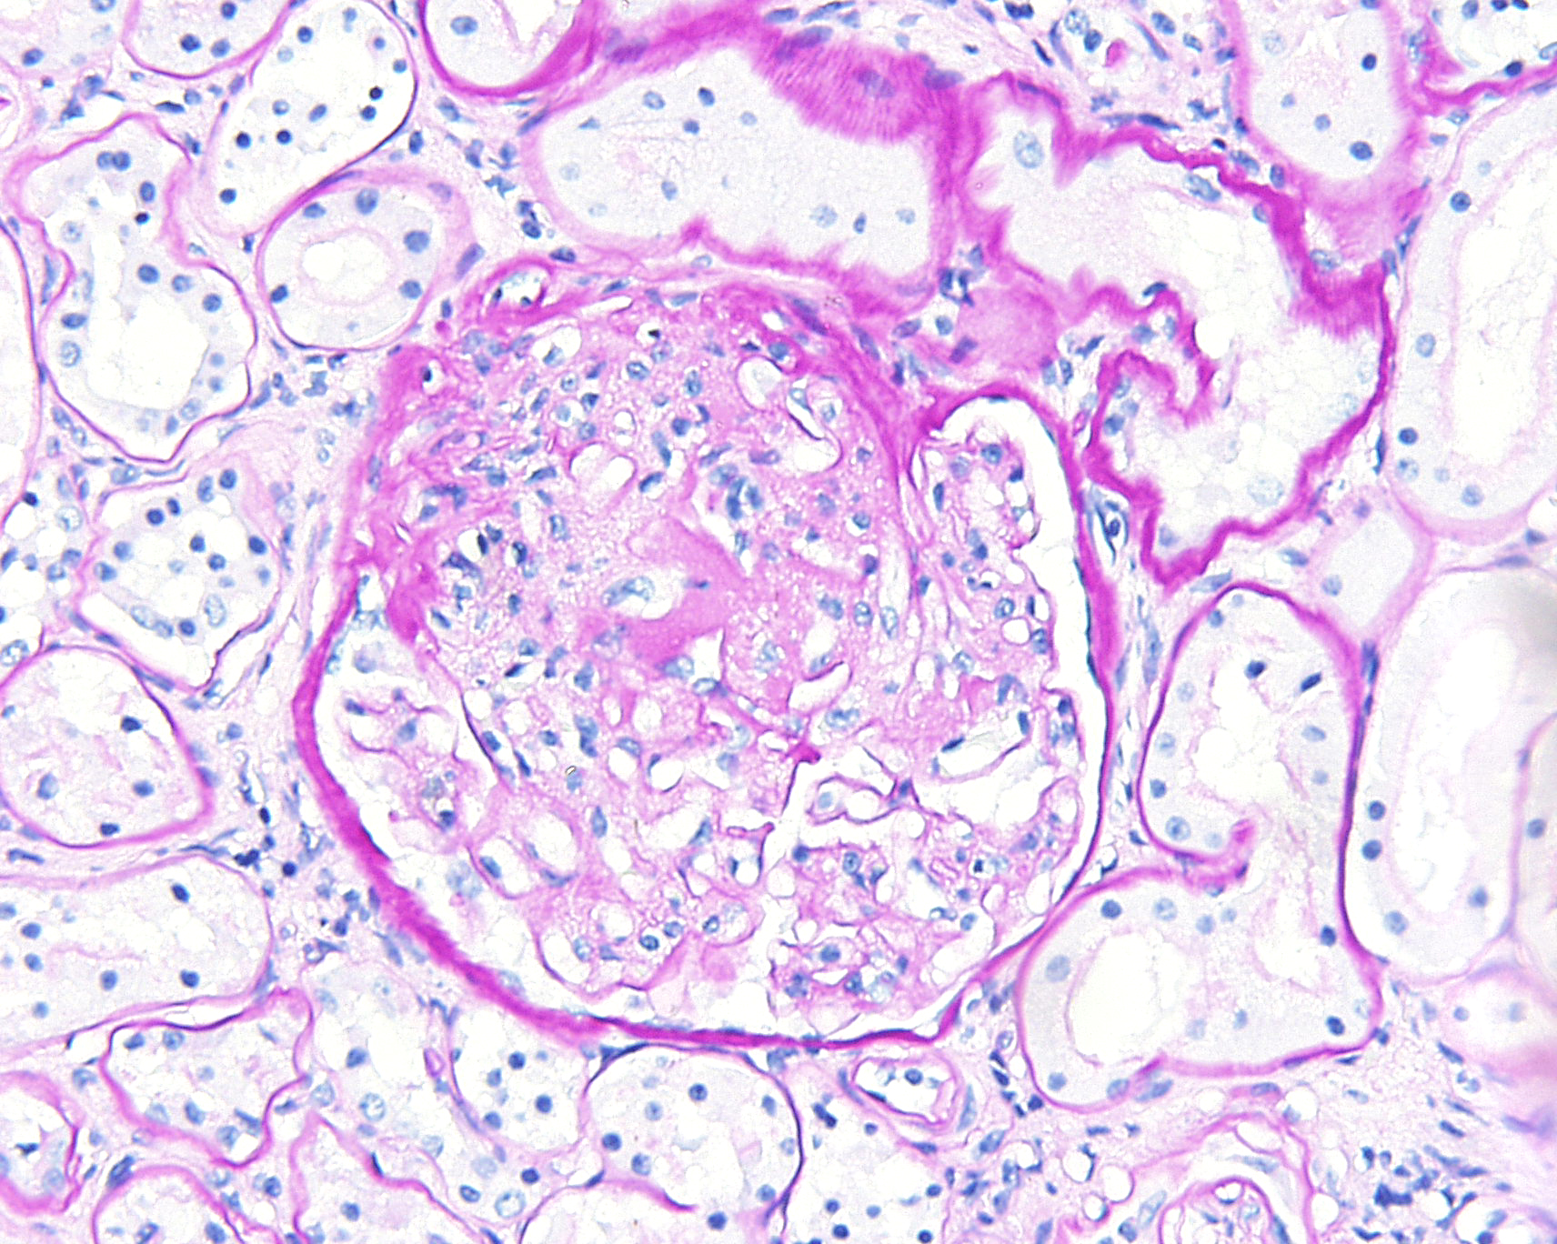
Introduction: Systemic hypertension
Affects between 20-60% cats with CKD
Pathogenesis largely unexplained
Significant impact
  Target organ damage
    Eyes
    Kidneys
    Heart
    Central nervous system
Stiles et al (1994) JAAHA 30; 564-572
Syme et al (2006) JVIM 20; 528-535
Images courtesy of Dr C Brown & Dr D Gould
Notes:
We also know that systemic hypertension is a common phenomenon in the elderly cat population.
Depending on the study population, the technique used for blood pressure assessment and the criteria used for the diagnosis of systemic hypertension somewhere between 20-60% of cats with chronic kidney disease also exhibit systemic hypertension.
The pathogenesis of hypertension in cats with kidney disease is largely unexplained. However, we do know from histopathological studies that target organ damage can be significant. Whilst owners may most frequently appreciate the implications of target organ damage such as hyphaema to the eye, on a microscopic level we can appreciate changes to the kidney, heart and central nervous system.

Slide 44
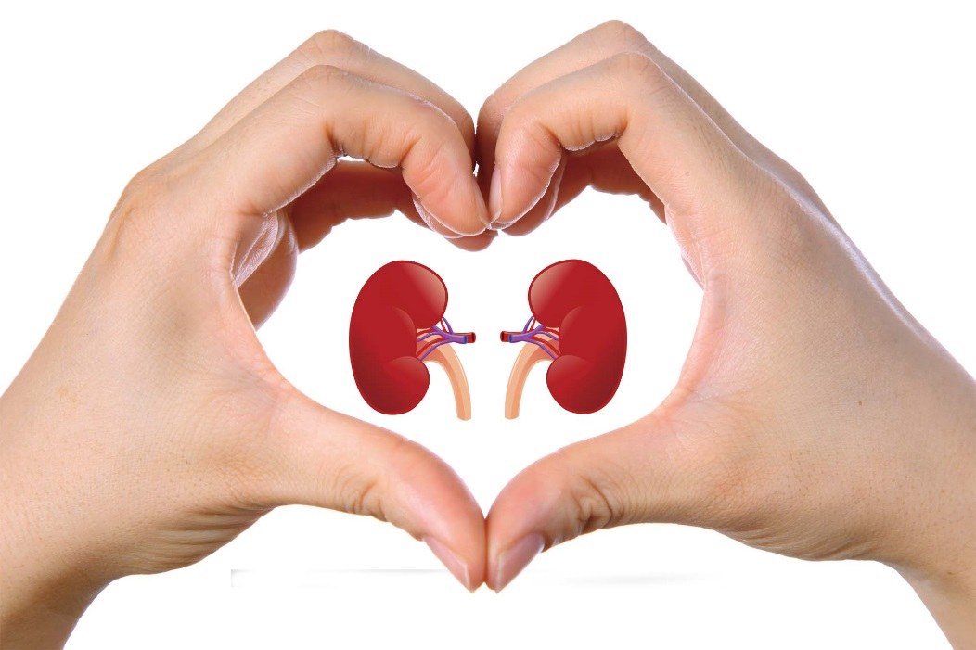
Biomarkers for CKD
#RVC225 still making history
Dr Rosanne E. Jepson
BVSc MVetMed PhD DipACVIM DipECVIM MRCVS

Slide 45
Introduction: Renal proteinuria
Direct damage
  Glomerular
    Predominance of albumin and high molecular weight (HMW) proteins
  Tubular
    Predominance of low molecular weight (LMW) proteins
Inflammatory cytokine release
Notes:
In the normal nephron low molecular weight proteins are filtered at the glomerulus but are almost completely re-absorbed in the proximal tubules via megalin and cubulin mediated mechanisms so that very little protein is present in the urine.
With damage at the level of the glomerulus a larger amount of protein and protein of a higher molecular weight may be filtered. At some point if the magnitude of protein exceeds the tubular resobative capacity then protein will be identified in the urine.
Alternatively if the glomerulus is intact but there is damage to the tubules then the uptake mechanism is impaired resulting in an increased concentration of predominantly low molecular weight proteins in the urine.
Unfortunately experimental studies suggest that the protein processing by the kidney may not be a benign process and that increased presentation of protein to the proximal tubular cells may incite the basolateral release of cytokines. This increased production of cytokines such as MCP1 and IL6 may promote the development of tubulointerstitial nephritis and further loss of tubules.

Slide 46
Introduction
Kidney
Disease
Systemic
Hypertension
TUBULAR
DAMAGE
GLOMERULAR HYPERTENSION
PROTEINURIA
Marker of disease
Notes:
So whilst kidney disease and systemic hypertension can both contributed to the development of proteinuria – it is possible that proteinuria itself may be completing the cycle and potentiating renal damage.

Slide 47
Hypertension
Feline literature:
  Population and disease associations
  Clinical presentation and clinicopathological variables
  Short term responses to antihypertensive therapy
Human literature:
  Risk factor
    Cardiovascular morbidity and mortality
    End stage renal disease
  Association between hypertension, proteinuria and renal disease
  Target blood pressure
Notes:
The veterinary literature on systemic hypertension has largely focussed on the population of cats affected and disease associations, the clinical presentation and clinicopathological variables of cats with systemic hypertension and the short term responses to anti-hypertensive therapies.
However, in the human literature there has been considerable interest in hypertension as a risk factor for cardiovascular morbidity and mortality, as a factor associated with proteinuria, development of renal disease and progression of renal disease. There has also been considerable interest in the targets that should be used to define adequate blood pressure control in each of these different disease conditions.

Slide 48
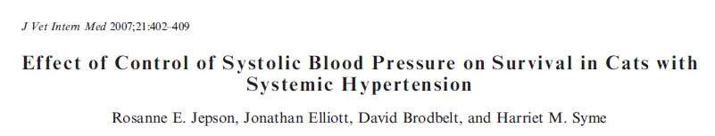
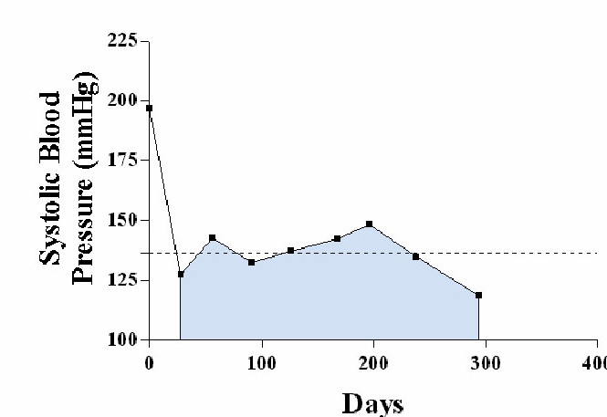
141 cats with systemic hypertension
    Longitudinal study
    Baseline parameters assessed
    Standardised treatment and monitoring
    Followed until death, euthanasia or study end-point
Notes:
And it was with some of these questions in mind that I started my PhD with a restrospective study looking for factors associated with the survival of cats with systemic hypertension.
In this study 141 cats with systemic hypertension were recruited and followed longitudinally. We recorded clinical and clinicopathological variables at baseline and then used a standardised monitoring programme for all cats following them until death, euthanasia or the study end point. Cats were examined on an 8 weekly basis and this gave us the opportunity to calculate a time avceraged blood pressure which gave us an indication of how well controlled a cats blood pressure was over their lifetime.

Slide 49
Hypertension and proteinuria
 | Quartile 1 | Quartile 2 | Quartile 3 | Quartile 4
N | 35 | 35 | 35 | 36
SBPOT (mmHg) | 137 [132,141] | 148 [145, 151] | 157 [155, 158] | 170 [164, 174]
SBP at diag (mmHg) | 192 [184, 209] | 186 * [181, 205] | 196 [184, 214] | 209* [190, 227]
UP/C at diagnosis | 0.23* [0.19, 0.32] | 0.30 [0.17, 0.59] | 0.36 [0.11, 0.55] | 0.46* [0.29, 0.94]
Survival (Days) | 293 [201, 493] | 202 [88, 346] | 307 [167, 792] | 162 [83, 522]
Notes:
Cats were divided into quartiles based on their time averaged blood pressure so that for example cats in quartile 1 represent those with what might be perceived as good blood pressure control with a median Sbp OF 137mmHg whilst those in quartile 4 would be considered to have poor blood prssure control and a median time averaged blood pressure of 170mmHg.
We found that there was no significant difference in survival when cats were divided according to their time averaged blood pressure.
However, there was a significant difference in urine protein to creatinine ratio between those cats in quartile 1 and those in quartile 4. This urine protein to creatinine ratio was obtained at diagnosis of systemic hypertension, so before any antihypertensive medication has been administered and this finding led us to hypothesise that it is perhaps those cats with the greatest magnitude of proteinuria that we ultimately find more difficult to control in terms of their blood pressure.

Slide 50
Biomarkers of CKD
Markers of GFR
Markers of tubulointerstitial injury
Markers of pathophysiological processes
Markers of metabolic derangement
Notes:
Generally speaking the currently research and available biomarkers for CKD can be considered in 4 major categories
Markers that tell us about GFR
Markers that tell us about tubulointerstitial injury (and I am going to focus on this rather than primary markers of glomeruar disease)
Markers that tell us about the pathophysiological proceesses that are taking place within the kidney
And finally markers that tell us perhaps not about the specific types of injury taking place within the kidney but actually are informative about the metabolic derangements that are occuring as a consequence of reduced renal function.

Slide 51
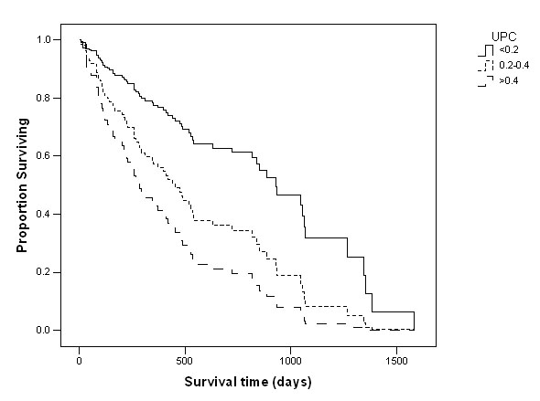
Hypertension and proteinuria
Cox’s proportional hazard survival analysis
Notes:
Using the same dataset we performed a Cox’s proportional hazard survival analysis and the only variable significantly associated with survival in this hypertensive population of cats was magnitude of proteinuria.
These survival curves show the survival of cats divided according to their IRIS staging of proteinuria at entry to the study with the top line representing non-proteinuric cats, the middle line borderline proteinuric cats and the bottom line proteinuric cats. There was a significant difference in survival between each stage of proteinuria.

Slide 52
Importance of proteinuria
Associated with survival of cats with systemic hypertension
Associated with survival of cats with CKD
Syme et al (2006) JVIM 20; 528-535
King et al (2007) JVIM 21; 906-916
Kuwahara et al (2006) JSAP 47; 446-456
Studies performed after established CKD
Pathological changes prior to development of azotemia
Notes:
This information emphasising the importance of proteinuria in cats with systemic hypertension added to previous studies that had demonstrated that proteinuria was also associated with the survival of cats with chronic kidney disease.
However, the studies performed evaluating feline kidney disease had all been looking at cats after the confirmed diagnosis of CKD and we are all more than well aware that pathological changes are taking place in the kidney well before the development of overt azotemia.

Slide 53
Early biomarkers
Benefits of biomarkers?
  Early diagnosis of cats at risk of developing azotemia
  Enable closer monitoring
  Facilitate earlier intervention
  Delay onset of clinically significant disease
Notes:
The benefits of such biomarkers would be the early detection of cats at risk of developing azotemia, the ability to monitor patients for small magnitude changes in renal function more closely, to facilitate earlier and perhaps new interventions with the hope that such interventions would allow us to delay the onset of clinically significant disease.

Slide 54
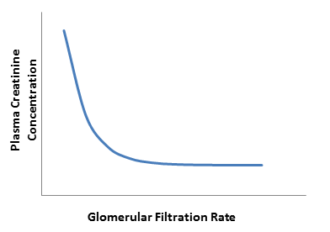
Biomarkers of CKD
Creatinine and urea
Limited sensitivity in early renal function
Breed and age specific reference interval:
  Creatinine increased after GFR decreased ~50% (range 39-68%)¹
¹Nabity et al (2015) JVIM 29: 1036-1044
Notes:
We currently base a diagnosis of CKD on a wealth of clinical information about a patient in addition to creatinine as our surrogate marker of GFR but as we are all aware there are concerns that due to the exponential relationship between creatinine and GFR, it doesn’t necessarily have the sensitivity that we might like for the early detection of CKD.
In a study by Dr Nabity, where dogs with X-linked hereditary nephritis evaluated and where breed and age specific reference intervals were available for plasma creatinine – in fact creatinine was only increased after approximately 50% of GFR had been lost.

Slide 55
Creatinine #trending:
Minimal change in creatinine over time
Critical difference for detecting change in creatinine in dogs 0.3mg/dL (27μmol/l)¹
Serial trending of creatinine can detect 27% decline in GFR (range 5-49%)²
Same laboratory with high quality control to avoid analytical variability
¹ Pagitz et al (2007) JVIM 21: 936-942 ²Nabity et al (2015) JVIM 29: 1036-1044
Notes:
It is true that creatinine may be a better marker when it is used to trend data over time – so for example comparing samples from an individual patient over time.
This may be useful providing the same laboratory is used with high quality control.
And Indeed in the same study by Dr Nabity, evaluating dogs with XLHN, although a single creatinine measurement only detected reduction in GFR fo 50% infact when serial trending of creatinine was used it was able to detect closer to 30% decline in GFR.

Slide 56
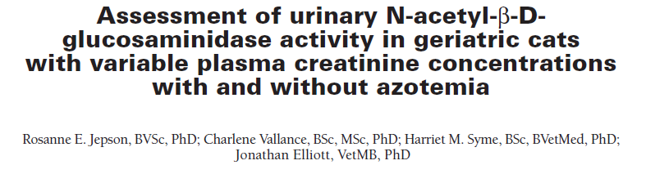
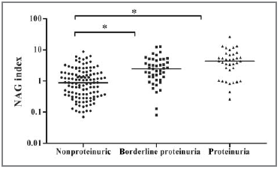
Cross sectional analysis:
  197 cats IRIS stage I-IV
  No significant difference in NAG index when cats grouped according to magnitude of azotemia
Notes:
Firstly considering NAG, we performed initial validation work for a colorimetric enzymatic assay and then went on to perform a cross sectional analysis evaluating cats according to their IRIS staging of azotemia.
There was no significant difference in NAG index when cats were grouped according to their magnitude of azotemia.
However we did find that there was a significant association with NAG index and proteinuria – so in the scatter plot below we have NAG index on the y axis and IRIS staging of proteinuria on the x axis and as you can see there was a significant difference between non-proteinuric and borderline or proteinuric cats but there is also a lot of overlap between the groups.

Slide 57
Cross sectional analysis:
  197 cats IRIS stage I-IV
  No significant difference in NAG index when cats grouped according to magnitude of azotemia
Notes:
Firstly considering NAG, we performed initial validation work for a colorimetric enzymatic assay and then went on to perform a cross sectional analysis evaluating cats according to their IRIS staging of azotemia.
There was no significant difference in NAG index when cats were grouped according to their magnitude of azotemia.
However we did find that there was a significant association with NAG index and proteinuria – so in the scatter plot below we have NAG index on the y axis and IRIS staging of proteinuria on the x axis and as you can see there was a significant difference between non-proteinuric and borderline or proteinuric cats but there is also a lot of overlap between the groups.

Slide 58

Cauxin:
  70KDa carboxylesterase enzyme
  Co-localises with megalin and cubulin in proximal tubules
  Secreted into urine
  Feline specific
  Important in the production of pheromone, felinine
  Found in high concentrations in entire male cats
Notes:
The second enzyme that I will mention briefly today is Cauxin, this is a 70KDa carboxylesterase enzyme which colocalises with megalin and cubulin in PTC and is secreted into the urine. It is feline specific and involved in the production of the pheromone Felinine and hence is found in particularly high concentrations in entire male cats.

Slide 59

118 cats recruited
    9.3% died or euthanized
    9.3% lost to follow up
    30% developed azotemia by 12 months
Parameter | Non-azotemic | Azotemic | Sig (p)
Urea (mg/dl) | 28.6 [25.5, 32.5] | 34.3 [30.0, 44.0] | <0.001
Creatinine (mg/dl) | 1.52 (1.30, 1.71] | 1.73 [1.57, 1.89] | 0.001
UA/C | 10.7 [6.6, 29.5] | 34.1 [15.1, 72.0] | 0.002
UP/C | 0.14 [0.11, 0.20] | 0.19 [0.14, 0.39] | 0.004
Age (years) | 12.6 [11.0, 14.0] | 14.6 [12.2, 15.1] | 0.023
USG | 1.050 [1.032, 1.060] | 1.042 [1.023, 1.051] | 0.043
NAG index | 0.85 [0.35, 1.35] | 1.40 [0.74, 2.39] | 0.05
Notes:
So eventually after trialling, validating and evaluating a number of assays for potential biomarkers we moved on to perform a multivariable model taking forwards those biomarkers of possible interest.
In total we recruited 118 initially healthy non-azotemic geriatric cats and followed them longitudinally to the 12 month time point.
Of these approximately 10% died or were euthanised for reasons unrelated to renal disease, a further 10 % were lost to follow up and 30% developed azotemia by 12 months.
The table on this slide highlights those variables in the univariate analysis that reached statistical significance nd were predictive at recruitment of the future development of azotemia at 12 months.

Slide 60
Prospective study
Multivariable regression model:
  Creatinine
  Proteinuria
    UP/C or UA/C
Importance of proteinuria
Individual cat versus population studies
Notes:
However, ultimately when the multivariable model was performed only plasma creatinine concentration and a measure of proteinuria (either UPC or UAC) depending on the model remained significantly associated with the development of azotemia in a 12 month period. Once again there appeared to be a recurrent theme although it is important with all of the studies that we have performed to realise that they reflect a population of cats rather than the individual cat presented to you in a clinica.
Even though none of the more specific urinary biomarkers that we had evaluated panned out there seemed to be no doubt of the importance of proteinuria.

Slide 61

Pressure, proteinuria and proteomics
Importance of proteinuria:
    Chronic kidney disease
    Development of azotemia
    Systemic hypertension
Much work remains to be done to understand the pathogenesis of feline kidney disease and systemic hypertension
The search for the golden biomarker continues…….
Notes:
So in conclusion, if I could summarise the outcome of my work it is not to neglect the importance to proteinuria in the early and later stages of chronic kidney disease and in systemic hypertension.
There is still much work that needs to be done to understand the pathogenesis of both kidney disease and systemic hypertension and that the search for the golden biomarker or biomarkers continues.

Slide 62




Acknowledgements:
Feline Research Group
Kim Souttar
Shanta Cariese
Helen Woodcock
Dr Jenny Wakeling
St George’s Biomics Centre
Dr Gary Coulton
Dr Matthew Cowan
Notes:
I would like to acknowledge the royal veterinary college where I have undertaken my internship, residency and phd and in particular the past an present members of the feline research group.
Waltham and Mars who funded my PhD
Drs Gary Coulton and Matthew Cowan at st Georges biomics centre for their assistance with the proteomic work.

Slide 63



Acknowledgements:
  Rosanne E. Jepson
  Royal Veterinary College
  London, UK
  rjepson@rvc.ac.uk
Notes:
And lastly and by no means least I need to thank hugely Professor Jonathan Elliott who was one of my PhD supervisors and D

Slide 64



Symmetric dimethylarginine (SDMA)
Endogenous methylarginine
Stereoisomer of ADMA (NOS inhibitor)
Properties of a surrogate marker of GFR

Slide 65



Symmetric dimethylarginine
Less affected by muscle wastage/poor BCS
DOGS
Hall et al (2015) JVIM 29: 808-814
Notes:
Symmetric dimethylarginine (SDMA) is a dimethylated derivative of arginine produced from intranuclear methylation of L-arginine residuals by protein-arginine methyltransferase along with its stereoisomer asymmetric dimethylarginine (ADMA). SDMA is primarily excreted via renal filtration indicating that it has characteristics required for an endogenous marker of renal function.

Slide 66


Symmetric dimethylarginine
In cats elevated earlier in course of disease¹
  Mean 17 months (range 2-48 months)
Similar data in dogs²
¹Hall et al (2014) JVIM 28: 1676-1683 ²Hall et al (2016) 30: 794-802

Slide 67
Assessing urine concentrating ability
Urine Specific gravity variable in health
Assess concurrently with plasma markers of GFR
Differentiation of pre-renal, renal and post-renal azotaemia
True for all surrogate markers of GFR – Creatinine and SDMA
Identification of pre-renal azotaemia:
  Cat >1.035-1.040
  Dog >1.030

Slide 68


Other aspects of urinalysis
Dipstick assessment:
  pH
  Blood/Haemoglobin
  Glucosuria
    Tubular injury
    Primary renal glucosuria
    Assess with normoglycaemia
  Proteinuria
    Pre-renal, Renal, Post-renal?
    Interpret with urine specific gravity
    Significance of 2+ proteinuria with USG of 1.008 vs 1.045
  Leucocyte pad (inaccurate) – do not interpret

Slide 69
Diagnosing CKD: Creatinine
Notes:
We also need to consider the relationship of creatinine with GFR and that this relationship as shown in the graph is exponential. So on this graph where we have GFR on the x axis and creatinine on the y axis we can see that if you take a patient with relatively normal GFR for every decline in GFR there is only a relatively small change in creatinine whilst by the time the patient is down here with more advanced CKD in fact a relatively small change in GFR is resulting in larger changes in creatinine.
This means that for most patients once they develop azotaemia creatinine is actually a pretty good and sensitive mrker of GFR for us. The time at which we may struggle more is in the early stages of CKD where creatinine is much less sensitive for changes in GFR.

Slide 70

Retinol binding protein
(RBP)
Low molecular weight protein 21KDa
Synthesized in liver
Transports retinol from liver to periphery
Circulates in a macromolecular complex with transthretin (54KDa)
Only free RBP filtered at glomerulus
Reabsorbed by megalin mediated endocytosis
Notes:
Retinol binding protein was one of the early low molecular weight proteins that underwent investigation,
With a molecular weight of 21Kg RBP’s role is to partake in transport of retinol from the liver to perhipheral cells
It circulates usualy in a macromolecular complex with transthretin
So that it is only isolated retinol binding protein that is freely filtered
And which should then undergo megalin and cubulin associated reabsorption within the proximal tubular cells

Slide 71


Urinary cystatin C
n=15
n=14
n=17
Williams & Archer (2016) JSAP 57: 122-129
Creatinine median 2.15 mg/dL (1.91, 2.77)
Monti et al (2012) JSAP 53; 254-259
Creatinine range 2.0-15.5 mg/dL
Ghys et al (2014) Vet Clin Pathol 43: 226-234
Notes:
We have spoken briefly already about the role of cystatin C as a serum based marker of GFR
However, as a low molecular weight protien of 13Kda there is also potenital interest regarding Cystatin C as a marker of tubular damage when measured in the urine and evaluated as a ratio with urine creatinine
A study by Monti and colleagues evaluated urine cystatin C to creatinine ratio in a cross sectional study with 14 healthy dogs 17 dogs with non-renal disease and 15 renal dogs of which 13 had CKD and 2 AKI. In dogs at least urine cystatin C to creatinine ratio were significantly higher
Similar results were demonstrated in cats with IRIS stage 3 and 4 CKD in a study performed by Ghys et al however,
the potential utility of urinary cystatin C in cats with CKD has been questioned by a recent publication by Williams and Archer where in 12 cats with IRIS stage 2 CKD urinary cystatin c to creatinine ratios were significantly lower than in healthy cats. It was suggested in this publication that this may be the consequence of relative absorption of proteins by tubules dependent on the overall magnitude of proteinuria but certainly calls into question whether cystatin C is genuinely going to be useful as an early marker.

Slide 72

NAG index in cats
Cats:³
  No significant difference
  Sig correlation with proteinuria
³Jepson et al (2010) AJVR 71: 241-247
Notes:
In cats a study that we performed at the Royal Vet College demonstrated that there was no significant difference in NAG index between cats when they were divided by IRIS stage although there was a significant positive correlation with proteinuria.

Slide 73
Markers of inflammation, fibrosis, hypoxia and oxidative stress
Preliminary information only
  Important mechanistic information
Inflammation | Fibrosis | Hypoxia/oxidative stress
IL18 Habernicht et al (2013) JFMS 15: 99-104 Future: MCP-1 YKL-40 (chitinase) IL1 IL1-beta TNFα IL6 | TGFβ Habernicht et al (2013) JFMS 15: 99-104 Arata et al (2005) J Vet Med Sci 67: 1253-1255 Transglutaminase 2 Sanchez-lara et al (2015) Vet Pathol 52: 513-522 Future: Galectin-3 | Glutathione peroxidase, Selenium, Total antioxidant capacity Krofic Zel et al (2014) JVIM 28:130-136 Superoxide dismutase, GSH : GSSG, neutrophil phagocytosis and oxidative burst Keegan et al (2010) JVIM 24: 514-519
Notes:
This is a category of markers that might provide us with information about the pathophysiological changes occuring within the kidney during injury.
I will be breif about these as currently we have only very preliminary information.
But it is likely that in the future we will start to see further studies evaluating the benefits of being able to track markers of inflammation, fibrosis, hypoxia and oxidative stress as we recognise that these are key pathophysiological mechanisms that contribute to the protression of CKD.
J Vet Intern Med. 2014 Jan-Feb;28(1):130-6. doi: 10.1111/jvim.12264. Epub 2013 Dec 16.
Plasma and erythrocyte glutathione peroxidase activity, serum selenium concentration, and plasma total antioxidant capacity in cats with IRIS stages I-IV chronic kidney disease.
Krofič Žel M1, Tozon N, Nemec Svete A.
Author information
Abstract
BACKGROUND:
Serum selenium concentrations and the activity of plasma glutathione peroxidase (GPx) decrease with the progression of chronic kidney disease (CKD) in human patients. Selenium is considered a limiting factor for plasma GPx synthesis. Plasma total antioxidant capacity (TAC) is decreased in CKD cats in comparison to healthy cats.
HYPOTHESIS:
Serum selenium concentrations and plasma and erythrocyte GPx activity in cats with CKD are lower than in healthy cats. Serum selenium concentrations, the activity of enzymes, and plasma TAC progressively decrease with the progression of kidney disease according to IRIS (International Renal Interest Society) classification.
ANIMALS:
Twenty-six client-owned cats in IRIS stages I-IV of CKD were compared with 19 client-owned healthy cats.
METHODS:
A CBC, serum biochemical profile, urinalysis, plasma and erythrocyte GPx activity, serum selenium concentration, and plasma TAC were measured in each cat.
RESULTS:
Cats in IRIS stage IV CKD had a significantly higher (P = .025) activity of plasma GPx (23.44 ± 6.28 U/mL) than cats in the control group (17.51 ± 3.75 U/mL). There were no significant differences in erythrocyte GPx, serum selenium concentration, and plasma TAC, either among IRIS stages I-IV CKD cats or between CKD cats and healthy cats.
CONCLUSIONS AND CLINICAL IMPORTANCE:
Erythrocyte GPx activity, serum selenium concentration, and plasma TAC do not change in CKD cats compared with healthy cats. Selenium is not a limiting factor in feline CKD. Increased plasma GPx activity in cats with stage IV CKD suggests induction of antioxidant defense mechanisms. Antioxidant defense systems might not be exhausted in CKD in cats.
Copyright © 2013 by the American College of Veterinary Internal Medicine.
J Vet Intern Med 2010;24:514–519
Oxidative Stress and Neutrophil Function in Cats with Chronic
Renal Failure
R.F. Keegan and C.B. Webb
Background: Oxidative stress is an important component in the progression of chronic renal failure (CRF) and neutrophil function may be impaired by oxidative stress.
Hypothesis: Cats with CRF have increased oxidative stress and decreased neutrophil function compared with control cats. Animals: Twenty cats with previously diagnosed renal failure were compared with 10 age-matched control cats.
Methods: A biochemical profile, CBC, urinalysis, antioxidant capacity, superoxide dismutase (SOD) enzyme activity, re-
duced to oxidized glutathione ratio (GSH : GSSG), and neutrophil phagocytosis and oxidative burst were measured. Statistical comparisons (2-tailed t-test) were reported as mean 􏰂 standard deviation.
Results: The CRF cats had significantly higher serum blood urea nitrogen, creatinine, and phosphorus concentrations than control cats, and significantly lower PCV and urine specific gravity than control cats. The GSH : GSSG ratio was significantly higher in the CRF group (177.6 􏰂 197, 61.7 􏰂 33; P o .02) whereas the antioxidant capacity was significantly less in the CRF group (0.56 􏰂 0.21, 0.81 􏰂 0.13 Trolox units; P o .005). SOD activity was the same in control and CRF cats. Neutrophil oxidative burst after Escherichia coli phagocytosis, measured as an increase in mean fluorescence intensity, was significantly higher in CRF cats than controls (732 􏰂 253, 524 􏰂 54; P o .05).
Conclusions: The higher GSH : GSSG ratio and lower antioxidant capacity in CRF cats is consistent with activation of antioxidant defense mechanisms. It remains to be determined if supplementation with antioxidants such as SOD beyond the level of control cats would be of benefit in cats with CRF.
Key words: Antioxidant capacity; Glutathione; Oxidative burst; Superoxide dismutase.

Slide 74

Markers of metabolic derangement

Slide 75

Fibroblast growth factor-23 (FGF23)
Member of the fibroblast growth factor family
Produced by osteocytes and osteoblasts
Circulates either as intact active (iFGF23) or fragments (cFGF23)
Acts together with cofactor alpha-Klotho
Phosphaturic protein
Phosphate homeostasis: Mineral and bone disorder
Donate-Correa et al (2012) Cytokine and Growth Factor Reviews 23: 37-46
Notes:
And so the marker that probably holds the most promise in this regard is Fibroblast growth factor 23.
It’s a member of the FGF family, produced by osteocytes and osteoblastcs and circulates as within the blood
It acts together with its co-factor klotho to have a key role in phosphate homeostasis

Slide 76


Elevation in FGF23 precedes other metabolic changes in CKD
Notes:
Studies in humans have shown that FGF23 is elevated very early in CKD and in advance of changes in PTH or phosphate that might indicate alteration in the phosphate homeostatic axis.
So on this graph here we can see FGF23 in blue, PTH in yellow and phosphate concentration in green,
We have GFR on the x-axis so that as we move from right to left we have declining renal funciton.
As you can see the proportion of patients in this study with elevated FGF23 concentrations early in the course of CKD is mcuh greater than either PTH or phosphate and yet these early increases do indicate deragnement in phosphate hoemostasis is present and is something that oculd benefit potentilly from therapy.

Slide 77


FGF23 in cats with CKD
Geddes et al (2013) JVIM 27: 234-241
Finch et al (2012) JAVMA 241; 1326-1335
Notes:
So what do we know about FGF23 in veterinary medicine. Well, the information that we have to date mainly relates to CKD in cats.
We know that FGF23 significantly increases with advancing stage of CKD
And that if we look at FGF23 it is significantly higher in those cats that go on to develop azotaemia 12 months later than those that remain non-azotaemic
Non-azotemic healthy cats >9 years (n=44)
34 had 12 month follow up – normal renal function
Cats with CKD
IRIS stage 2 n=20
IRIS stage 3 n=22
IRIS stage 4 n=14
Not on renal diet or receiving phosphate binders
Hyperthyroid cats (T4 >40 nmol/l) excluded
No significant difference in age
Finch et al
118 cats > 9 years recruited
Baseline plasma creatinine <2mg/dL
Followed for 12 months
Outcome groups at 12 months
1) Creatinine ≤1.6 mg/dL (n=35)
2) Creatinine >1.6<2.0 mg/dL
or creat ≥2.0 mg/dL if USG >1.035 (n=52)
3) Creatinine ≥2.0 mg/dL & USG <1.035 (n=31)

Slide 78

FGF23 in cats with dietary phosphate restriction
Notes:
If we start by looking at the graph on the right side of this slide then we know that we can identify a change in FGF23 concentration when we introduce a phosphate restricted diet in cats with CKD. This is true whether we are dealing with cats that had an elevated phosphate concentration according to the IRIS guidelines to start with or whether their phosphate was within RI.
And is true despite – no apparent change in phosphate or PTH.
The graphs on this slide are looking at just the cats that were started on renal diet with CKD.
They are divided according to whether at baseline the cats were normo or hyperphosphatemic before starting renal diet.
We can clearly see that there is a significant decline in phosphorus, PTH and FGF23 in those cats that were hyperphosphatemic at diagnosis of CKD when started on the renal diet.
However, when we look at the cats that were normophosphateamic – but matched for renal function – we see no significant change in phosphorus, PTH or FGF23.
This data supports that changes in FGF23 concentration in cats is not just dependent on GFR and that we are seeing modulation of FGF23 in line with dietary phosphorus intake.

Slide 79
Fibroblast growth factor 23 (FGF23)
Future work:
  Early evidence of mineral and bone disorder
    Elevated FGF23
  Early diagnosis of CKD
    Patients with persistently elevated SDMA
  Benefit from dietary manipulation?
    Use of FGF23 to monitor response?
Notes:
And so this raises the question whether for example for those patients that we suspect have early CKD before the onset of azotaemia, and an example of this oculd be a patient with elevated SDMA but normal creatinine – if we had evidence of mineral and bone disorder and deragnemetn in phosphate hoemostasis through an elevated FGF23 – would this be good evidence that this patient woud benefit from a phosphate restricted diet
And so future work in this area should concentrate on the role that dietary manipulation might make in these early identified cats and whether FGF23 is an appropriate too to monitor these patients.

Slide 80
Summary of biomarkers for CKD
Many biomarkers have been evaluated for CKD
Few have made it from laboratory to clinic
Some offer information relating to populations
Some perform better with longitudinal analysis
Multifactorial biomarkers
  Early diagnosis
  Progression
  Surrogate markers of response to therapy
Notes:
So to summarise, we’ve considered a number of biomarkers for CKD ranging from markers of GFR, markers of tubulointerstitial injury, inflammation and markers of metabolic derangement, I have by no means been comprehensive with all the information that is available as this is a vast subject area but I hoep that I’ve given a summary of where we are to date.
There are very few markers that have made it from laboratory to clinic and of those that I’ve discussed today it is really only SDMA that has made this transition on an international level.
Some of the biomarkers whilst perhaps not useful as an individual spot test for an individual patietn do offer information when used on a population basis or when used as trending markers for an individual rather than as a spot.
Whilst we should strive for novel biomarkers it is likely to be that we will always need to pull information from multiple markers together and learn more about how to interpret subtle changes.

