Slide 1
ROLE OF THE EXTERNAL EXAMINER
How the system works at the RVC
Notes:
Cheryl

Slide 2
Who we are:
Cheryl Jackson – Academic Quality Manager
Sarah Channon – Teaching Quality Committee Chair
Adam Osgood – Examinations Officer
Ana Filipovic – Senior Academic Quality Officer ‘Standards’
Notes:
Cheryl

Slide 3
The main purposes of external examining are:
to verify that academic standards are appropriate for the award, or part thereof (appointed to examine);
to help institutions assure and maintain academic standards across HE awards;
to help institutions ensure that their assessment processes are sound, operated fairly and in line with the institution's policies and regulations.
Notes:
Cheryl

Slide 4
External Examiners play an important role in our assurance of quality and standards. Their duties are comprehensive, and include:
ensuring that the assessment schedule satisfies the objectives of the course and covers the specified content;
approving all written examination papers;
confirming that the standard of marking is satisfactory, by scrutinising a sample of scripts and, optionally, coursework. Flag at the Exam Board meeting any batches of marking that lack annotations for the purpose of helping to determine why a mark(s) has been provided;
observing (not participating in) oral, practical and clinical examinations;
ensuring that there are no irregularities in the conduct of the examination and that it has been conducted in accordance with the Regulations;
Notes:
Cheryl

Slide 5
External Examiners duties cont'd
attending meetings of the Board of Examiners held to determine the results of examinations, and participating fully in all their decisions.
Note: In exceptional circumstances and with the prior agreement of the Exam Board Chair, an External Examiner may be permitted to attend the meeting remotely via video call. At least one External Examiner must be present at the Board of Examiners;
approving results by signing lists of results;
Submit an annual (individual/collaborative) report to the College;
If appropriate, submit a confidential report to the Principal if dissatisfied with any decision of a Boards of Examiners.
Notes:
Cheryl

Slide 6
Very useful information – please familiarise yourself with….
To continue to meet the ongoing conditions of registration with the OfS, the RVC and other
registered providers must ensure that:
any standards set appropriately reflect any applicable sector-recognised standards; and
awards are only granted to students whose knowledge and skills appropriately reflect any applicable sector-recognised standards.
Office for Students (OfS) Condition B5 - Sector-recognised standards
Outlines examples of typical higher education qualifications for each level (4, 5, 6, 7, and
8), volumes of credit, credit values, and qualification descriptors.
Uses content drawn from:
The Frameworks for Higher Education Qualifications of UK Degree Awarding Bodies (FHEQ) and elsewhere.
Notes:
Cheryl

Slide 7
Very useful information continued….
​
Quality Assurance Agency (QAA):
External Examining Principles
UK Quality Code for Higher Education
Qualification Frameworks​
Characteristics Statements​
Credit Frameworks​
Subject Benchmark Statements ​
​
​Professional Body Requirements:
RCVS – Accrediting veterinary degrees
RCVS – Accrediting veterinary nursing qualifications
​RSoB - Degree Accreditation & Advanced Degree Accreditation
​etc.
Notes:
Cheryl

Slide 8
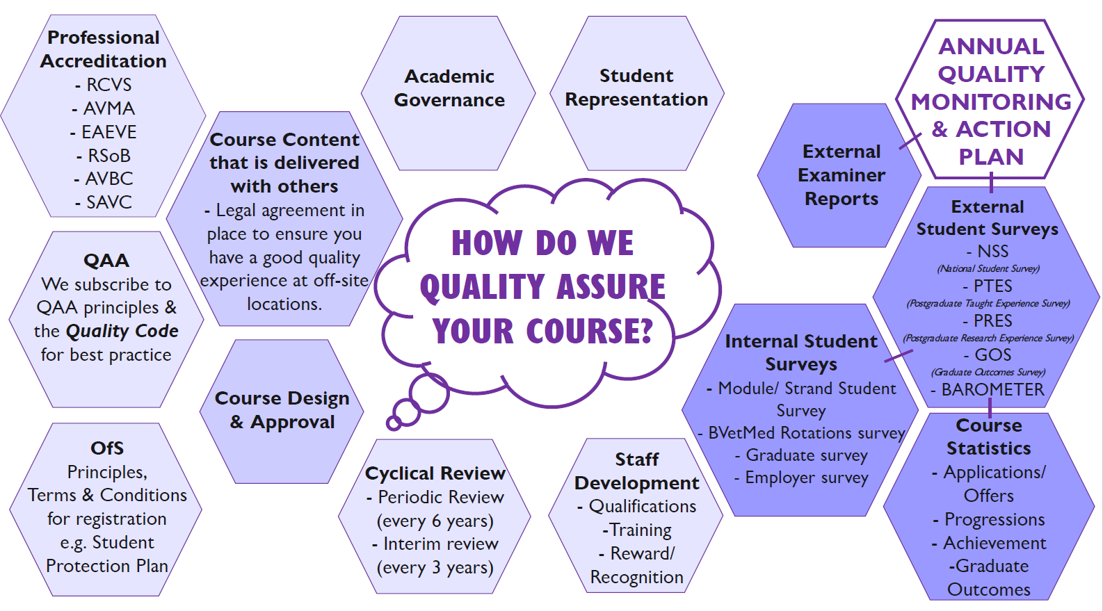
Quality Monitoring
Notes:
Cheryl

Slide 9
Information we provide:
The RVC’s Academic Quality, Regulations and Procedures
External Examiner information on website
RVC Learn – this is the RVC’s Virtual Learning Environment: username and password supplied by learn@rvc.ac.uk
Overall learning outcomes for part of course you examine (Learn/Programme Support)
Learning objectives for every teaching session (Learn/Programme Support)
Programme Specification (Website/Academic Quality)
Assessment and Award Regulations (Website/Exams)
Marking schemes and mark descriptors (Website/Exams)
Course work - with contribution to in-course assessment specified (Exams)
Examination timetables (Website/Exams)
Examination papers (Exams)
External Examiner reports for the previous year with the College’s responses (Website/Academic Quality)
Notes:
Ana

Slide 10
Process of appointment
Approached by Course Director/Year Leader
Nomination approved by Exam Board Chair
Nomination & CV scrutinised by TQ Committee
Approved by Academic Board
Notes:
Ana

Slide 11
The Exams Office Team
Laura Buckman– Head of Examinations and Assessment (HH & Camden)
Christina Stobo – Senior Examinations Officer (HH)
BVetMed Year 5 (Final Year)
Adam Osgood – Senior Examinations Officer (Camden)
BSc Biosciences Year 3
MSci Biosciences Year 4
Emma Rosenberg – Examinations Officer (Camden)
BSc Biosciences Year 1
Gateway (BVetMed Year 0)
MSc Wild Animal Biology / Wild Animal Health
Bernadette Dulko-Bocking – Examinations Officer (HH)
BVetMed Year 3
Post Graduate in Veterinary Clinical Practice
Direct Observation of Procedural Skills (DOPs)
Notes:
Adam

Slide 12
The Exams Office Team
Maria Johnson – Examinations Officer (Camden)
BVetMed Year 1
BVetMed Year 2
Graduate Year (GAB)
Claire Day – Examinations Officer (HH)
MSc Veterinary Epidemiology
MSc One Health
MSc Veterinary Education
Certificate in Advanced Veterinary Nursing
Shona Hayes – Examinations Officer (HH)
FdSc/BSc Nursing
Masters in Veterinary Medicine
Certificate in Advanced Veterinary Practice
Graduate Diploma in Applied Equine Locomotor Research
Notes:
Adam

Slide 13
The Exams Office Team cont'd
Phoebe Quare – Examinations Officer (HH)
BVetMed Year 4
RP2
Tolu Atanda – Examinations Officer (HH)
Objective Structured Clinical Examinations (OSCEs)
Rotations
Special Exam Arrangements
Penny Edwards – Examinations Officer (Camden)
BSc Biosciences Year 2
Comparative Pathology
BSc Animal Health and Disease
Notes:
Adam

Slide 14
Information we provide you with:
Examination questions should be sent to you, for scrutiny, well in advance of the examination;
All questions should be provided with key point model answers and, if appropriate, how marks are to be allocated for sub-sections of questions. This includes how each question will test a specific Learning Outcome in the course or module.
Notes:
Adam

Slide 15
External Examiners should see:
Completed course work contributing to in-course assessment
Written scripts
Practical exams (questions and answer sheets)
Mark sheets and associated statistics
List of candidates taking oral exams/structured
orals at re-sits
Notes:
Adam

Slide 16
“Institutions will make every effort to ensure that their external examiners are competent to undertake the responsibilities defined in their contract.”
‘Teams’ of examiners
Key criteria of appointment
Provision of training
Provision of information
If any doubt please inform us (we can always provide more information!)
Notes:
Sarah

Slide 17
Institutions should ensure that, once appointed, external examiners are provided with sufficient information and support to enable them to carry out their responsibilities effectively.
Specifically, external examiners must be properly prepared by the recruiting institution to ensure they understand and can fulfil their responsibilities.
Accompanying paperwork should be comprehensive.
Notes:
Sarah

Slide 18
An institution should ask its external
examiners, in their expert judgement, to
report on:
whether the academic standards set for its awards, or part thereof, are appropriate;
the extent to which its assessment processes are rigorous, ensure equity of treatment for students and have been fairly conducted within institutional regulations and guidance;
the standards of student performance in the programmes, or parts of programmes, which they have been appointed to examine;
where appropriate, the comparability of the standards and student achievements with those in some other higher education institutions;
good practice they have identified.
Notes:
Sarah

Slide 19
Process of consideration
Course Directors/Year Leader are invited to consider External Examiners comments and provide response and course of action where appropriate.
Response and Actions form part of the Course Director/Year Leader’s annual report (AQIR).
Annual Quality Improvement Group meets to consider and approve External Examiners Report and responses to their comments (College Response).
Approved External Examiner reports and College Response are published on the RVC website.
Notes:
Sarah

Slide 20
How to submit final report
Examiners submit final reports to RVC via online system
During exam board meeting, inform exams officer:
whether an individual or collaborative report will be submitted
if collaborative, who will act as lead examiner
After exam board meeting, emails will guide you through the process
Final reports needs to be submitted online, within three weeks.
To note:
Names of staff and students, student candidate numbers and similar should be omitted to ensure a level of confidentiality
Details about exam questions should be omitted, as these are often reused.
Any queries contact Ana Filipovic afilipovic@rvc.ac.uk
Notes:
Ana

Slide 21
Notes:
Ana – logins provided upon appointment. These are also included in the email invite to complete the report. If any problems to log in, contact Ana

Slide 22
For Info: Personal Development for External Examiners
The AdvanceHE has developed a course for external examiners, which is designed to be complementary to a higher education provider’s induction and training provision for their external examiners.
Upon completion of this course participants receive:
a certificate of completion
an entry on the searchable list of certificated External Examiners on the Advance HE website
membership of the External Examiners’ Community of Practice on Connect.
Notes:
Ana

Slide 23
Thank you!
Q&A
If you require any further information or clarification prior to the examinations please contact the relevant Exams officer.
Notes:
Ana

